Slide 1

English as a Second Language Basic Workshop

Slide 2
Three Literacy Missions Ministries
Adult Reading and Writing
Tutoring Children and Youth
English as a Second Language

Slide 3
English as a Second Language Workshop Overview
ESL ministry - effective mission outreach
Organizational plan for a ESL ministry
Understanding student fluency and class placement
Foundations of language teaching

Slide 4
English as a Second Language Workshop Overview -2
Planning your ESL Lessons
How to teach new vocabulary
How to teach pronunciation
How to help students practice creating English language sentences
Practice preparing advanced ESL lesson plans

Slide 5
English as a Second Language Workshop Overview -3
Dealing with cultural misunderstandings
Incorporating Biblical material in your classes
Sharing your faith with your student

Slide 6
Introductions
Get with a partner you don’t know
Interview your partner
What is your name?
In what city were you born?
Where do you live now?
What church do you belong to?
Why did you come to this workshop? (one sentence answer)

Slide 7
Introductions -2
Get together with another pair
Introduce the person you interviewed

Slide 8
Chapter 1 Church-based ESL Ministries: an Effective Mission Outreach Tool

Slide 9
Opportunities for Church-based ESL Ministries
Neighbors who need to improve their ability
to speak and understand English:
• Immigrants
• Refugees
• Migrant workers
• International students
• International businessmen and their families

Slide 10
God Commands us to Love our International Neighbors
The Lord your God is supreme over all gods and over all powers. He is great and mighty, and he is to be obeyed. He does not show partiality, and he does not accept bribes. He makes sure that orphans and widows are treated fairly; he loves the foreigners who live with our people, and gives them food and clothes. ¹⁹ So then, show love for those foreigners, because you were once foreigners in Egypt.
Deuteronomy 10:17-19 (Good News Translation)

Slide 11
The Purpose of a Church-based ESL Ministry
is to intentionally share and demonstrate the gospel of Jesus Christ as you teach English Language Learners.

Slide 12
Church-based ESL Ministries Are Effective Mission Outreach Tools
Because they
• Build relationships
• Meet basic human needs
• Physically demonstrate Christ’s love
• Provide a natural setting for sharing the gospel
• Often results in new missions and church starts

Slide 13

Chapter 2 Organizational Plan for an ESL Ministry

Slide 14
Seven Basic Organizational Tasks
1. Recruit volunteers
2. Train volunteers
3. Decide when classes will be
4. Decide where classes will be
5. Decide how long the classes will be
6. Recruit students
7. Develop church support

Slide 15
Task 1 - Recruit Volunteers
• Number of volunteers needed
• Volunteer tasks
- Teach
- Administration
- Transportation
- Childcare
- Refreshments

Slide 16
Task 1 - Recruit Volunteers
• Prepare job descriptions
• Set dates for training
• Advertise
• Personally contact
• Review church rolls
• Speak/sign up booths
• Invite to visit classes

Slide 17
Task 2 - Train Volunteers
• Basic workshop
• Continuing in-service training

Slide 18
Task 3 – Decide When Classes Will Meet
During public school year
Once a week
Twice a week

Slide 19
Task 4– Decide Where Classes Will Meet?
• Church
• Places of business
• Apartment complexes
• University campuses
• Where God opens the doors

Slide 20
Task 5 – Decide How Long Classes Will Be
1 ½ - 2 hours Total
Small group classes: 1- 1 ½ hours
Large group time: 30 minutes

Slide 21
Task 6 - Recruit Students
Advertise
Make sure church secretary knows the basic information.
Contact places you find internationals
Word of mouth from satisfied students

Slide 22
Student Attendance
Students drop out
Every student won’t attend every class
Check on absent students

Slide 23
Task 7 - Develop Church Support
Become recognized as a part of the church’s outreach
Display promotional materials about the ministry
Meet with pastor or church staff at least quarterly
Make oral and written reports to the church
Enlist prayer support

Slide 24
Seven Basic Organizational Tasks
Recruit volunteers
Train volunteers
Decide when classes will be
Decide where classes will be
Decide how long the classes will be
Recruit students
Develop church support

Slide 25
Appendices
• Teacher’s job description
• Additional ideas for an ESL ministry
• Responsive reading for a volunteer commissioning service
• Sample student registration form

Slide 26

Chapter 3 Understanding Student Fluency and Class Placement

Slide 27
Placement Interviews
Structured one-on-one interviews
Determine the student’s English fluency level
Notes:
3.2 Read the slide

Slide 28
Reasons to Conduct Placement Interviews
Choose appropriate student placement:
not too easy
not too hard
Choose appropriate teaching materials
Notes:
3.3 Read the slide

Slide 29
Fluency Levels—Beginners
Beginner Students:
Know less than 100 words
Rarely use complete sentences
Cannot carry on a conversation in English

Slide 30
Fluency Levels—Intermediate
Intermediate Students:
May have fair oral and written vocabulary
Can carry on a limited conversation in English
May use complete sentences, but poor grammar
Have difficulty with prepositions, verb tense
Know few idioms or slang words
Notes:
3.5 Read slide

Slide 31
Fluency Levels—Advanced
Advanced Students:
Can converse freely in English
Have problems with sentence structure
Need help with
Pronunciation
Vocabulary expansion
Idioms and slang

Slide 32
Fluency Levels
○ Non–literate
 Doesn’t read Roman alphabet
 May be illiterate in own language
○ Literate
 Can read Roman alphabet
 May read some English

Slide 33
Determining Class Levels
The number of teachers you have dictates how many classes you can have.
You won’t know which levels you will have until after placement interviews are conducted.
Levels are not precise but structured to your own ministry’s situation.

Slide 34
When Should You Conduct Placement Interviews?
At the first class session of each semester
The first time a student visits the ministry

Slide 35
Where Should You Conduct Placement Interviews?
In a quiet place, away from the group
Possibly in a separate room/corner of a large room

Slide 36
Who Should Conduct Placement Interviews?
The same person should test all students for consistency of placement
Experienced teachers in existing ministries may help
After first day, the director or assistant director

Slide 37
Overview of Placement Interview
The Placement Interview evaluates
Comprehension
Speaking
Whether the student is literate or non-literate
Reading
Writing

Slide 38
Components of Placement Interview
Placement Interview Form – 2 pages (1 page alternative)
Placement Interview Pictures
Reading Section
Writing Section

Slide 39
Preparing for the interview
Make copies of the interview form (TELL pp. 43-44)
Make one copy for each student
Make copies of the interview pictures and reading material-(TELL pp. 45-48)
Make one copy for each interviewer
Place in individual sheet protectors in a notebook
Have pen and lined paper for the writing section

Slide 40
Conducting The Placement Interview—Overview
The Interviewer
Sits across from the student
Shows the student the interview pictures and reading page and asks the questions on the interview form
Asks the student to write his name, four words, and a sentence
Marks how the student responds with a ✓ or an X
Later counts ✓s to determine the student’s fluency level

Slide 41
Two Pages
Page 1 – Evaluates Comprehension and Fluency
Page 2 – Evaluates whether the student is literate
Notes:
3.16 Point out that there are two boxes on the interview form.

Slide 42
When Conducting the Interview
Don’t ask questions more than 2 times.
Don’t explain or try to teach vocabulary.
This is not a time of instruction.
If student can’t respond, simply smile and move on.

Slide 43
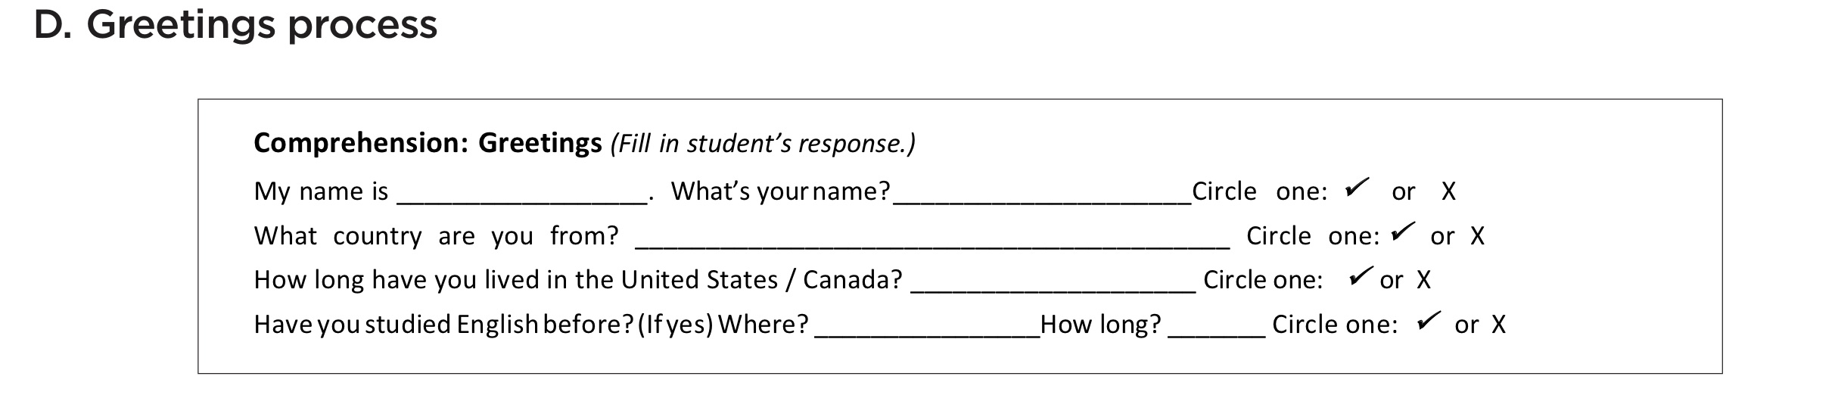
Comprehension- Greetings

Slide 44
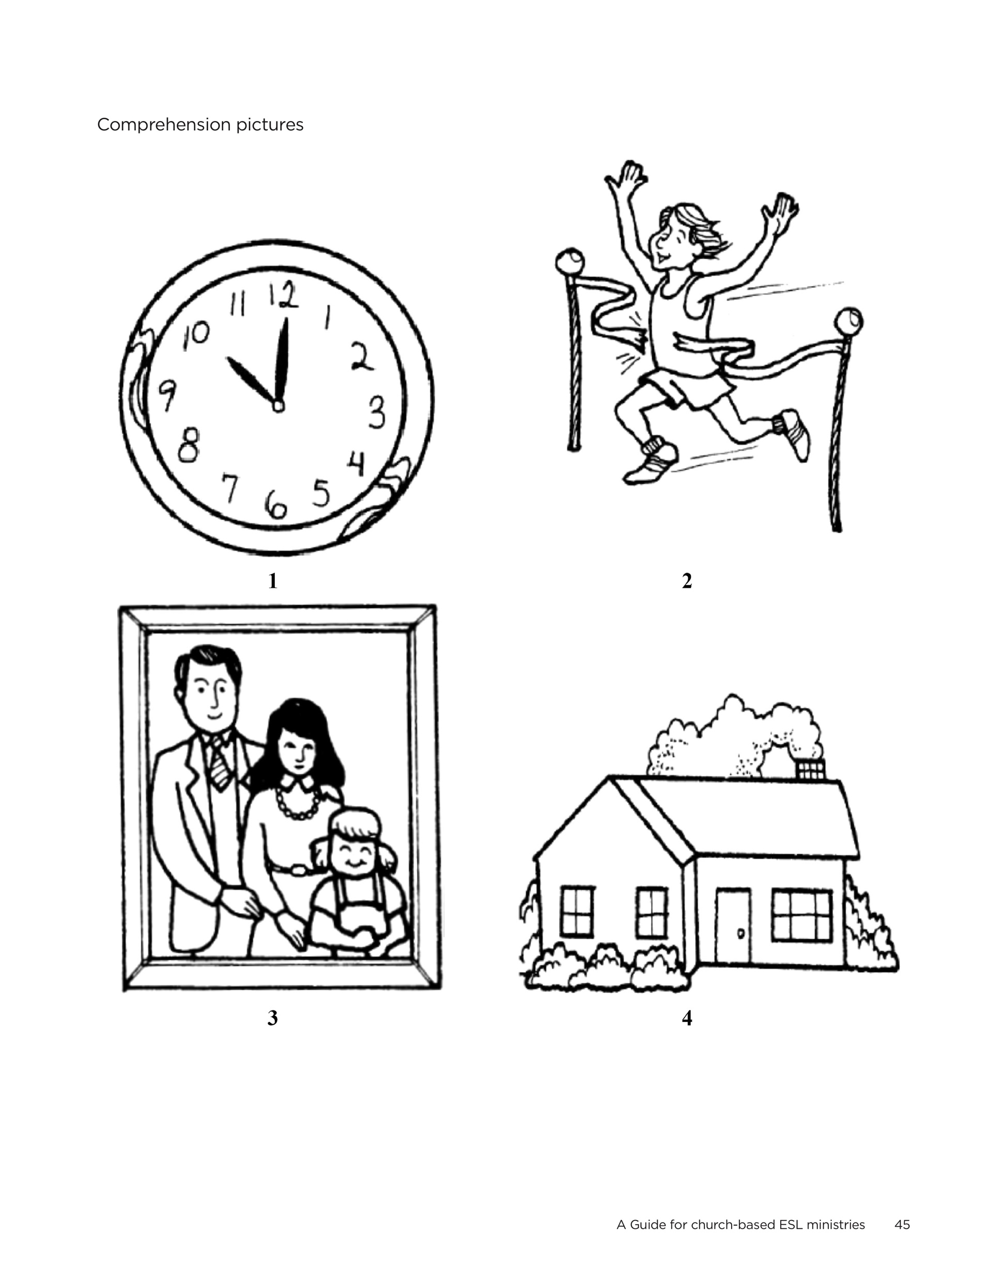
Comprehension Pictures
Show the student
the comprehension pictures.

Slide 45
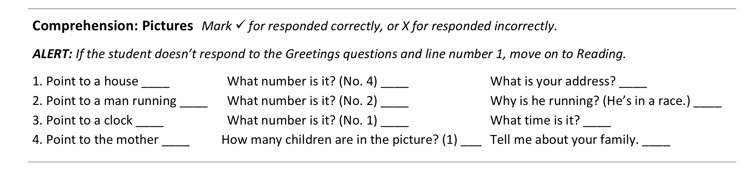
Comprehension - Questions for Pictures 1- 4
Note: the fourth set of questions is different than lines 1-3.
Notes:
3.20 Review the items in this section of the Interview form
The interviewer will
• Ask 3 questions about each picture
Left column -
Ask the student to point to pictures
Center and right column
Ask the student to answer questions related to the pictures
• Mark whether the student responded accurately =✓ or inaccurately =x
There is a shaded area that is a Comprehension- ALERT
If the student doesn’t respond to Greetings or Line 1 move on to the Reading section in box 2.

Slide 46
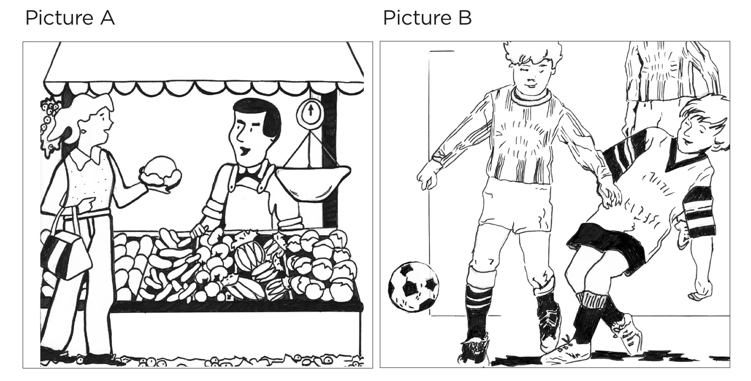
Speaking
Show the student the speaking pictures one at a time.
Notes:
3.21 After completing the two comprehension sections the interviewer will show the student the Speaking Pictures. This part of the Interview will help you determine the student's ability to communicate orally.

Slide 47
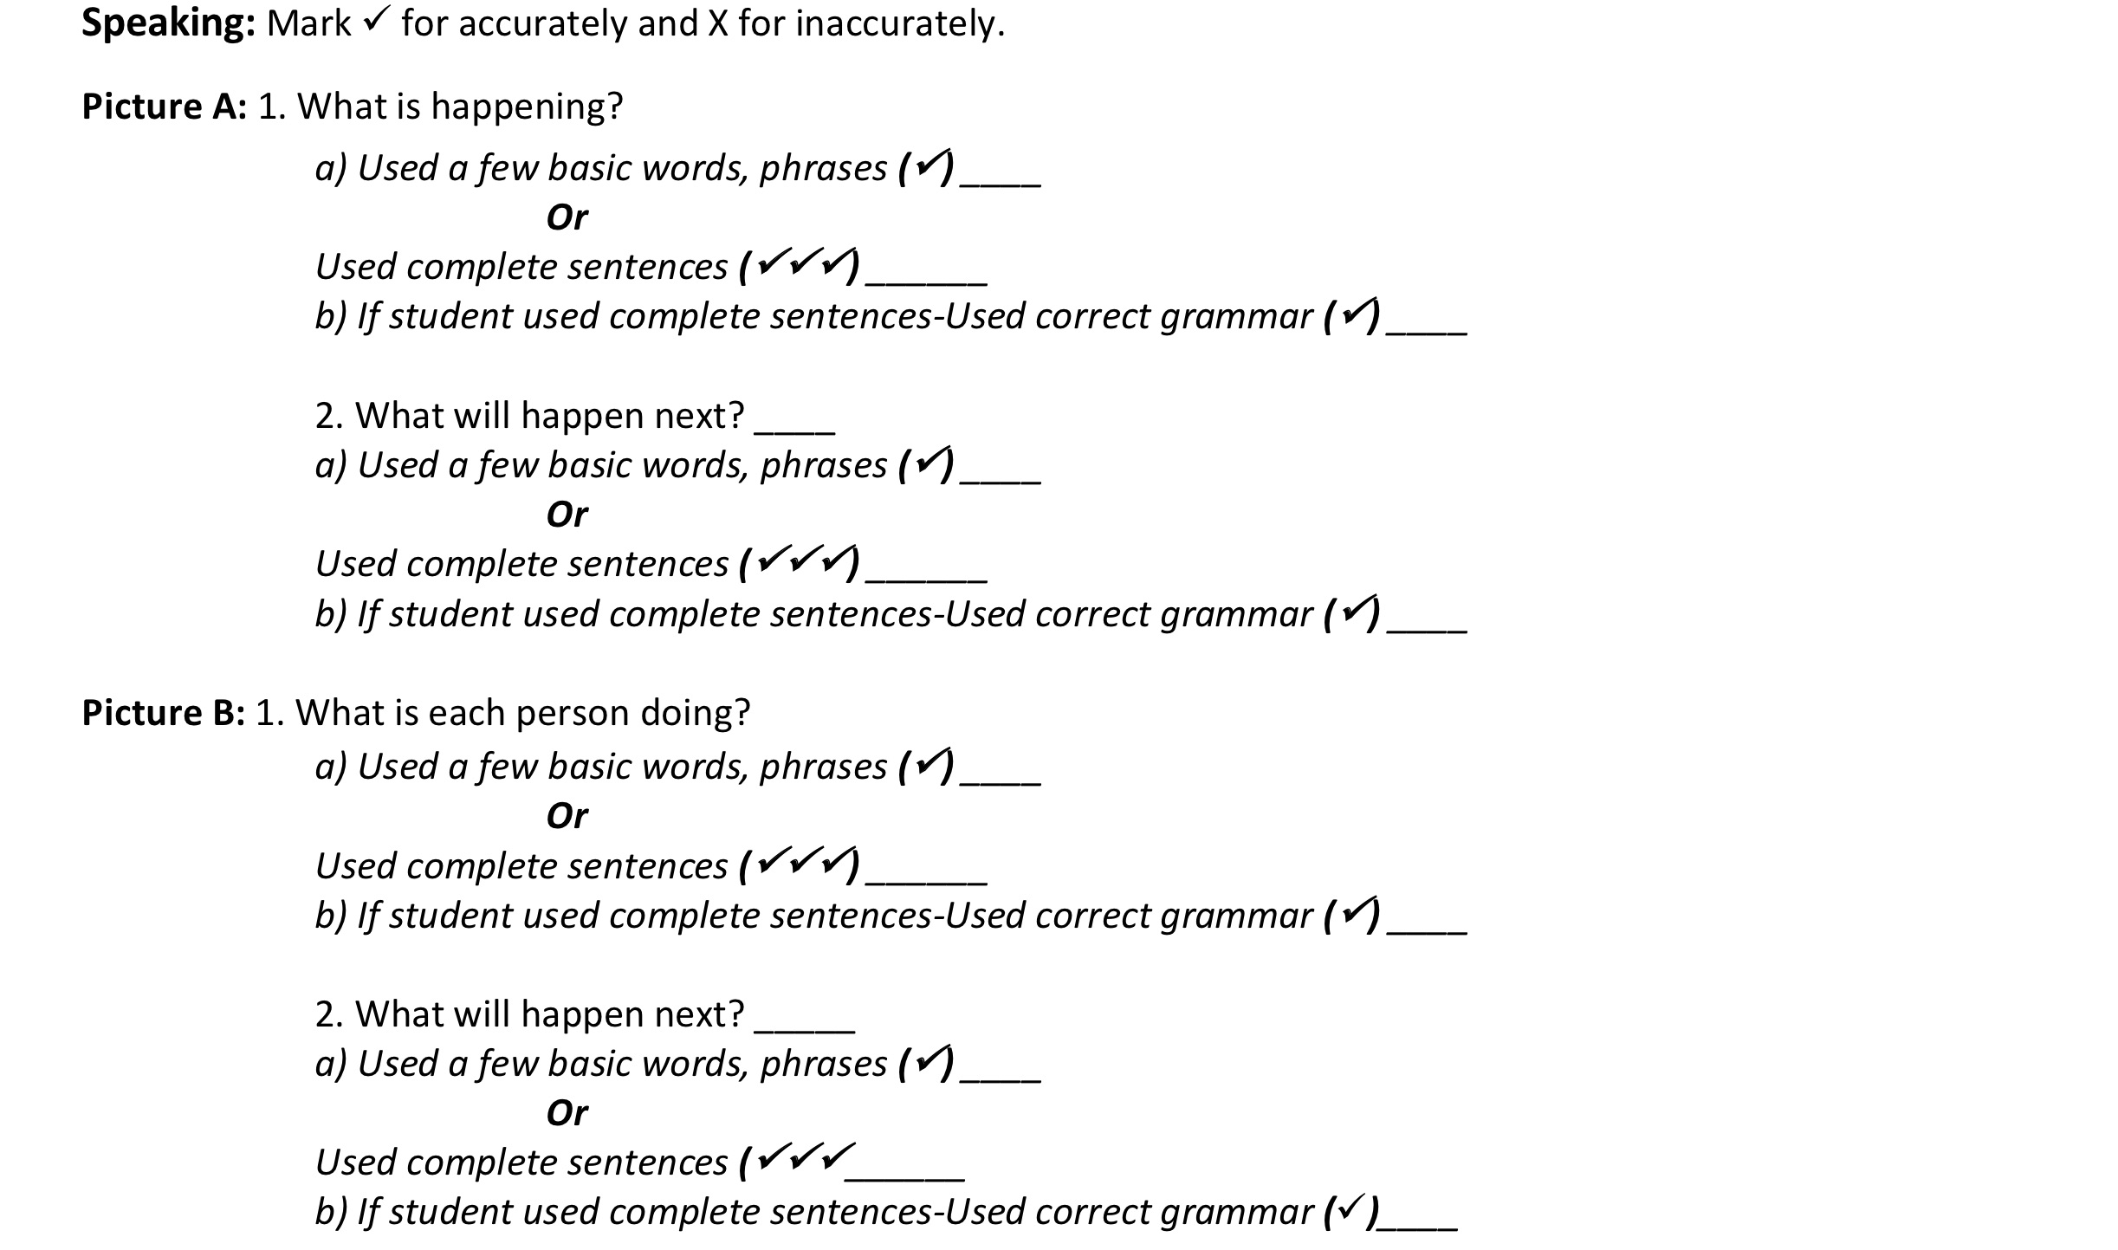
Speaking Questions
Notes:
3.22 Review the items in this section of the Interview form. The interviewer will
• Ask the student the two questions about each picture.
• When you have concluded each set of questions mark whether the student
• Responded accurately ✓✓
• Used a few basic words, phrases ✓✓
• Used complete sentences ✓✓✓✓
• Used correct grammar ✓✓
x = no
Information for Workshop Leaders:
Many students understand English better than they can speak English. In this evaluation the ability to communicate orally is given more weight than the ability to understand or comprehend English . The ability to use sentences is given great weight than using single words or phrases.

Slide 48
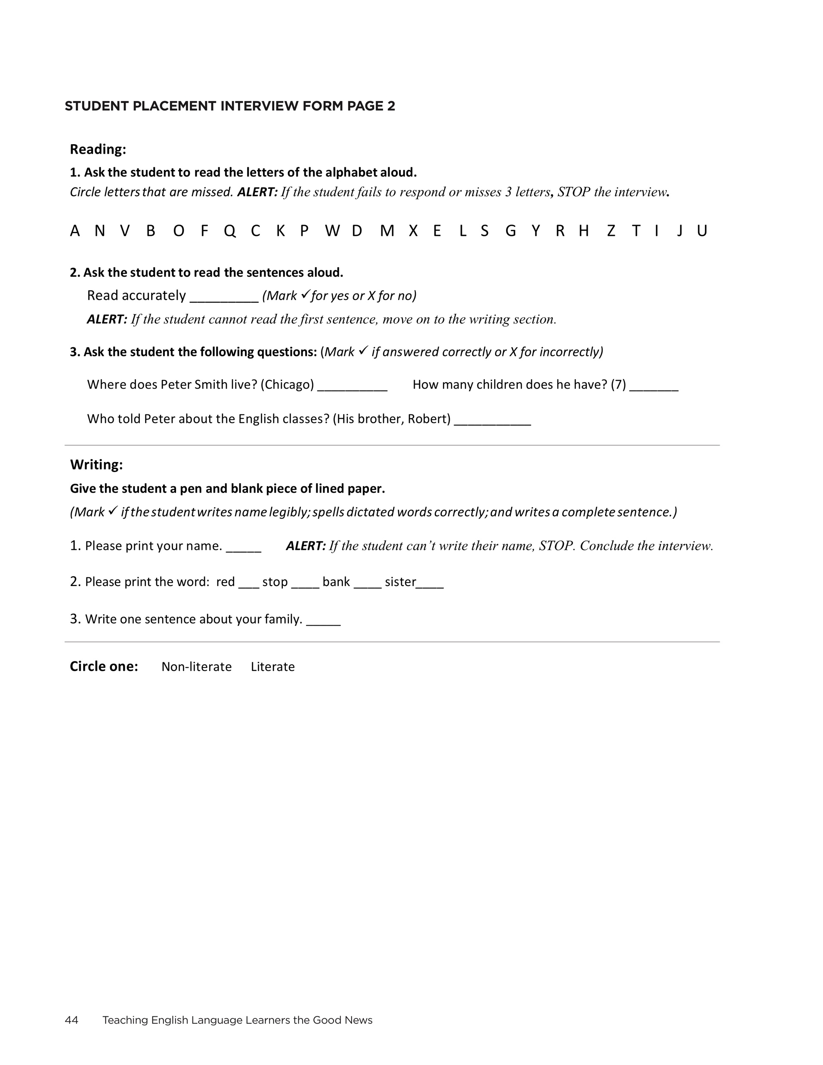
Interview: Page Two
Evaluate if the student is literate.
Notes:
3.16 Point out that there are two boxes on the interview form.

Slide 49
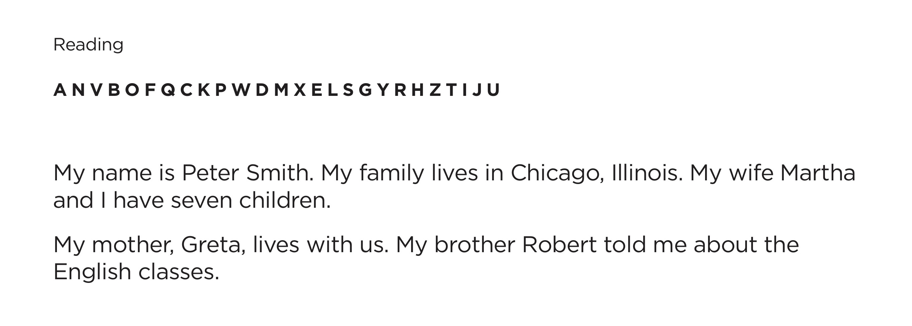
Reading
Show the student the Reading Page
Notes:
3.25 The interviewer shows the student the Reading Section page.

Slide 50
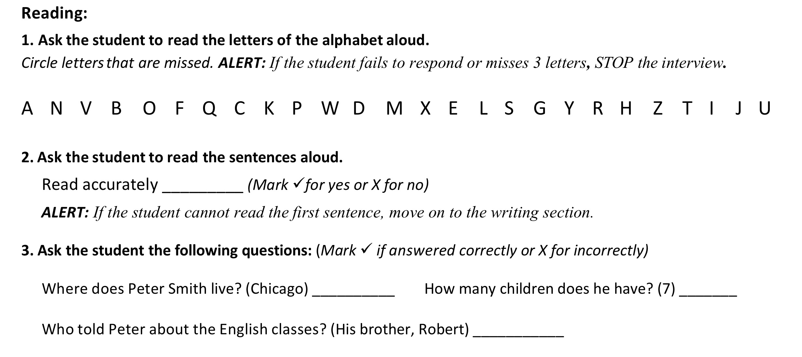
Reading Procedure
Notes:
3.26 Ask the participants to look at the Reading Section Directions on the Interview page.
Review the items in this section of the Interview form
• Ask the student to read the letters of the alphabet aloud.
• Circle any he misses.
• Reading - ALERT in the shaded line
If the student fails to respond or incorrectly identifies 3 letters, stop. End the interview.
If the student made fewer than 3 errors
• Ask the student to read the sentences in Number 2.
Mark if he reads smoothly or haltingly.
• Ask the student 2 comprehension questions about what he read.
The questions are on the Placement Interview Form.
Mark if he answered correctly or incorrectly.

Slide 51
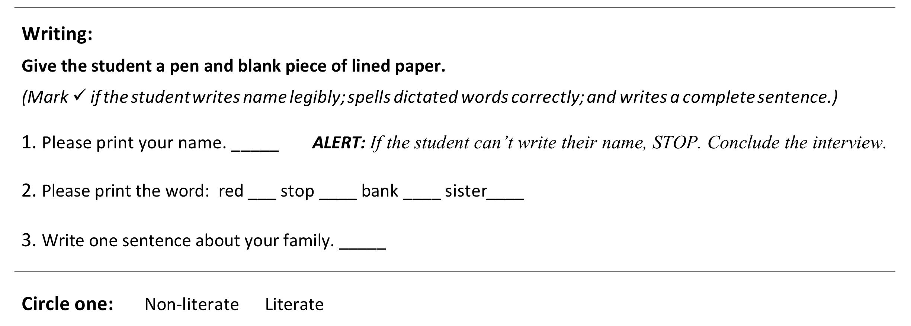
Writing Section
Notes:
3.27 Ask the participants to look at the Writing Section
.
Review the writing procedure
• Give the student a piece of lined paper.
• Ask the student to print his name.
• Writing - ALERT : If the student cannot legibly write his name STOP.
If the student can write his name legibly
• Ask the student to write four words you dictate. These words contain 14different letters.
Mark whether he did it legibly and correctly
• Ask the student to write one sentence about his family.
Mark whether it was legible and understandable.
Evaluating spelling and grammar is part of the process. But in this interview you are not trying to evaluate how literate the student is; only if it appears that he is literate rather or non-literate.

Slide 52
Conclude the Interview
Thank the student.
Ask if he has any questions.
Notes:
3.28 Read the slide

Slide 53
Observe the Placement Interview
Mark the placement form as you watch.
Notes:
3.29 Place participants in pairs.
Partners follow the Interview directions.
Remind participants not to mark on your Placement Interview Pages. These are masters to copy for later use.
Partner A- Comprehension and Speaking
Partner B- Reading and Writing

Slide 54
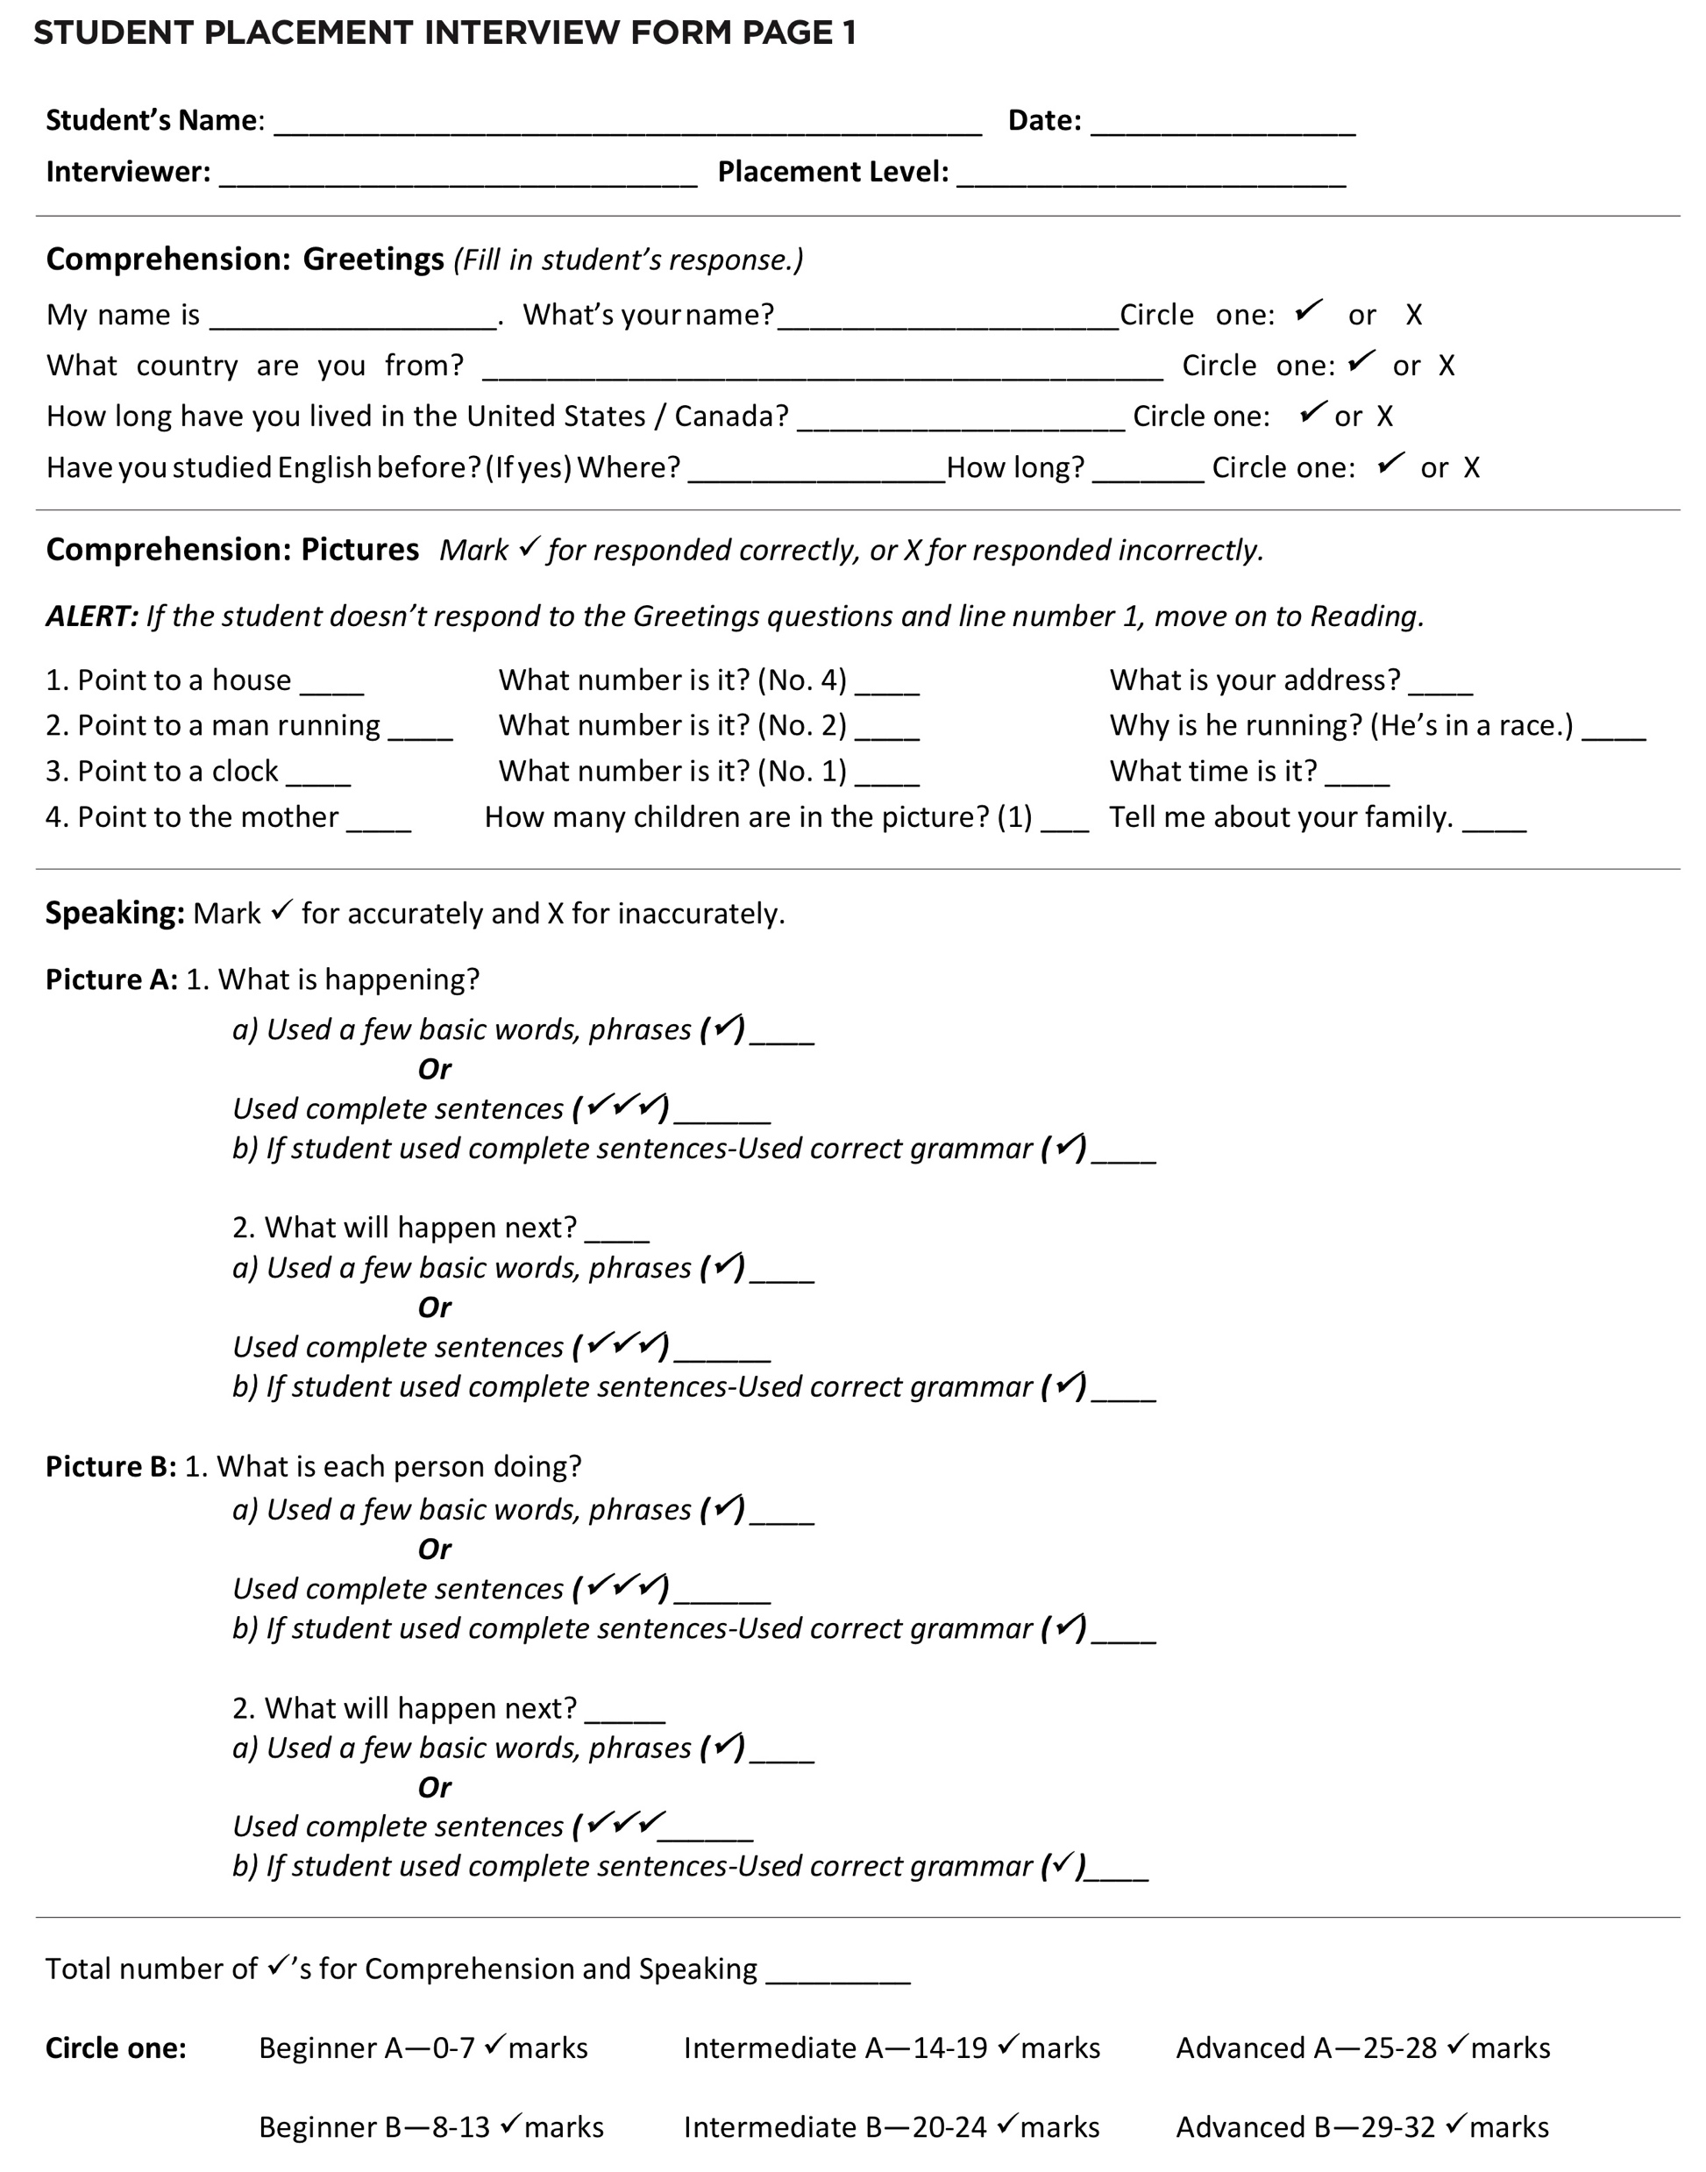
What do you do after the Placement Interview?
Count and record the number of checkmarks ✓ for Comprehension and Speaking
Circle fluency level based on the number of checkmarks ✓
Notes:
3.30 Read the slide. Show participants where to write the total.

Slide 55

What do you do after the Placement Interview?-2
Mark whether the student is literate.
Notes:
3.31 Read the slide. Show participants where this is on the Interview form.

Slide 56
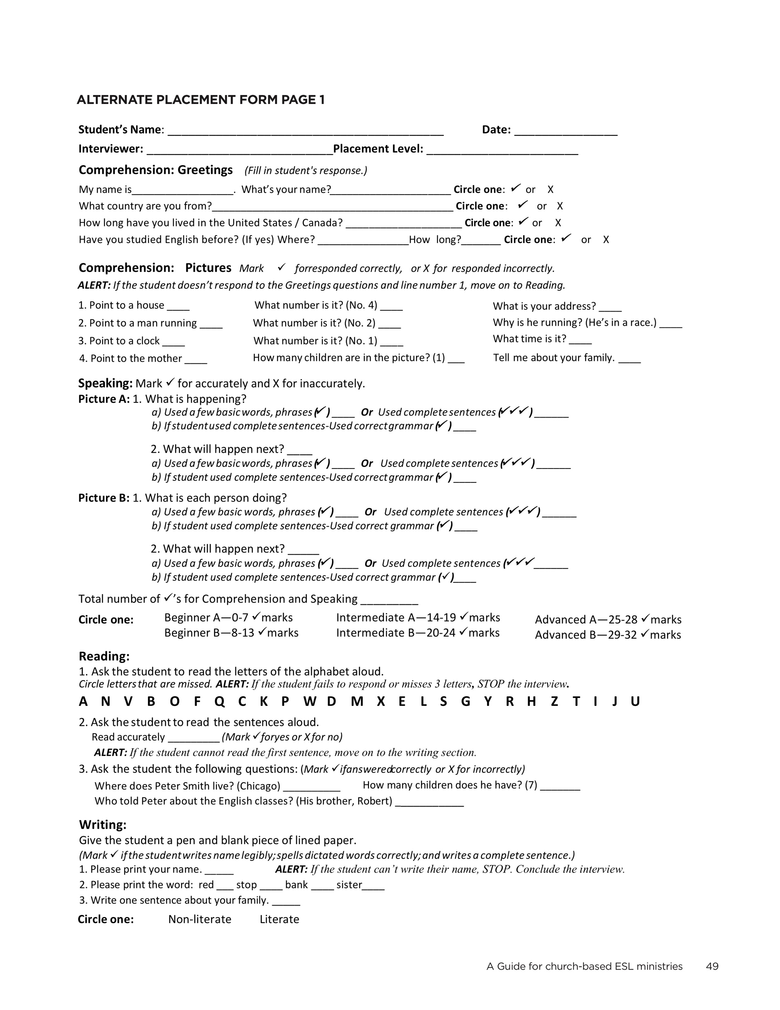
Alternate Placement Form
Same process; recording space is condensed.
Copy on back of registration form to easily insert in student’s file.
Notes:
3.31 Read the slide. Show participants where this is on the Interview form.

Slide 57
After Determining Fluency Level
Assign students to classes
If there is a question about the level always place the student in lower level
If it’s not the right level–offer to move him
If the student wants to go to a different class, let him
Average Attendance:
Beginner—3-8, ( 6-12 enrolled)
Intermediate—5-10 (8-15 enrolled)
Advanced—5-10 (8-15 enrolled)

Slide 58
Activities for the First Class Session
During first meeting:
Conduct placement interviews with all students individually
Provide activities for students while they are not being interviewed
Use activity ideas and the guidelines for using them provided in the TELL manual

Slide 59

Chapter 4 Learning and Teaching a Foreign Language

Slide 60
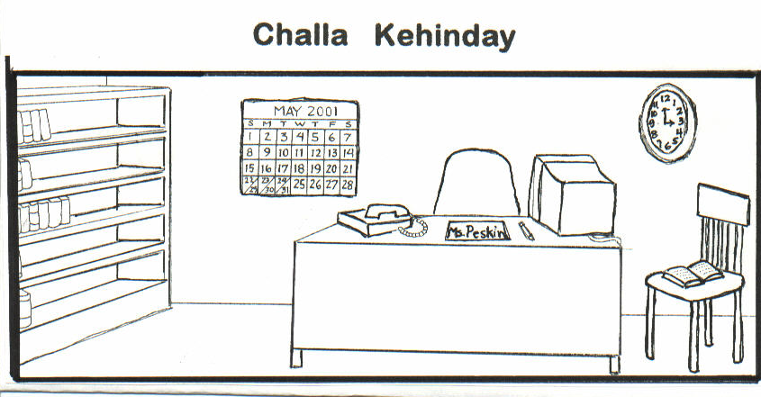
goota__ alay__ yoma__ lameechga__ etoomba__

Slide 61
Challa Kehinday
1.
2.
3.
4.
5.
goota
alay
yoma
lameechga
etoomba

Slide 62
Language Learning Skills
Hearing/Listening
Speaking
Reading
Writing

Slide 63
Differences between learning first and second languages
1st language
➲ Acquired without being aware.
➲ Saturated with 1st language daily
2nd language
➲ Very aware you are learning a language
➲ Often don’t use
language outside of
class

Slide 64
Differences in learning first and second language - 2
1st language
➲ Learn vocabulary and sentence structure without interference
➲ Willing to take risks
to learn
2nd language
➲ Relearn vocabulary and sentence structure
➲ Reluctant to take
risks to speak the language

Slide 65
Differences in learning first and second language - 3
1st language
➲ Begin with small vocabulary and expand as needed
➲ Several years of speaking and listening before reading and writing
2nd language
➲ Need for broad
vocabulary sooner
➲ Speaking, listening, reading and writing introduced together

Slide 66
Learning to Speak a Language Differs from Learning to Read a Language
Students may read English but not be able to speak it
Students must produce and derive meaning from sound, not written symbols

Slide 67
Learning to Speak a Language Differs from Learning to Read a Language -2
Spoken language has elements that written language doesn’t
Individual sounds
Rhythm
Stress
Intonation

Slide 68
Practice Speaking the Language Is Essential
A student must hear and use a word or phrase 40-60 times
Class time should focus on the student speaking
The greatest teacher error is talking too much

Slide 69
Teaching Suggestions
Create a low anxiety environment
Use material relevant to the student
Build on what the student already knows

Slide 70
Teaching Suggestions - 2
Enunciate clearly
Use visuals
Use lots of gestures, facial expressions, non-verbal communication

Slide 71
Teaching Suggestions - 3
Demonstrate rather than explain
Structure classes so students do most of the speaking
If you speak the student’s language, don’t translate
Discourage the use of electronic translators during class.

Slide 72
Teaching suggestions-4
Encourage students to listen to, speak, and read and write English each day.

Slide 73
Chapter 5 Planning Your ESL Lesson

Slide 74
The beginning point of lesson planning is an ESL textbook.

Slide 75
ESL textbooks
Are written by professionals
Provide teaching suggestions and ideas
Provide controlled progression
Have more material in a single “lesson” than can be taught in a single teaching session

Slide 76
The Text Book is an Idea Book
It is not a lesson plan!
Choose vocabulary and ideas in the lesson you can teach in a single teaching session that are appropriate for your class.

Slide 77
An ESL Lesson Plan
Provides structure for you to select the material you will teach
Helps you cover the basic areas of language learning in the correct sequence
Provides an outline to use in class
Allows you be sensitive to the Holy Spirit

Slide 78
Steps in Preparing an ESL Lesson Plan
Pray
Read the introduction to the text
Review the lesson in the text
Select the material and activities
Complete the Lesson Plan form

Slide 79
Elements of an ESL Lesson Plan

Slide 80
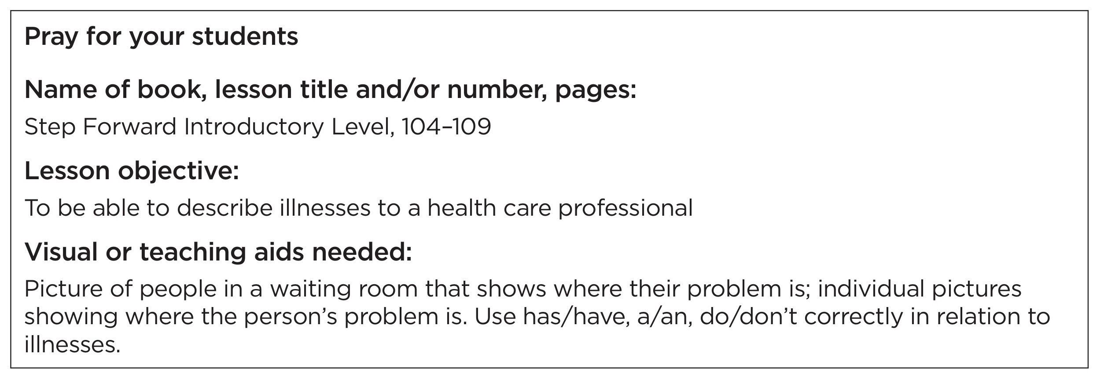
ESL Lesson Plan – Top box

Slide 81
ESL Lesson Plan Greetings, Scripture, and Prayer

Slide 82
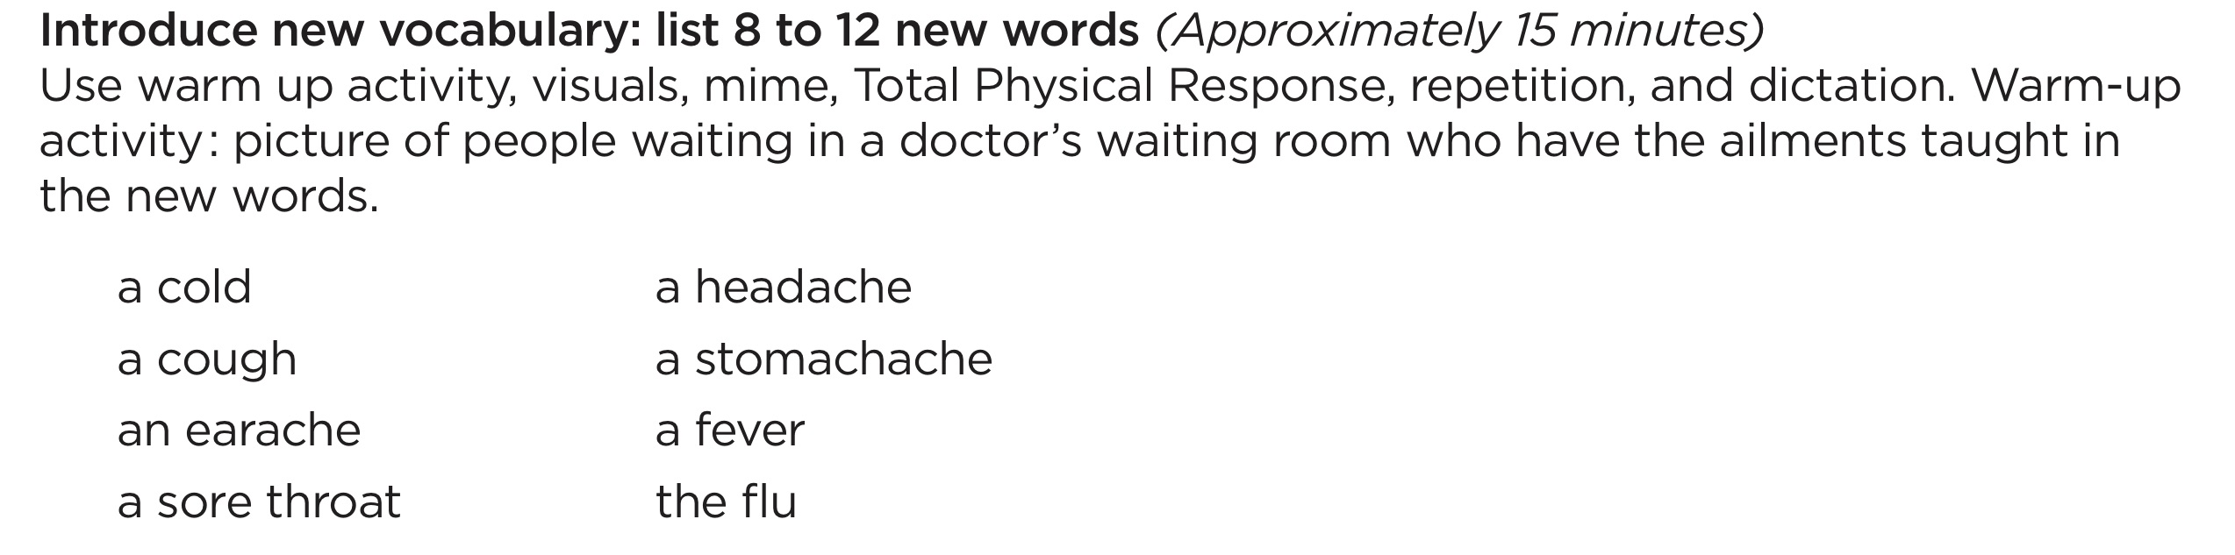
ESL Lesson Plan – Introduce New Vocabulary

Slide 83
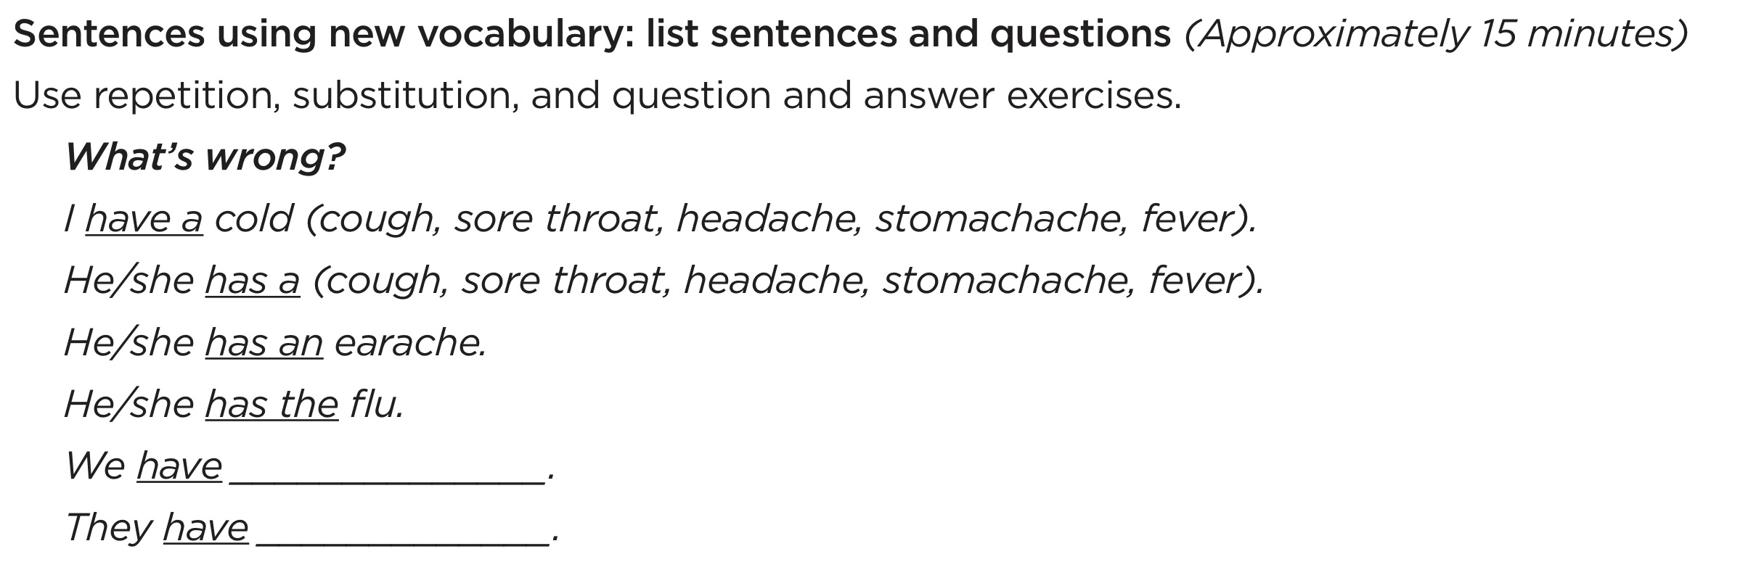
ESL Lesson Plan Sentences Using New Vocabulary

Slide 84
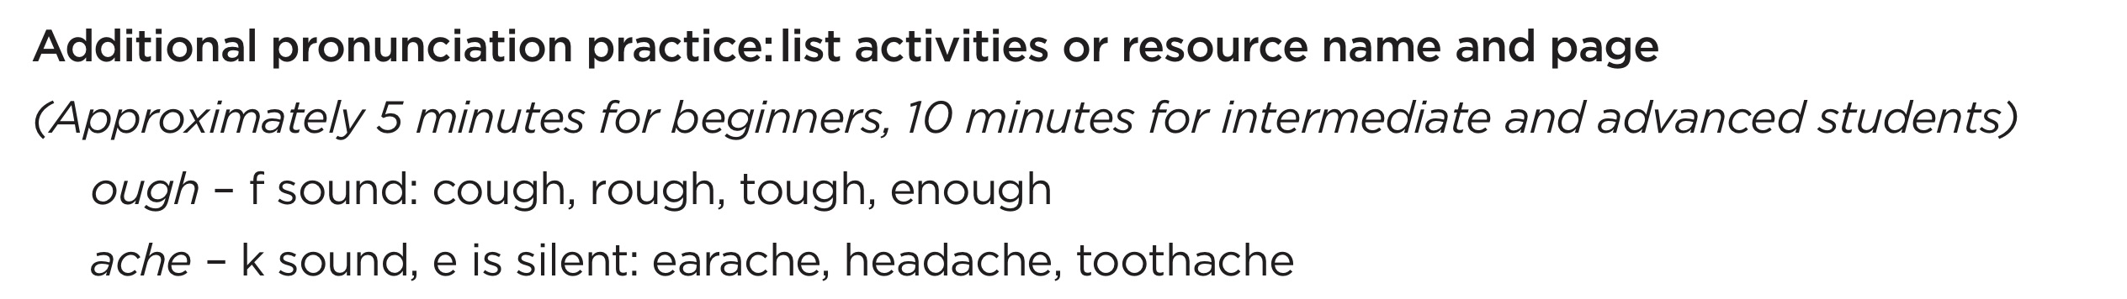
ESL Lesson Plan Additional Pronunciation Practice

Slide 85
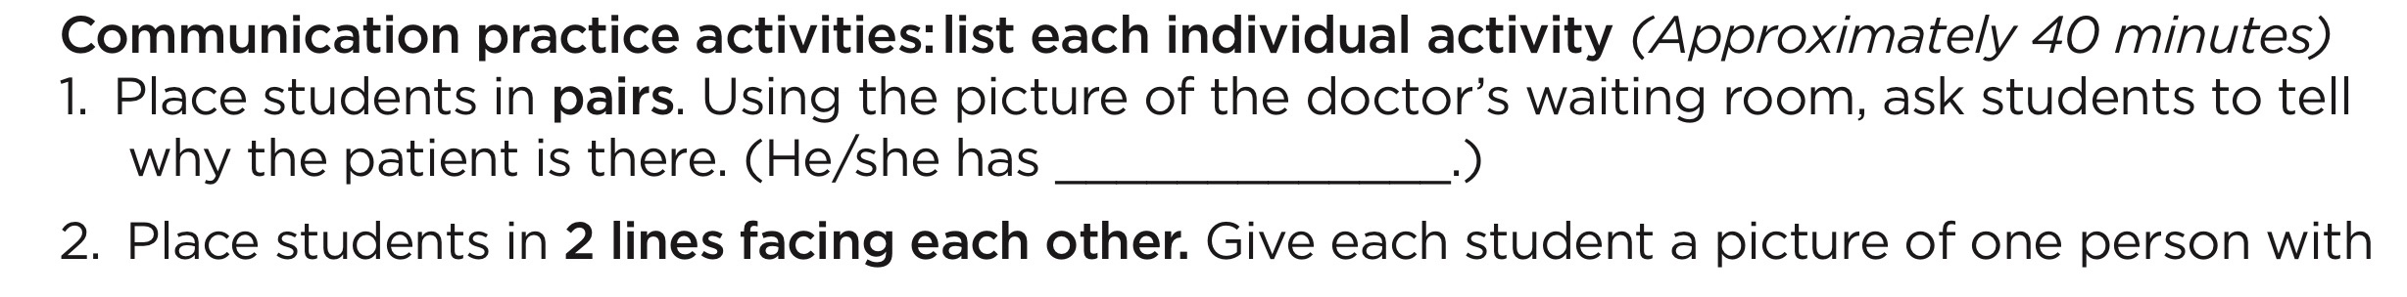
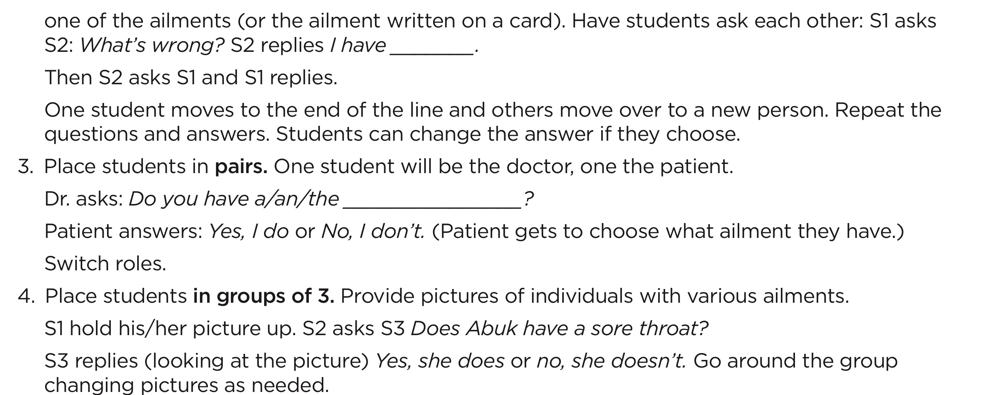
ESL Lesson Plan Communication Practice Activities
Structured
Students generate language
Interactive
Fun

Slide 86
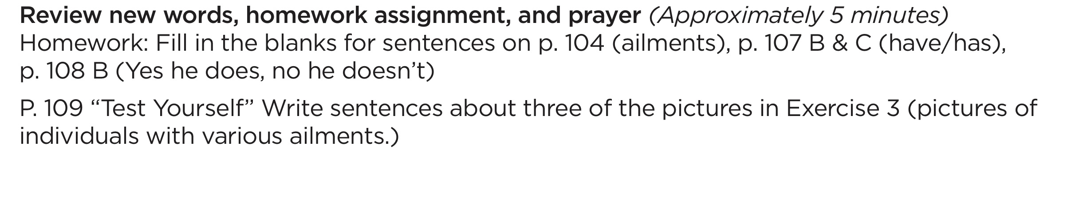
ESL Lesson Plan Review New Words, Homework and Prayer

Slide 87
ESL Lesson Plan Time Allotment

Slide 88
Lesson Planning Helps
▪ Teaching Techniques p. 67
▪ Sample Lesson Plans pp. 71-76
▪ Blank Lesson Plans pp. 68-69

Slide 89
Chapter 6 Introducing New Vocabulary

Slide 90
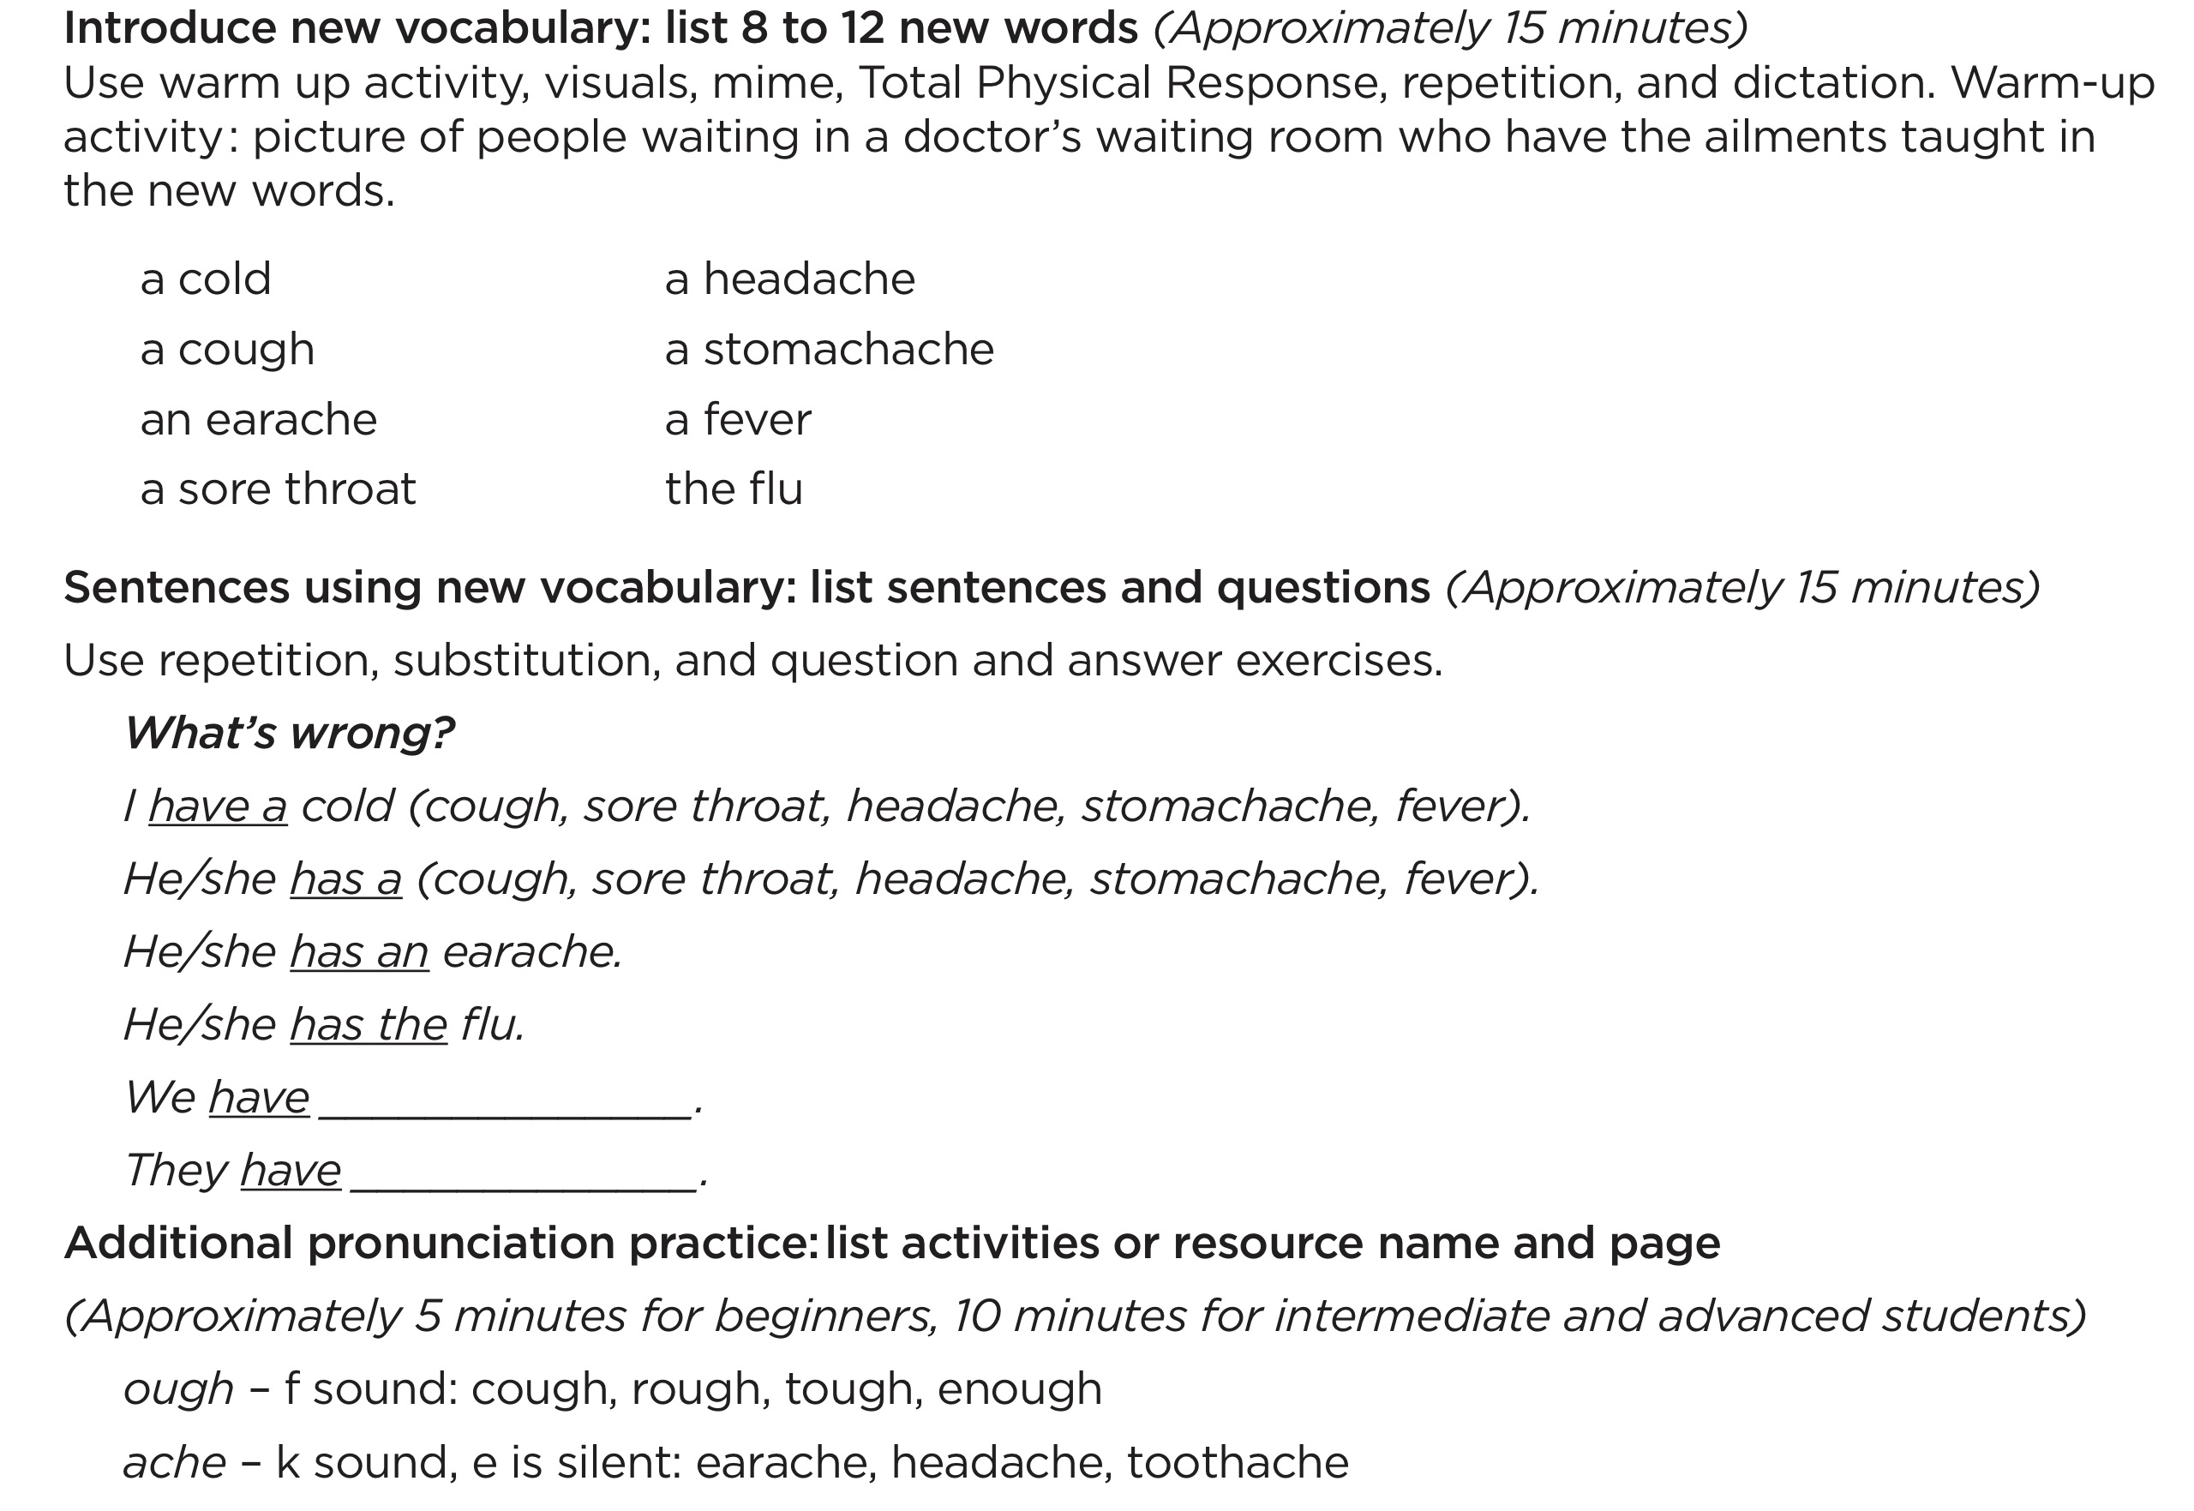
ESL Lesson Plan Section

Slide 91
The Lesson Plan Begins with Guided Practice
Introducing New Vocabulary
Sentences Using New Vocabulary
Additional Pronunciation Practice

Slide 92
The Lesson Plan Begins with Guided Practice
• Teacher introduces new material in a structured manner
• Students respond with set predictable responses
• Laying the foundation for the 2nd half of the lesson- structured activities where the student’s communication is spontaneous

Slide 93






Hand Gestures
1. Listen
4. Teacher points to class
“Ready” verbal cue
Shhhh
3. Teacher points to self
6. Students speak/respond

Slide 94
Introducing New Vocabulary Warm-up Activities
Introductory activity (5 minutes or less)
• to focus the student’s attention on the topic
• to activate student’s prior knowledge about the topic
Varies according to language level of students

Slide 95
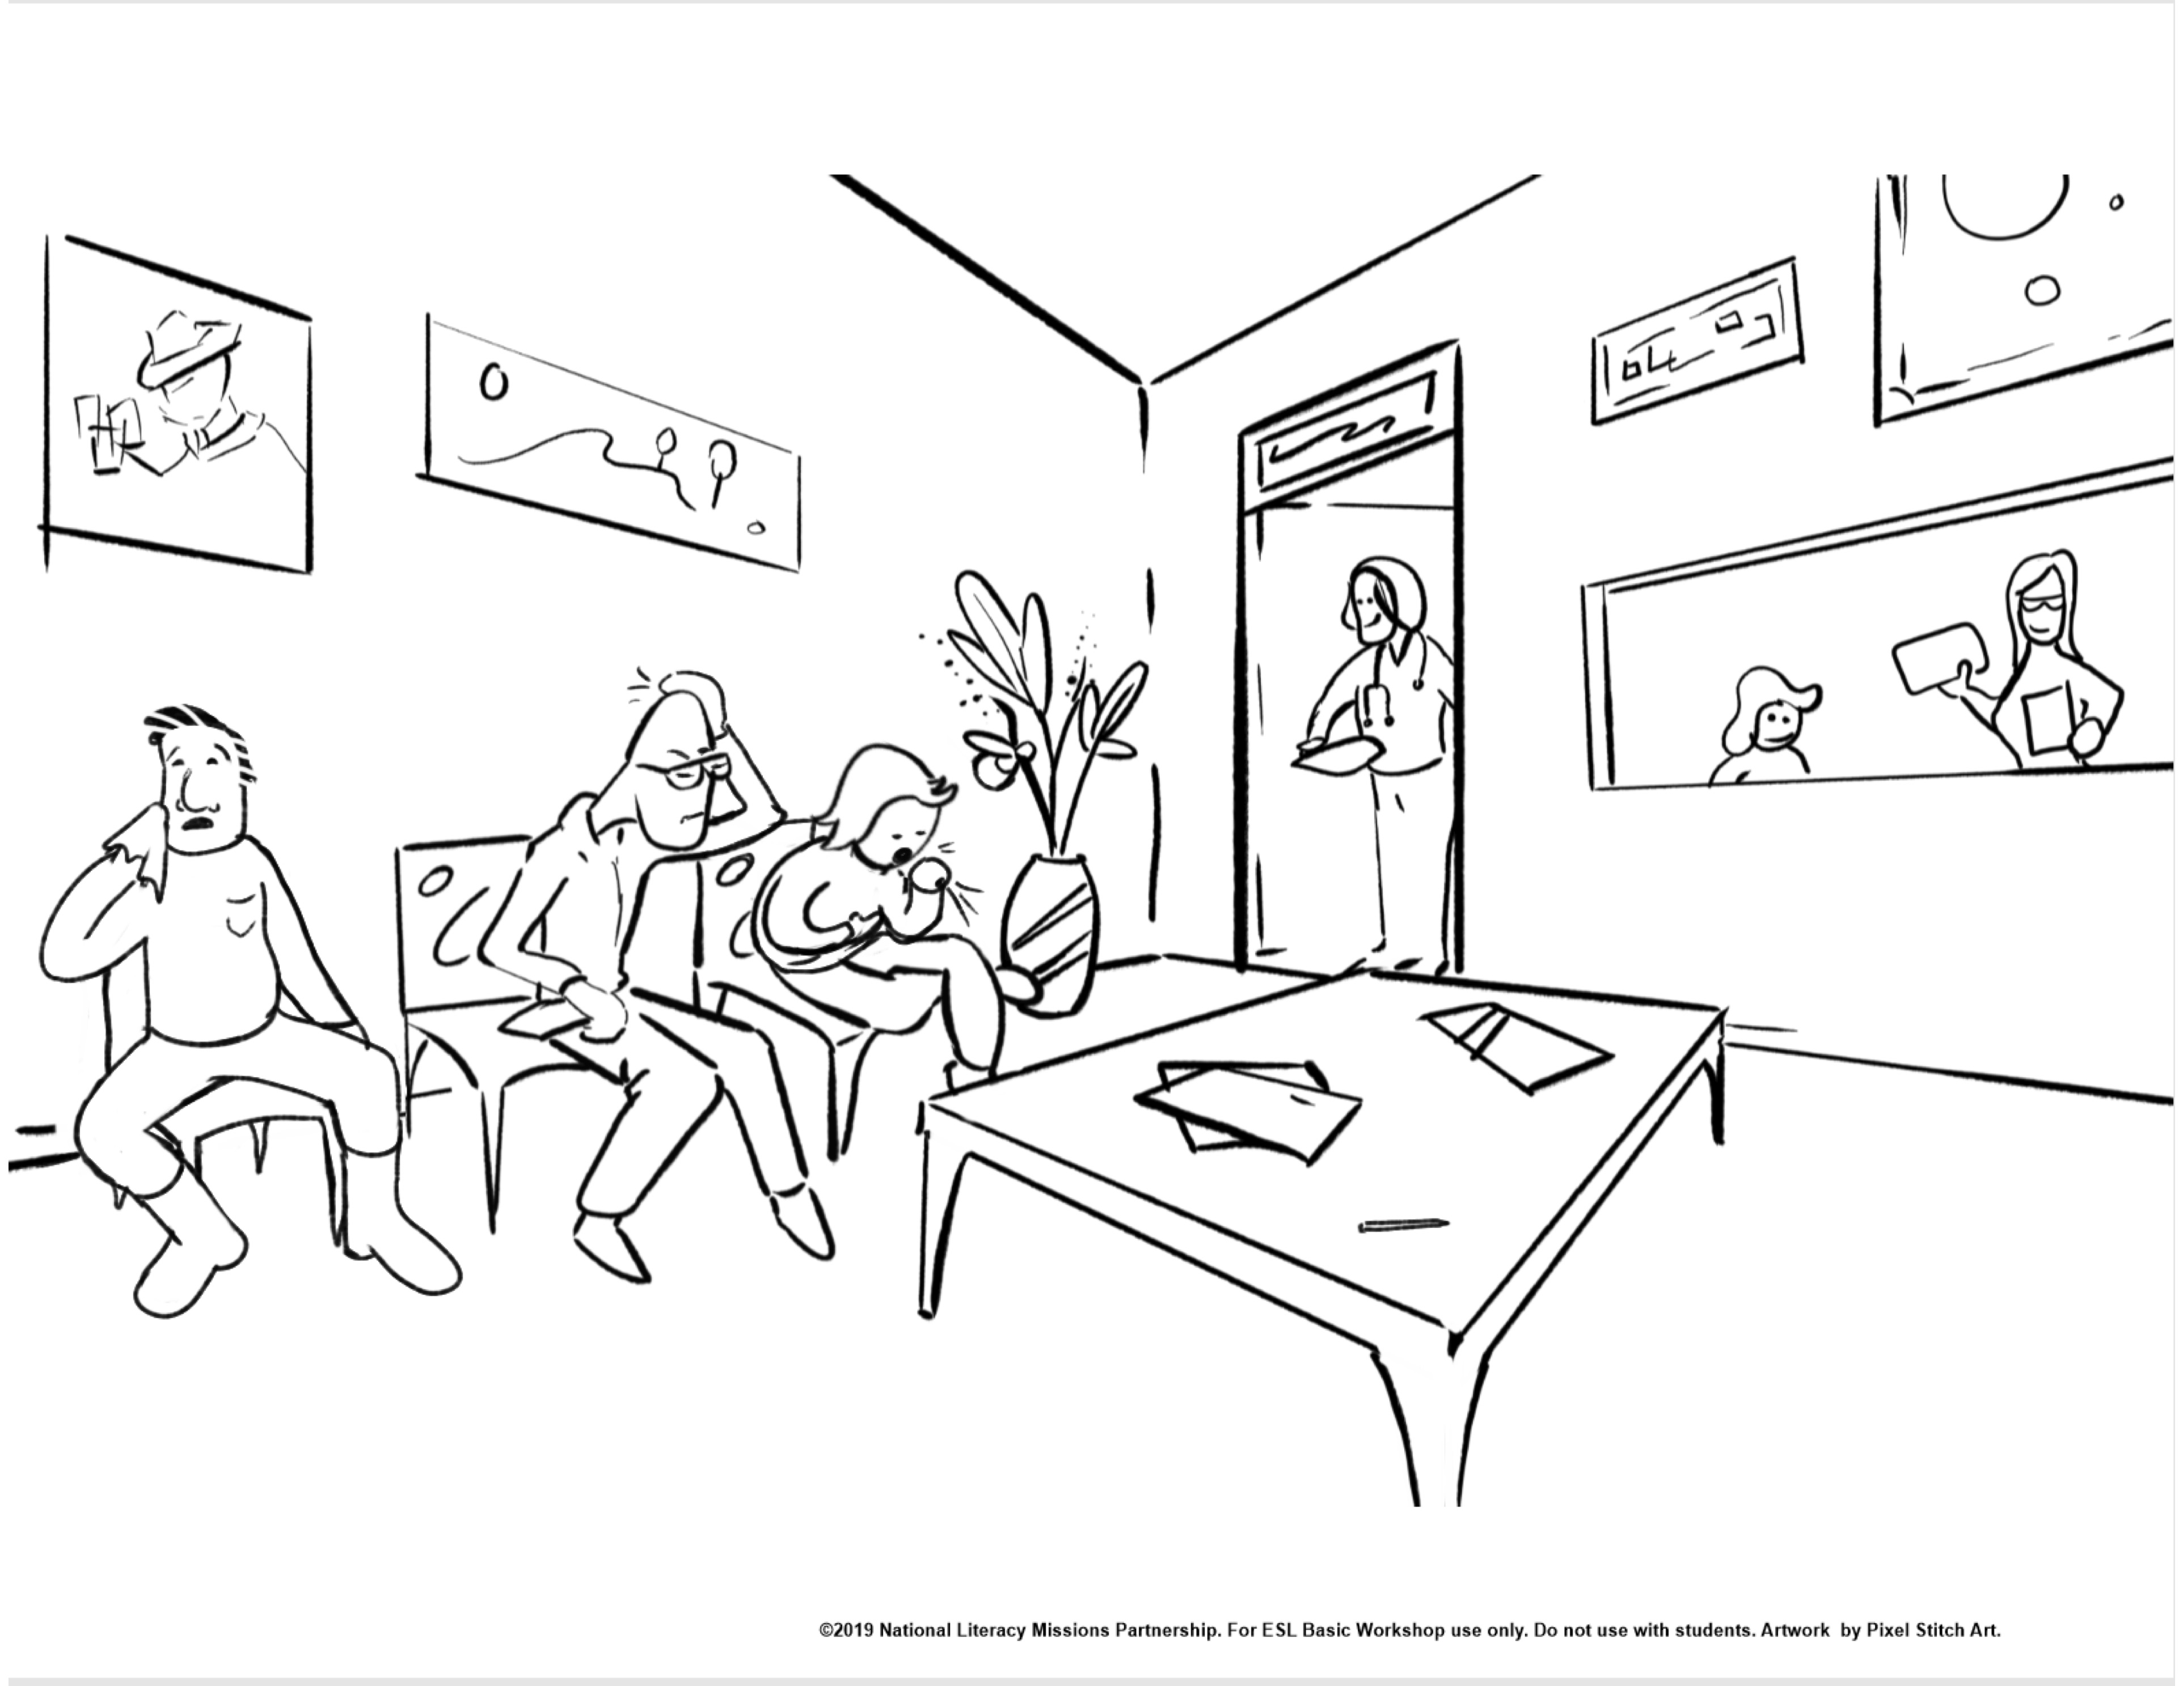

Slide 96
Basic Teaching Drills for Introducing New Vocabulary
Total Physical Response (TPR)
Repetition
Dictation

Slide 97
Total Physical Response Procedure
1. T says vocabulary word several times, shows picture, places picture where all students can see it. (Repeats until all the vocabulary words are displayed)
Ss watch
2. T gives a command, then models action
Ss watch
3. T gives command, then models action –
Gestures for students to do the action.
T and Ss do action together, but Ss. don’t speak
4. T gives command, but does NOT do action
Ss do action but don’t speak

Slide 98
Total Physical Response - practice
1. Hold up picture and say the word 5 times – put it on the wall or lay it on the table. (Repeat with all pictures.)
2. Say point to… for a picture. Do the action. (Repeat with all pictures.)
3. Say point to… for a picture. (Gesture for students to do it with you. Repeat for all pictures.)
4. Say “point to … and gesture for students to do the action but teacher does not do the action. (Repeat for all pictures.)

Slide 99
Repetition – Words Procedure
3.
T Ready?
Ss listen
4.
T (points to self) says word
T gestures students to respond
Ss repeat word
1.
T says word 5 times
Ss listen
2.
T (points to self) says word T. (points to Ss.) says word
Ss listen

Slide 100
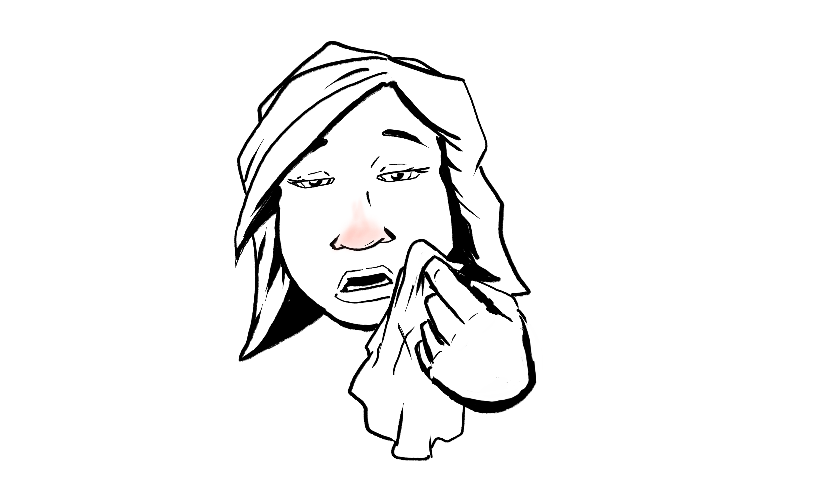
Repetition- practice
1. T: (Repeat 5 times) a cold
2. T: (points to self) a cold
(points to Ss.) a cold
3. T: Ready?
4. T: (points to self) a cold
Gesture students to respond
Ss: a cold

Slide 101
Dictation Drill Procedure
T writes words in numbered list form.
T indicates that Ss. should copy the words Ss Write the numbered words
T Points to a number, says the number; Points to the word and says it
Ss Repeat the number and the word (Do this for all numbers and words)
T (points to self) says a word out of sequence
T (points to Ss) says the corresponding number
Ss listen (Repeat this word/number sequence with a different word/number.)
T Ready?
T says word out of sequence (Does NOT point to it)
Ss Respond with corresponding number (Repeat with all words)
Reverses what was done in Step 4; say number and Ss respond with word.
T asks Ss to write numbers, then dictates words in random order for Ss to write.

Slide 102
Review: Basic Drills for Teaching New Vocabulary
Total Physical Response (TPR) – students do not speak, but perform actions to show comprehension of new words
Repetition (words) – students practice saying the new words
Dictation – students practice reading and writing the new words

Slide 103
ESL Lesson Plan Section Sentences using new vocabulary words

Slide 104
Basic Teaching Drills for Using New Vocabulary in Sentences
Repetition of Sentences
Substitution
Question/Answer
Chain Drill

Slide 105
Repetition – sentence using new word
Set the pattern – say sentence for each picture.
1.
T says the sentence 5 or 6 times
Ss listen
2.
T (points to self) says the sentence
T (points to Ss.) says the sentence
Ss listen
3.
T Ready?
Ss Listen
4.
T (points to self) says the sentence
T Gestures for students to answer.
Ss repeat sentence
Repeat step 4 three times.

Slide 106
Repetition of Sentences - Practice
I have a cold
I have a cough
I have a headache.
Set the pattern.
1. T: I have a cold. (Repeat 5 times.)
2. T: (point to self) I have a cold.
(point to Ss.) I have a cold.
3. T: Ready?
4. T: (point to self) I have a cold.
T: Gesture for students to respond.
Repeat step 4 three times.

Slide 107
Substitution Procedure
1.
T (points to self) – says word
T (points to Ss.) – says sentence using the word
Ss listen
2.
T (points to self) – says another word
T (points to Ss.) – says sentence using that word
Ss listen
This sets the pattern.
3.
T Ready?
Ss listen
4.
T (points to self) - says word
T gestures students to respond
Repeat Step 4 with all words.

Slide 108
Substitution - practice
T (points to self) a cough
T (points to Ss) I have a cough.
2. T (points to self) a headache
T (points to Ss) I have a headache.
3. T (points to self) a cold
T (points to Ss) I have a cold.
T Ready?
4. T (points to self) a cough
Gestures for students to respond.
Repeat Step 4 with a headache and a cold.

Slide 109
Question/Answer Drill Procedure – Part 1
Set the pattern.
T (holds ? Card and one picture) asks question.
T (flips to . side) answers question.
Ss listen.
Repeat with 2 or 3 different words (pictures).
1. T (points to self) asks question
T (points to Ss) answers question
Ss listen
Repeat Step 1 with a different word.
2. T Ready?
3. T asks question.
T gestures to Ss and Ss answer.
Repeat Step 3 with all words.

Slide 110
Question Answer Drill—Part 1- practice
1. T (points to self) What’s wrong?
T (points to Ss) I have a cold.
T (points to self) What’s wrong?
T (points to Ss) I have a headache.
T (points to self) What’s wrong?
T (points to Ss) I have a cough.
2. T Ready?
3. T What’s wrong?
Gesture for students to respond.
Ss I have a cold.
Repeat Step 3 with a headache and a cough.
Set the pattern:
Use pictures and ? and . card to do the following.
What’s wrong?
I have a cold.
What’s wrong?
I have a headache.
What’s wrong?
I have a cough.

Slide 111
Question/Answer Drill Procedure—Part 2
1. T: (points to Ss)—asks question
T: (points to self)—gives answer
Ss: Listens
Repeat Step 1 with a different picture.
2. T: Ready?
3. T: gestures for students to ask question
Ss: ask question
T: answers question
Repeat Step 3 with all words.

Slide 112
Question Answer Drill—Part 2 practice
1. T (Point to Ss) What’s wrong?
T (Point to self) I have a cold.
T (Point to Ss)What’s wrong?
T (Point to self) I have a headache.
T (Point to Ss) What’s wrong?
T (Point to self) I have a cough.
2. T Ready?
3. T Gesture for students to ask question.
Ss What’s wrong?
T I have a cold.
Repeat Step 3 with a headache and a cough.

Slide 113
Chain Drill Procedure
T (holds a picture) prompts S1 to ask question
S1 asks question
T Prompts S2 to answer
S2 answers
Move the chain.
T (holds a different picture) prompts S2 to ask question
S2 asks question
T Prompts S3 to answer
S3 answers
Continue the chain until all students have asked and answered at least once.

Slide 114
Chain Drill- practice
T Bill, ask Mary (T point to card and hold ?)
S1 What’s wrong?
T Mary, tell Bill (T point to card and hold .)
S2 I have a cold.
Change picture.
T Mary, ask Sam (T hold ?)
S2 What’s wrong?
T Sam, tell Mary (T hold .)

Slide 115
Practice Teaching Question/Answer Drill
Set the pattern: Use ? and . and picture cards.
T: (holds ? card and one picture) – asks question
T: (flips to . side) answers question
Ss: Listen
T: Repeat with 2 or 3 different words (pictures)
Part 1 – T Asks/Ss Answer
1. T (Point to self) What’s wrong?
T (Point to Ss) I have a cold.
Repeat Step 1 with another picture.
2. T Ready?
3. T (Point to self) What’s wrong?
T (Gesture for Ss. to respond)
Repeat Step 3 with all words.
Part 2—Ss Asks/T answers
1. T (Point to Ss) What’s wrong?
T (Point to self) I have a cold.
Repeat Step 1 with another picture.
2. T Ready?
3. T (Gestures for Ss. to ask question)
T (Point to self – answers question)
Repeat Step 3 with all words.
Move into Chain Drill.

Slide 116
Basic Teaching Drills
Total Physical Response
Repetition - words
Dictation
Repetition - sentences
Substitution
Question/Answer
Chain Drill

Slide 117
Conducting Drills
Model several times before student speaks
Students repeat 5-6 times
Speak naturally
Be consistent in rhythm, stress and intonation
Move from all to groups to individuals; encourage verbally
Vary word order
Encourage verbally
Review

Slide 118
Tips for Error Correction
Allow time for students to respond
Allow time for students to correct themselves
Don’t correct every error
Avoid negative terms

Slide 119
Tips for Error Correction - 2
Provide an accurate model: say Listen and repeat the statement correctly
Never interrupt or correct when student is expressing a thought
Review errors common to class
Don’t correct errors in a social setting

Slide 120
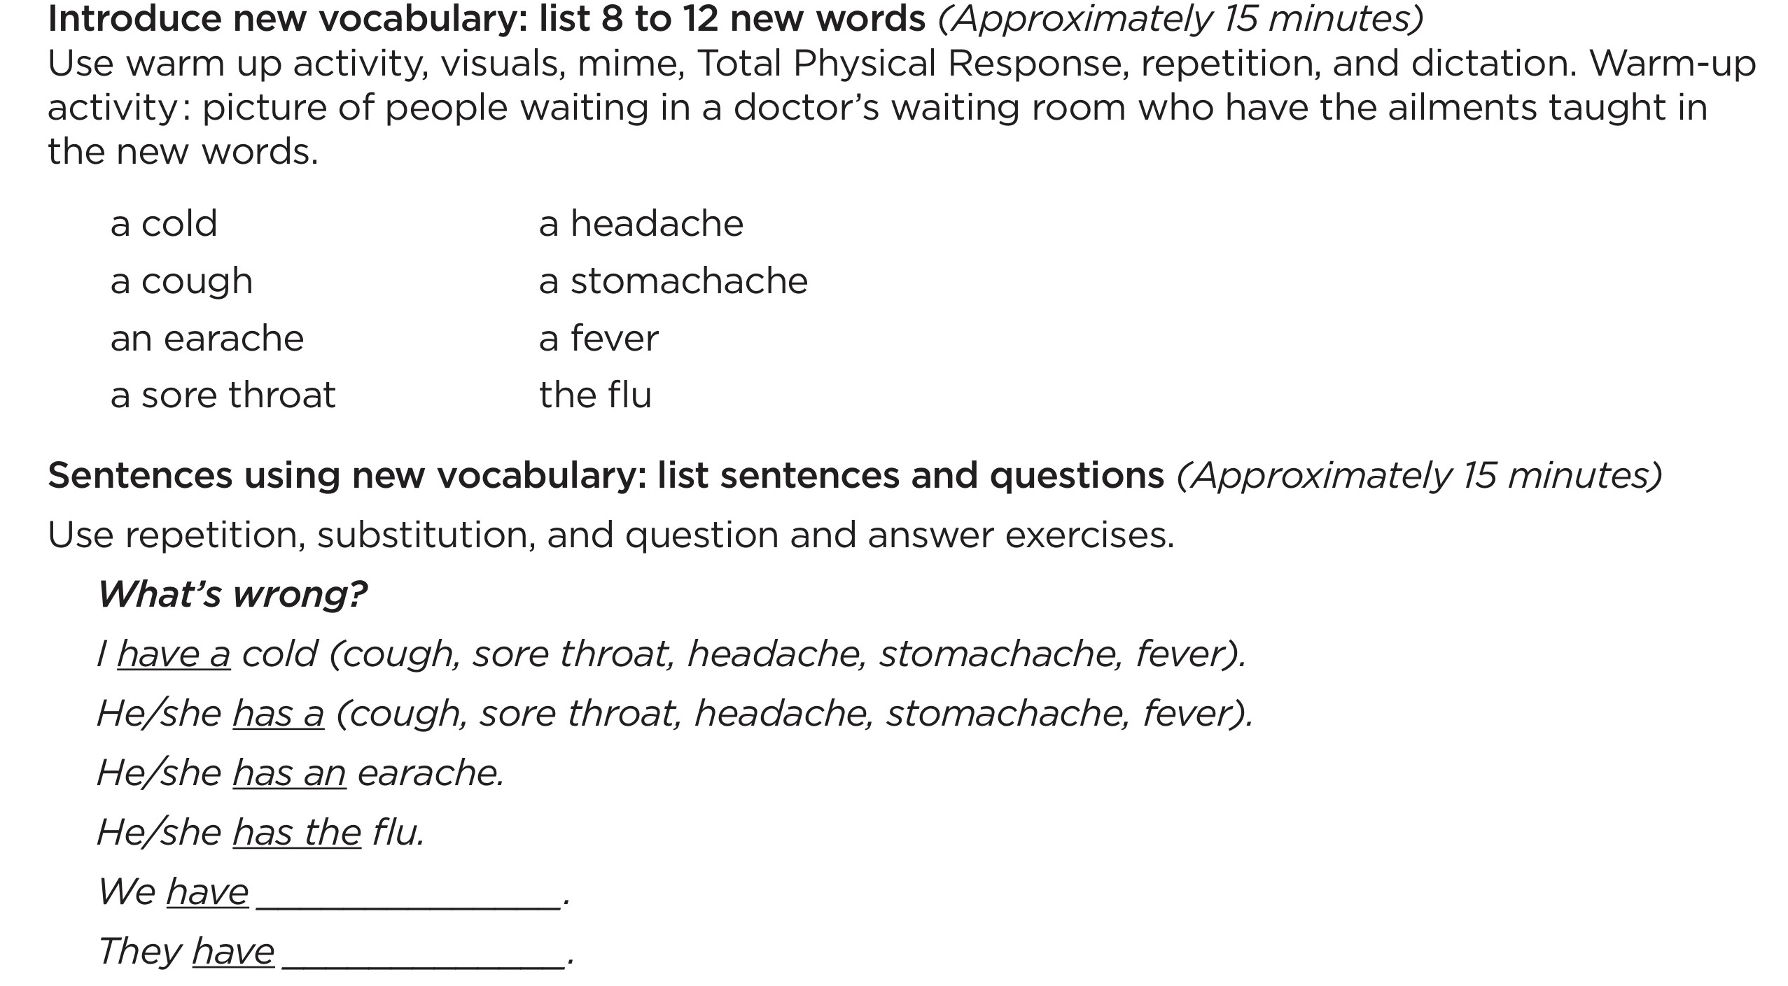
ESL Lesson Plan—Vocabulary

Slide 121
Complete Lesson Plan—Vocabulary
Write an objective for the lesson.
Select a warm-up activity.
Select vocabulary to teach during the lesson and write those words under Introduce new vocabulary.
Select sentences and questions to practice the selected vocabulary. Write them on the blank lesson plan form under Sentences using new vocabulary.

Slide 122
Chapter 7 Teaching Pronunciation

Slide 123
ESL Lesson Plan Additional Pronunciation Practice

Slide 124
Elements in Teaching Pronunciation
How to produce individual sounds
How to hear the differences between sounds
Stress
Intonation
Rhythm
Phrasing
Reduced/Relaxed Speech

Slide 125
1. How to Produce Individual Sounds
Factors in Production of a Speech Sound
1. Lip or jaw position
2. Tongue position
3. Flow of air
4. Vocal cords

Slide 126
Helps for teaching individual sounds
Descriptions of How to Produce the Sounds of English – TELL pp. 107-113
Teacher demonstrations
A hand mirror

Slide 127
2. How to Hear the Differences Between Sounds
Minimal Pairs
Beginning sound
pet - bet
Medial sound
staple - stable
Final sound
tap - tab

Slide 128
Minimal Pair Exercise Sequence
Teacher writes sample on board and models
Teacher presents example; student responds
Students present example; students respond

Slide 129
Minimal Pair Exercise 1
Same or Different
+ +  
bet - bet bet - pet

Slide 130
Minimal Pair Exercise 2
Which is Different? 1, 2, or 3
bet bet pet
1 2 3

Slide 131
Minimal Pair Exercise 3
How does it begin?
/b/ or /p/
pat bat
tab tap
How does it end?
/b/ or /p/
pat bat
tab tap

Slide 132
Minimal Pair Exercise 4
Which did I say ?
led or red

Slide 133
Elements in Teaching Pronunciation
1. How to produce individual sounds
2. How to hear the differences between sounds

Slide 134
3. STRESS
The stressed syllable in a word or the stressed word
in a sentence is
LOUDER
L –o – n – g – e –r
Higher Pitched
trans-por-TA-tion

Slide 135
Stress - 2
In individual words only 1 syllable is stressed
In Sentences
Content words are stressed
Structure and linking words are not

Slide 136
Stress - 3
Where stress is placed affects meaning and comprehension.
Conduct Conduct
Suspect Suspect
I didn’t say you were disorganized.

Slide 137
Ways to Show Stress in Words
Identify the number of syllables
trans-por-ta-tion
Show the stressed syllable
trans-por-TA-tion
Use a rubber band
THIR-ty thir-TEEN

Slide 138
Backward Buildup
tric
- LEC-tric
e-LEC-tric
eLECtric

Slide 139
Ways to Show Stress in Sentences
Underline content words
Nouns
Verbs
Adjectives
Adverbs
question words
My grandmother saw a crocodile.

Slide 140
Ways to Show Stress in Sentences - 2
Circle the word/s that get the most stress (focal word).
He ate the whole pie by himself!
Use a rubber band
stretch on the stressed word

Slide 141
Elements in Teaching Pronunciation
1. How to produce individual sounds
How to hear the differences between sounds
3. Stress

Slide 142
4. Intonation
The Rise and Fall of Pitch
OH
Disgust
Question
Disappointment
Surprise

Slide 143
Intonation - 2
Shows whether a sentence is a statement or a question
Conveys
Certainty or uncertainty
Cooperativeness or lack of it
Feeling of the speaker

Slide 144
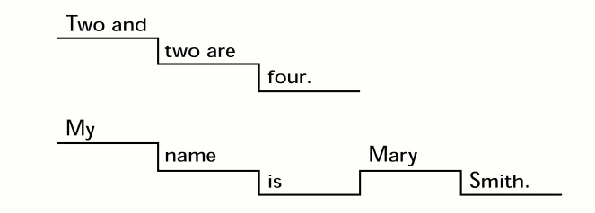
Intonation -3
English sentences move in a descending pattern
from higher pitch to lower pitch.

Slide 145


Ways to Teach Intonation Tone Shifts
Show where the tone shifts:
Draw a line to show the direction of pitch movement
Move your hand up and down with pitch shifts.

Slide 146
Ways to Teach Intonation Tone Shifts -2
Hum the sentence (or sing oo)
1. I don’t know.
2. Hello, how are you?

Slide 147
Elements in Teaching Pronunciation
1. How to produce individual sounds
2. How to hear the differences between sounds
3. Stress
4. Intonation

Slide 148
5. Rhythm
North American English has accents/beats that occur
at regular intervals.

Slide 149
Rhythm - 2
   
Yesterday was Wednesday, tomorrow’s Friday.
Yesterday was Wednesday, on Thursday I’ll go home.

Slide 150
Jazz Chant
A
Hello, how are you?
I’m fine.
Got to go.
(Gotta go)
Bye.
B
Fine, thank you. And you?
I’m glad.
See you
(Seeya)
Bye.

Slide 151
Elements in Teaching Pronunciation
1. How to produce individual sounds
2. How to hear the differences between sounds
3. Stress
4. Intonation
5. Rhythm

Slide 152
6. Phrasing
North American English blends words together in “thought groups.”
The Lord is my shepherd,
I shall not want;
He makes me lie down in green pastures.

Slide 153
Phrasing-2
The thought group is said in one breath
We link words together in the thought group
The Lord is my shepherd
I shall not want;
He makes me lie down in green pastures.

Slide 154
7. Reduced/Relaxed Speech
Standard speech becomes
1. He is here.
2. What are you doing?
Hez here.
Whaddaya doin’?
Or
Whatcha doin’?

Slide 155
Elements in Teaching Pronunciation
1. How to produce individual sounds
How to hear the differences between sounds
3. Rhythm
4. Stress
Intonation
6. Phrasing
7. Reduced/relaxed speech

Slide 156
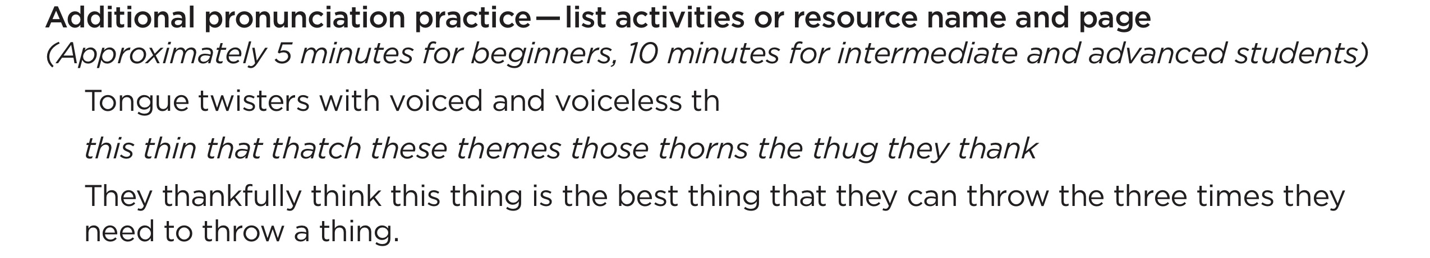
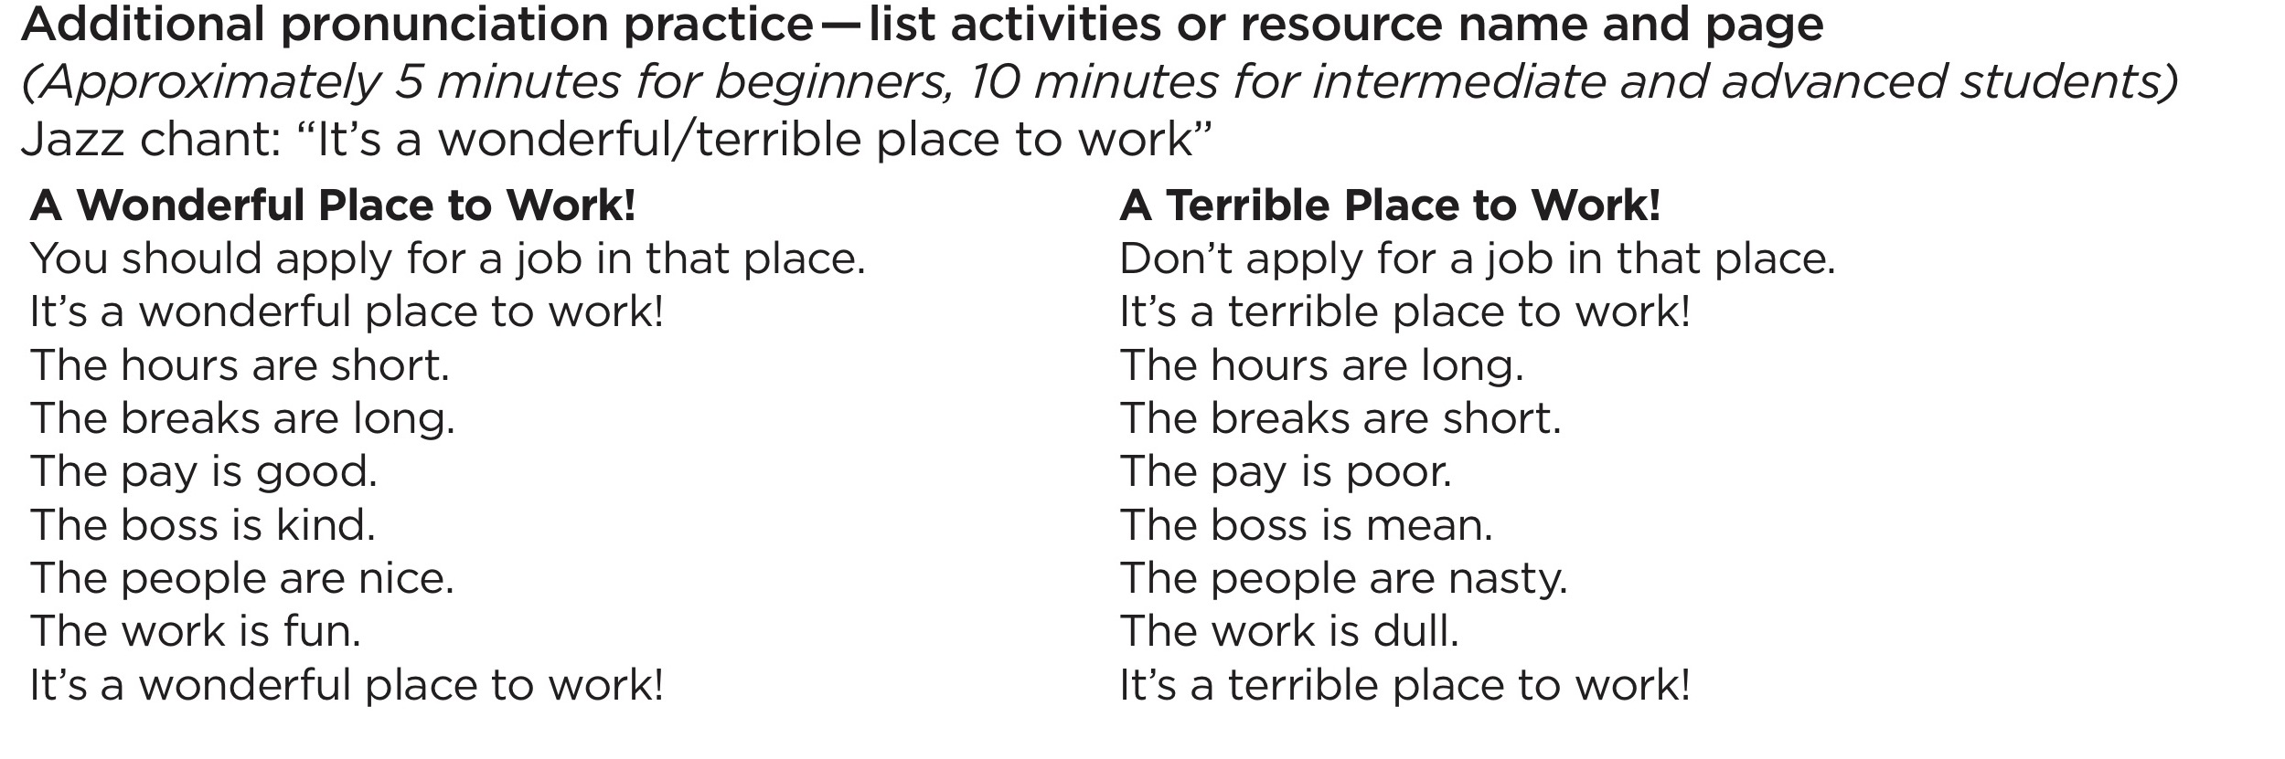
Beginner
Intermediate
Advanced

Slide 157
Complete the Lesson Plan- Additional Pronunciation
Activity 1
Create a minimal pair exercise (TELL, pp. 100-101)
Choose one sound.
/e/ or /i/
/b/ or /v/
/d/ or /dge/
Choose one type of minimal pair exercise.
List the words you will use for the exercise.

Slide 158
Complete the Lesson Plan-Additional Pronunciation -2
Activity 2 - Samples
Counting Syllables
1. Demonstrate how to count syllables in a word.
2. Ask students, How many syllables are in _____? (bowl, oven, microwave, cabinet, toaster, plate)

Slide 159
Chapter 8 Communication Practice Activities

Slide 160

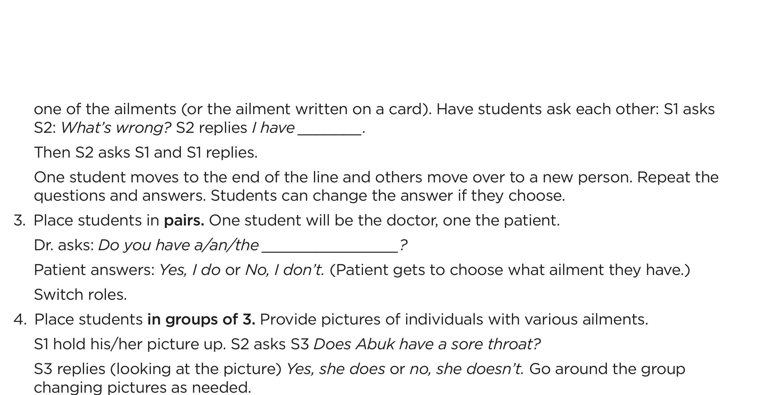
Communication Practice Activities

Slide 161
Communication Practice Activities
Structured activities to help the students have a reason to intentionally generate English language sentences using the new vocabulary.

Slide 162
Communication Practice Activities -2
The teacher
• Demonstrates activity.
• Circulates verifying groups understand the task and are using English.
• Doesn’t correct errors during the activity.
Complete accuracy is not the objective.
Generating meaning in English is.

Slide 163
Communication Practice Activities -3
Student Groupings:
Work in pairs or groups of 3 or 4.
Change up groupings for each activity.
See multiple ways to determine who is in each group TELL p. 119.
You can keep the same activity and change groupings.

Slide 164
Types of Communication Practice Activities
Role Play
Games
Interviews
Information Gap
Describing/discussing pictures

Slide 165
Types of Communication Practice Activities -2
Story telling
Combining pictures and storytelling (Lipson Method)
Discussion
Debate
Problem Solving

Slide 166
Communication Practice Activity - Role Play
Person 1 – asks “What’s wrong?”
Person 2 – answers
Person 2- asks “What’s wrong?”
Person 1- answers

Slide 167
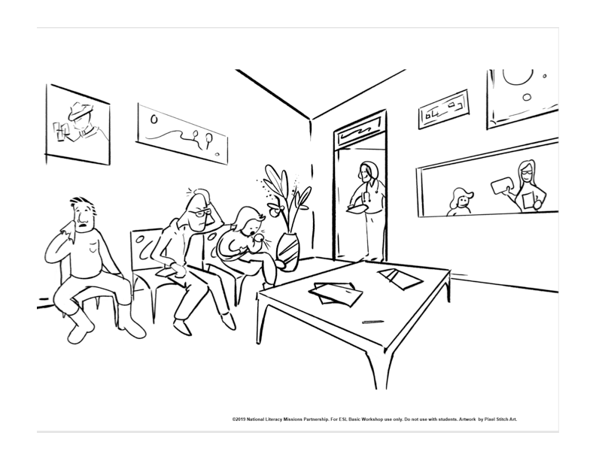

Slide 168
Communication Practice Activity - Games
1. Each person select an illness.
2. Person 1 ask your partner a question that can be answered YES or NO. Guess which illness your partner chose.
3. Person 2 ask your partner a question that can be
answered by YES or NO. Guess which illness your partner chose.
Answer in complete sentences, not just a single word.
Does your head hurt?
No, my head doesn’t hurt.

Slide 170
Communication Practice Activity - Interviews
Factual – name and address
Experiential – Have you ever..? (eaten squid?, climbed a mountain, ridden a Ferris wheel, etc.)
Opinions/preferences
Do you like…? (broccoli soup? camping? watching football?)
Do you prefer A or B? (fish or chicken? tea or coffee?) Why?

Slide 171
Interviewing all or a portion of the class
Popular forms – Have you ever…? (walked to work? won a contest? )
Do you…? (eat breakfast? talk to your neighbors?)
Find someone who…(has worked in a restaurant. likes to pull weeds. can run a mile.)

Slide 172
Group Interview Directions
Interview 2 participants. Alternate asking questions.
Ask the first person 1 question from item 1.
Ask the second person 1 question from item 2.
Ask complete questions: Have you ever eaten squid?
Answer in complete sentences. Yes, I have eaten squid.

Slide 173
Communication Practice Activity Interviews-facing lines
Where did you live when you were 8 years old?
What was your favorite toy?
Who did you play with?

Slide 174
Communication Practice Activities Information Gap
Pairs have handouts that have similar information on them.
Each handout is missing a portion of the information.
Students must ask their partner questions to get the missing information.

Slide 175
Communication Practice Activity Information Gap directions
Partner 1: asks for information to complete one of his blanks
Partner 2: answers
Partner 2 : asks for information to complete one of his blanks
Partner 1: answers

Slide 176
Communication Practice Activity Describing/discussing Pictures-Basic
What do you see? Each person name 1 item
What happened? Each person name 1 thing
What will happen next? Each person name 1 possibility

Slide 177
Communication Practice Activity Describing/discussing Pictures-More complex
What time of day is it?
Why do you think so?
What is the man thinking?”
Would you like to work there?
Why or why not?

Slide 178
Communication Practice Activity Compare and Contrast Pictures
Find differences
between two very similar pictures.

Slide 179
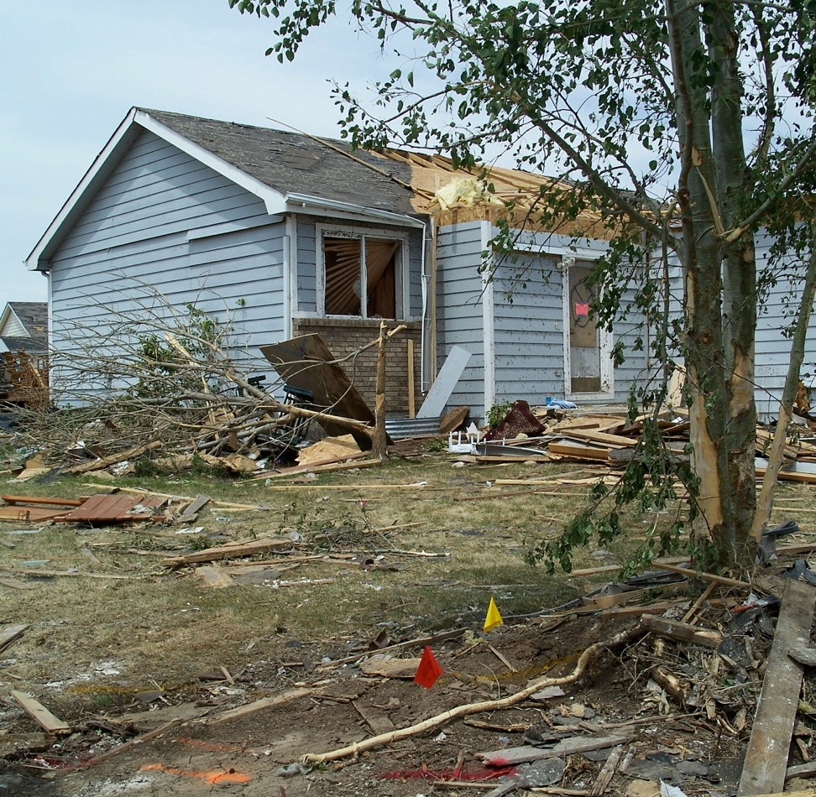
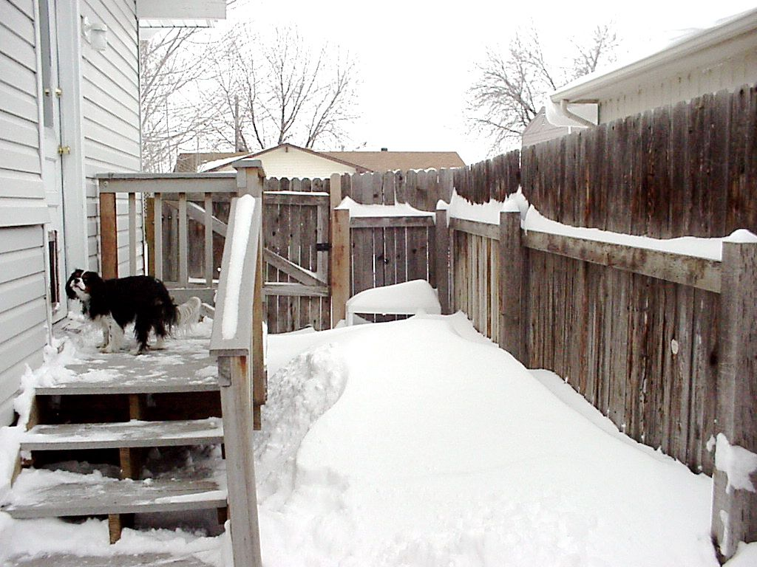
Compare and Contrast two very different pictures
Picture A
Picture B
Photo Credit: Claudean Boatman. © 2008 Used by permission

Slide 180
Communication Practice Activity - Storytelling
The Doctor’s Waiting Room
Partner 1 begins: I went to the doctor. In the waiting room I saw a man. I said, “Excuse me...”
Partner 1 completes the sentence using a question and answer .
Each remaining partner repeats what has been said and adds a sentence, using new question and answer.
Each partner retells the story.

Slide 181
Communication Practice Activity Story
What’s wrong?
I have
She has
He has
We have
They have
I went to the doctor. In the waiting room I saw a man. I said, “Excuse me...”

Slide 182
Combining Pictures and Storytelling Lipson Method
Write story in simple, subject-verb-object sentences.
Make simple line drawings with stick figures to illustrate main ideas of story.
Use pictures to help the student learn, remember, and retell the story.

Slide 183
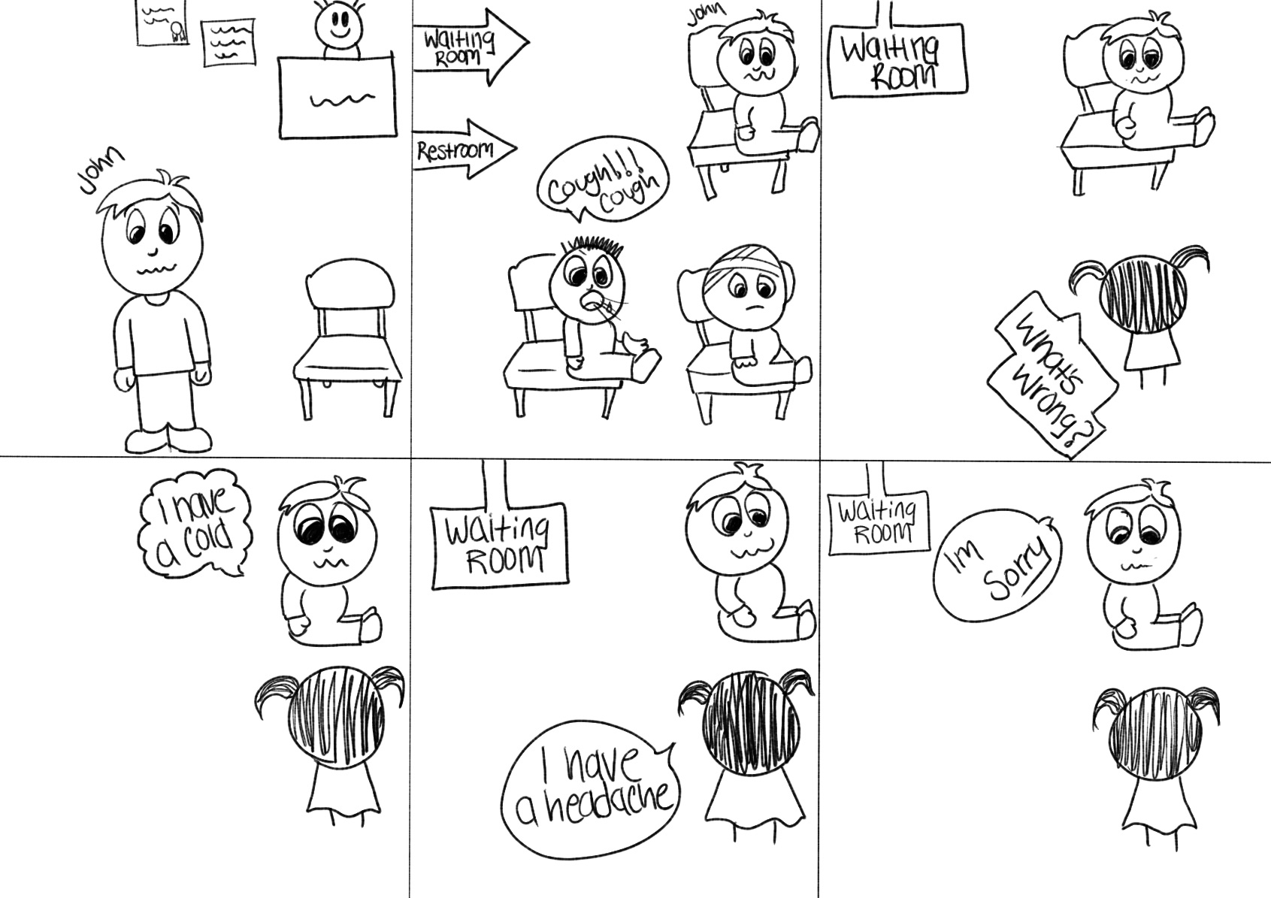

Slide 184
Lipson Method
Ask students to retell the story.
Ask life application questions.
Why do you think John was sorry?
What do you do when you have a cold? Why?
What illnesses have you had?
Do you go to the doctor when you are sick? Why?

Slide 185
Communication Practice Activities - Discussion
Pairs or small groups discuss assigned topics.
Discuss the assigned proverb.
What do you think it means?
What cultural value does it teach?
Is there a proverb in your country that means the same thing?
The grass is always greener on the other side of the fence.
You reap what you sow.
Man does not live by bread alone.
A bird in the hand is worth two in the bush.

Slide 186
Communication Practice Activity - Debate
Individuals or small groups present different view points
on a subject.
Your friend Rachel, a college student, has to choose a major. She wants to be a writer. She has won awards for her poetry.
But her parents would like her to become a teacher so she can have a steady income.

Slide 187
Communication Practice Activity - Debate-2
Each pair write two sentences supporting your point of view. Use the two assigned idioms in your sentences.
Pair 1. Rachel should pursue her poetry.
black and white and fine line
Pair 2. Rachel should get a teaching degree.
right under their/her nose and see things in a whole new light

Slide 188
Communication Practice Activity - Problem Solving
Groups work together to solve a problem.
Example:
A friend of yours has just come to the United States.
Make a list of 4 problems he will face.
Suggest one way he could solve each problem.

Slide 189
Types of Communication Practice Activities
Role play
Games
Interviews
Information gap
Describing/discussing pictures

Slide 190
Types of Communication Practice Activities
Storytelliing
Combining pictures and story telling (Lipson Method)
Discussion
Debate
Problem Solving

Slide 191
Communication Practice Activity Sampler
36 Communication Practice Activities are outlined giving:
Fluency level
Materials needed
Procedures

Slide 192
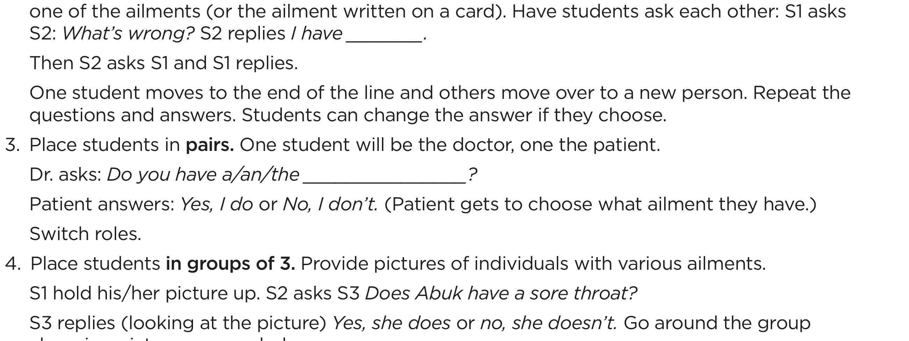
Planning Communication Practice Activities
Estimate the time an activity will take.
Plan more activities than you think you need.
You don’t have to use every activity you planned.
Place participants in pairs/groups before you give teaching directions.

Slide 193
Complete Lesson Plan Communication Practice Section
1. Identify activities in the manual appropriate for beginning students.
2. Each person chooses 3 activities appropriate for beginners.
3. Each person writes
the 3 activity titles on the lesson plan form
the TELL page number
whether the activity is for pairs, groups of 3-4, etc.
estimate the time for the activity.

Slide 194
Chapter 9 Working with and Planning for Advanced Students

Slide 195
Characteristics of Advanced Students
Converse easily
Need help with
Vocabulary expansion
Sentence structure
Idioms and slang expressions
Pronunciation
Writing skills

Slide 196
Characteristics of Advanced Students-2
Want to learn more about culture, history, literature
May be preparing to take TOEFL exam
Seeking North American friends

Slide 197
Ministries Targeting Advanced Students
Classes with a single theme
North American Idioms and Slang
North American Culture
Review of Basic English Grammar
Academic English
Conversation Corner (free discussion)

Slide 198
Materials for Advanced Students
Newspaper
Idiom texts
Conversation/discussion texts
Specialized texts (Pronunciation, job specific, TOEFL, citizenship)
Student reports/presentations

Slide 199
Preparing Advanced Lessons
Starting Point
Usually not from a text book but alternative materials
Top Box of Lesson Plan
Same procedure as used with Beginners and Intermediates
Greetings Scripture and Prayer
Same procedure as used with Beginners and Intermediates

Slide 200
Preparing Advanced Lessons
Introduce vocabulary:
Repetition is still necessary
CHANGE – Advanced students define words
CHANGE – Advanced students give synonyms and antonyms
observed

Slide 201
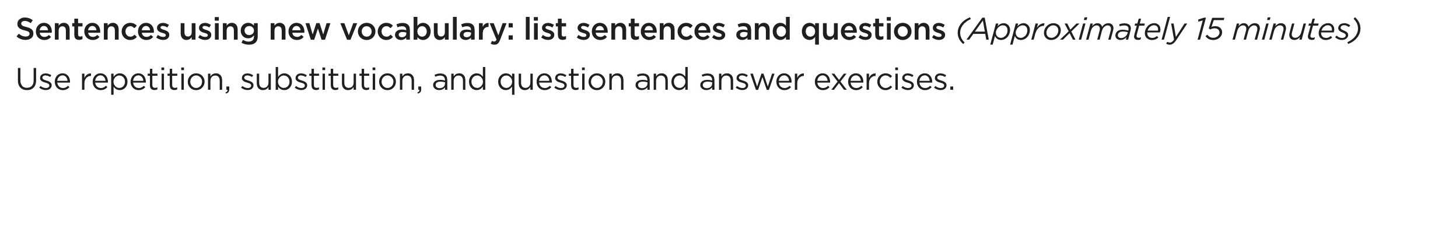
Preparing Advanced Lessons
Sentences using new vocabulary
CHANGE – Advanced students create the sentences
Dictation
Substitution Drill

Slide 202

Preparing Advanced Lessons
Sentences using new vocabulary
CHANGE– Advanced students create the question and answers
Ask a question using the word observed.
Answer a question using the word observed.
Chain Drill – conducted as with beginner and intermediate

Slide 203
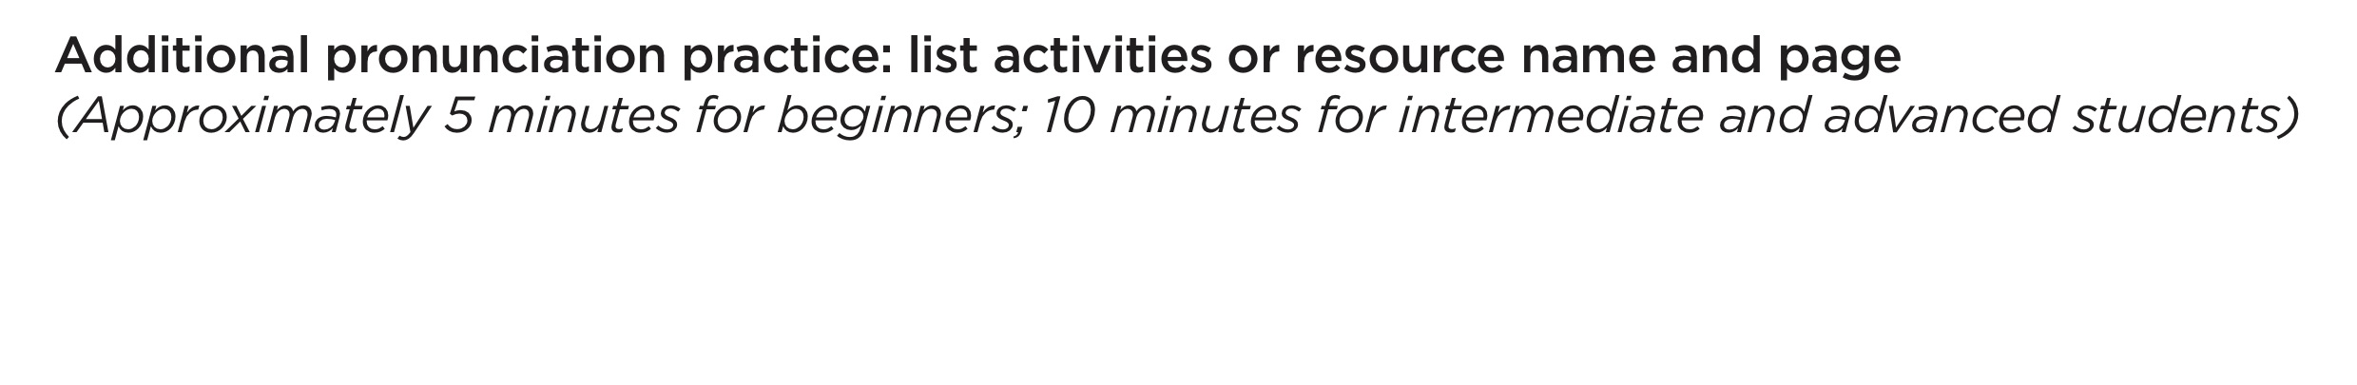
Preparing Advanced Lessons - Pronunciation
Additional Pronunciation Practice
Can be longer
Work on more complex rhythm and stress, phrasing, reduced/relaxed speech

Slide 204
Reduced/relaxed speech practice Could have
Present rule and practice pronunciation
A. Could have + word that begins with a consonant = kuda
Written: You could have gone with me.
Spoken: You kuda gone with me.
B. Could have + word that begins with a vowel = kudav
Written: I could have eaten the whole thing.
Spoken: I kudav eaten the whole thing.

Slide 205
Reduced/relaxed speech practice
I could have had rice. (kuda)
I could have opened the door (kudav)
Sample Pronunciation Practice Exercise
Place students in pairs. Distribute page with 8 sentences using could have.
Partners alternate reading the sentences.
Each partner will write and then read a sentence using could have.

Slide 206
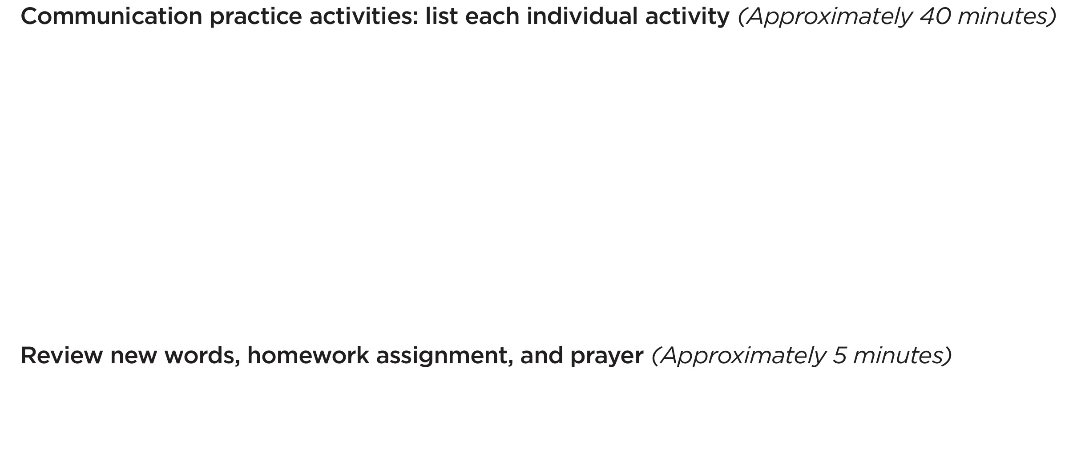
Preparing Advanced Lessons Communication Practice & Review Section
Communication Practice - select from all ten communication practice activities
Review, homework and prayer – use same procedure as used with Beginners and Intermediates

Slide 207

Chapter 10 Dealing with Cultural Misunderstandings

Slide 208
What is culture?

Slide 209



Culture and Language are Intertwined
That’s par for the course
The ball’s in your court
They’re running neck and neck

Slide 210

Culture and Religion Are Intertwined
If you are from Thailand, it is assumed you are Buddhist
If you are from Saudi Arabia, it is assumed you are Muslim
If you are from Mexico, it is assumed you are Catholic

Slide 211
Culture and Values Are Intertwined
Culture shapes…
What is proper or improper behavior
What you can do or cannot do
What you can say or not say
Who you can say it to
When you can say it
What is of value and what is not

Slide 212
Most Frequent Cause of Misunderstandings
Misattribution
Attributing meaning or motive to someone’s behavior based upon your own culture or experience

Slide 213
Your Cultural Framework Affects Your Relationships
We judge people based on your cultural assumptions of what is right and wrong
We emotionally respond and react to behaviors that conflict with what your culture has taught you

Slide 214
Culture Clash
A. What did the teacher think about the student?
B. What did the student think about the teacher?
Both partners- What USA cultural value was violated?

Slide 215
Did you include
Always late
Runs on (fill in the country) time
Impatient
Rude
Inconsiderate
Undependable
Untrustworthy
Wasted my time
Didn’t care about me
Didn’t care about the classes

Slide 216
Nonverbal Cultural Considerations
Gestures
Personal space
Touching
Eye contact

Slide 217
Ways to Deal with Cultural Misunderstandings
Be aware of your own cultural values and attitudes.

Slide 218
Matching Cultural Values Answers
1 – F 7- K
2 – D 8 - I
3 – B 9 - J
4 – E 10 -L
5 – C 11- G
6 – A 12- H

Slide 219
Some Negative Responses to North American Cultural Values
Independence: cold, aloof
Self-reliance: not strongly committed to family
Individual identity: too focused on self and not others
Time conscious: impatient, slaves to the clock
Task centered: more concerned about things than people
Focused on achievement: materialistic

Slide 220
Some Negative Responses to North American Cultural Values -2
Action Oriented: unable to relax
Competitive: constant emotional strain and pressure to win
Future oriented: don’t value the past and tradition don’t show proper respect for parents and elderly
Equality: only given lip service, people are not treated equally
Informality: not respectful of others, superficial relationships
Direct in your communication: pushy, assertive

Slide 221
Ways to Deal with Cultural Misunderstandings -2
Don’t attribute meaning or motive to your student’s behavior based on your own cultural values.
When your student’s actions or conduct offend your cultural values suspend negative character judgments.

Slide 222
Ways to Deal with Cultural Misunderstandings -3
Teach your students North American cultural values, attitudes and non-verbal communication.

Slide 223
Ways to Deal with Cultural Misunderstandings -4
Learn about and respect your students’ cultures.
Read books and articles
Ask your student and international friends

Slide 224
Ways to Deal with Cultural Misunderstandings -5
Show grace and Christian love (1 Corinthians 13:4-8)
Kind and patient
Slow to anger
Doesn’t keep a record of wrongs
Never rude
Always supportive
Always loyal
Always hopeful
Always trusting

Slide 225
The Gospel Transcends Culture
For the Scripture says, Everyone who believes on him will not be put to shame, since there is no distinction between Jew and Greek, because the same Lord of all richly blesses all who call on him. (Rom. 10:11-12, CSB)

Slide 226
Chapter 11 Incorporating Biblical Materials in Your Classes

Slide 227
Why Incorporate Biblical Materials?
To present the gospel of Jesus Christ: the goal of Literacy Missions Ministry

Slide 228
Full Group Time
Posters, wall displays
Songs and Music
Devotionals

Slide 229
Small Individual Classes
Read and distribute verse each lesson
Use internet sites for Scriptures in multiple languages

Slide 230
New vocabulary and sentences using new vocabulary
garden – The first garden was the Garden of Eden.
Good Samaritan – A Good Samaritan helps people in trouble.
The handwriting’s on the wall.
You can’t take it with you.

Slide 231
Additional Pronunciation Practice
Listening exercises using Christian materials- songs, stories
Christian jazz chants

Slide 232
Jazz Chant based on Philippians 1:3
A B
Every time Every time
Every time I think of you. Every time I think of you.
I thank the Lord. I thank the Lord.
Every time I think of you. I thank the Lord.
I thank the Lord. Every time I think of you.
A and B Together
Every time I think of you.
I thank the Lord.
Every time I think of you.
I thank the Lord.

Slide 233
Communication Practice Activities
Teach and discuss Biblical proverbs
“Kind words are like honey- they cheer you up and make you feel strong.” (Proverbs 16:24 CEV)
Role Play being a “Good Samaritan”
Discuss: If you saw someone who needed help would you stop to help? Why or why not?

Slide 234
Full session on Biblical material
Create your own English lesson using a single Bible story
Create a lesson using resources that provide ideas and materials for using the Bible with ESL students

Slide 235
English Lessons From the Bible: The Book of Mark
• Sequentially presented passages from the Book of Mark used as basis for ESL instruction
• Available for free download at https://www.sendrelief.org/projects/esl-classes and for purchase through Fed Ex
• Target group – high beginners/intermediate
• Uses the Lipson Method to help the student remember and tell the story

Slide 236
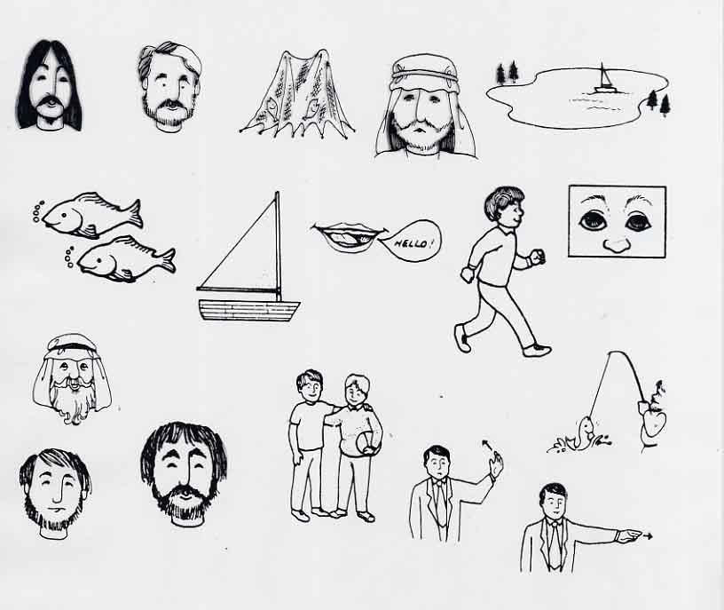
TELL p. 155

Slide 237
ELB Information in the Appendices
• Overview of ELB: TELL p.160
• Sample Lesson Plan: TELL pp.161-163
• Sample ELB pages: TELL pp.164-172
• Reference charts for lesson planning : TELL pp. 173-177

Slide 238
With forethought and planning
you can and should
incorporate Biblical materials
into your classes.

Slide 239
Chapter 12 Sharing Your Faith with Your Students

Slide 240
The Purpose of an ESL Ministry is…
To share the gospel of Jesus Christ as you meet the needs of people who need to learn to speak English.
Commit to yourself and God that you will share
your own experience with Christ with your students.

Slide 241
Prepare through Prayer
• Pray Personally
• Enlist prayer supporters
• Pray silently during class
• Pray aloud during class

Slide 242
Prepare to tell your own experience with Christ
Short
Simple, clear language
Avoid church jargon
Positive
Current
Adequate details of why you needed Christ and how you accepted Him
Practice writing your testimony

Slide 243
Preparing Your Testimony
• Read TELL pp. 175-176
How to become a Christian and Scriptures to Keep in Mind
• Review TELL pp. 181-182
Witnessing Word Chart and Personal Testimony Outline suggestions
• Write TELL p. 183
Personal Testimony Outline

Slide 244
Practice Sharing Your Faith
Partner A – share Partner B – share
Partner B – give feedback Partner A – give feedback
1. Did the presenter use church jargon?
2. Do you know why the presenter needed to acknowledge Christ as Lord?
3. Do you know what the presenter did to acknowledge Christ as Lord?
4. Do you know how Christ is working in the presenter’s life today?

Slide 245
Things to Keep In Mind When Sharing Your Faith
• Be prepared at any opportunity
• Vary your witness
• Find out what your student believes about Jesus
• Learn about your student’s faith
Comparison charts TELL pp. 190-195

Slide 246
Things to Keep In Mind When Sharing Your Faith-2
• Don’t tear down someone’s religion
• Simply share what Christ has done for you, your joy and peace through Him
• Be open to questions

Slide 247
Christian Concepts Difficult for Some Internationals
There is one and only one God
God is a loving God concerned for the well-being of each individual
Man can’t earn a right relationship with God
Personal faith in Jesus Christ is the only way to have a right relationship with God

Slide 248
Be prepared to wait for results
• Many students will consider becoming a Christian very cautiously
• Our job is to share what Christ has done in our lives
• The Holy Spirit does the wooing, leading and convicting

Slide 249
Creating Opportunities to talk about Spiritual Matters
Every time you meet with your student
• Give God credit for His creation
• Cultivate a thankful spirit
• Call upon God in times of difficulty, doubt, and crisis

Slide 250
Creating Opportunities to talk about Spiritual Matters -2
Visit students outside of class
• Visit in their home or invite them to yours
• Visit during times of crisis or celebration

Slide 251
Other ways you Demonstrate your Faith
Christ shows through your attitudes and how you interact with your student

Slide 252
If Your Student Expresses a Desire to Become a Christian
Ask questions
• In simple language the student can understand
• That can’t be answered with “yes” or “no”
• That clarify the student’s understanding
- Why do you want to become a Christian?
- How will becoming a Christian change you?
- What do you think about your relationship with Jesus?

Slide 253
If Your Student Expresses a Desire to Become a Christian -2
• Use Scripture
• Lead the student in a prayer of repentance
• Talk about the role of baptism
• Help the student begin the road of discipleship

Slide 254
Above all, YOUR STUDENTS NEED TO BE LOVED.
If they know YOU love them,
they will be more open
to hearing and responding
to the message
that GOD loves them.

Slide 255
Literacy Missions Prayer

