Slide 1

English as a Second Language Basic Workshop

Slide 2
Three Literacy Missions Ministries
Adult Reading and Writing
Tutoring Children and Youth
English as a Second Language

Slide 3
English as a Second Language Workshop Overview
Learning and teaching a foreign language
How to teach new vocabulary
How to teach pronunciation
How to help students practice creating English language sentences
How to use the English Lessons from the Bible curriculum
Sharing your faith with your student

Slide 4
Introductions
Get with a partner you don’t know
Interview your partner
What is your name?
In what city were you born?
Where do you live now?
What church do you belong to
Why did you come to this workshop? ( one sentence answer)

Slide 5
Chapter 4 Learning and Teaching a Foreign Language
🤔

Slide 6
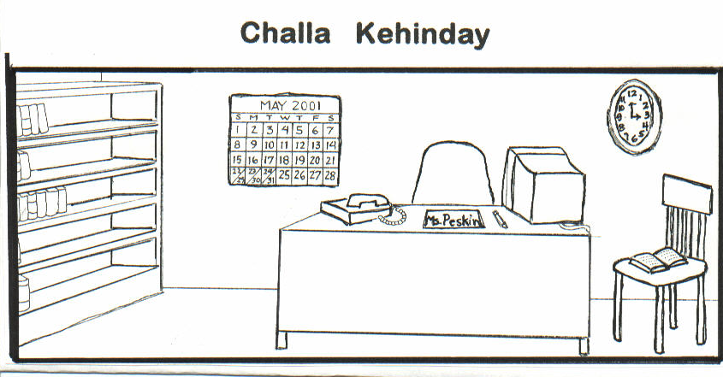
goota__ alay__ yoma__ lameechga__ etoomba__

Slide 7
Challa Kehinday
1.
2.
3.
4.
5.
goota
alay
yoma
lameechga
etoomba

Slide 8
Chapter 6 Introducing New Vocabulary

Slide 9
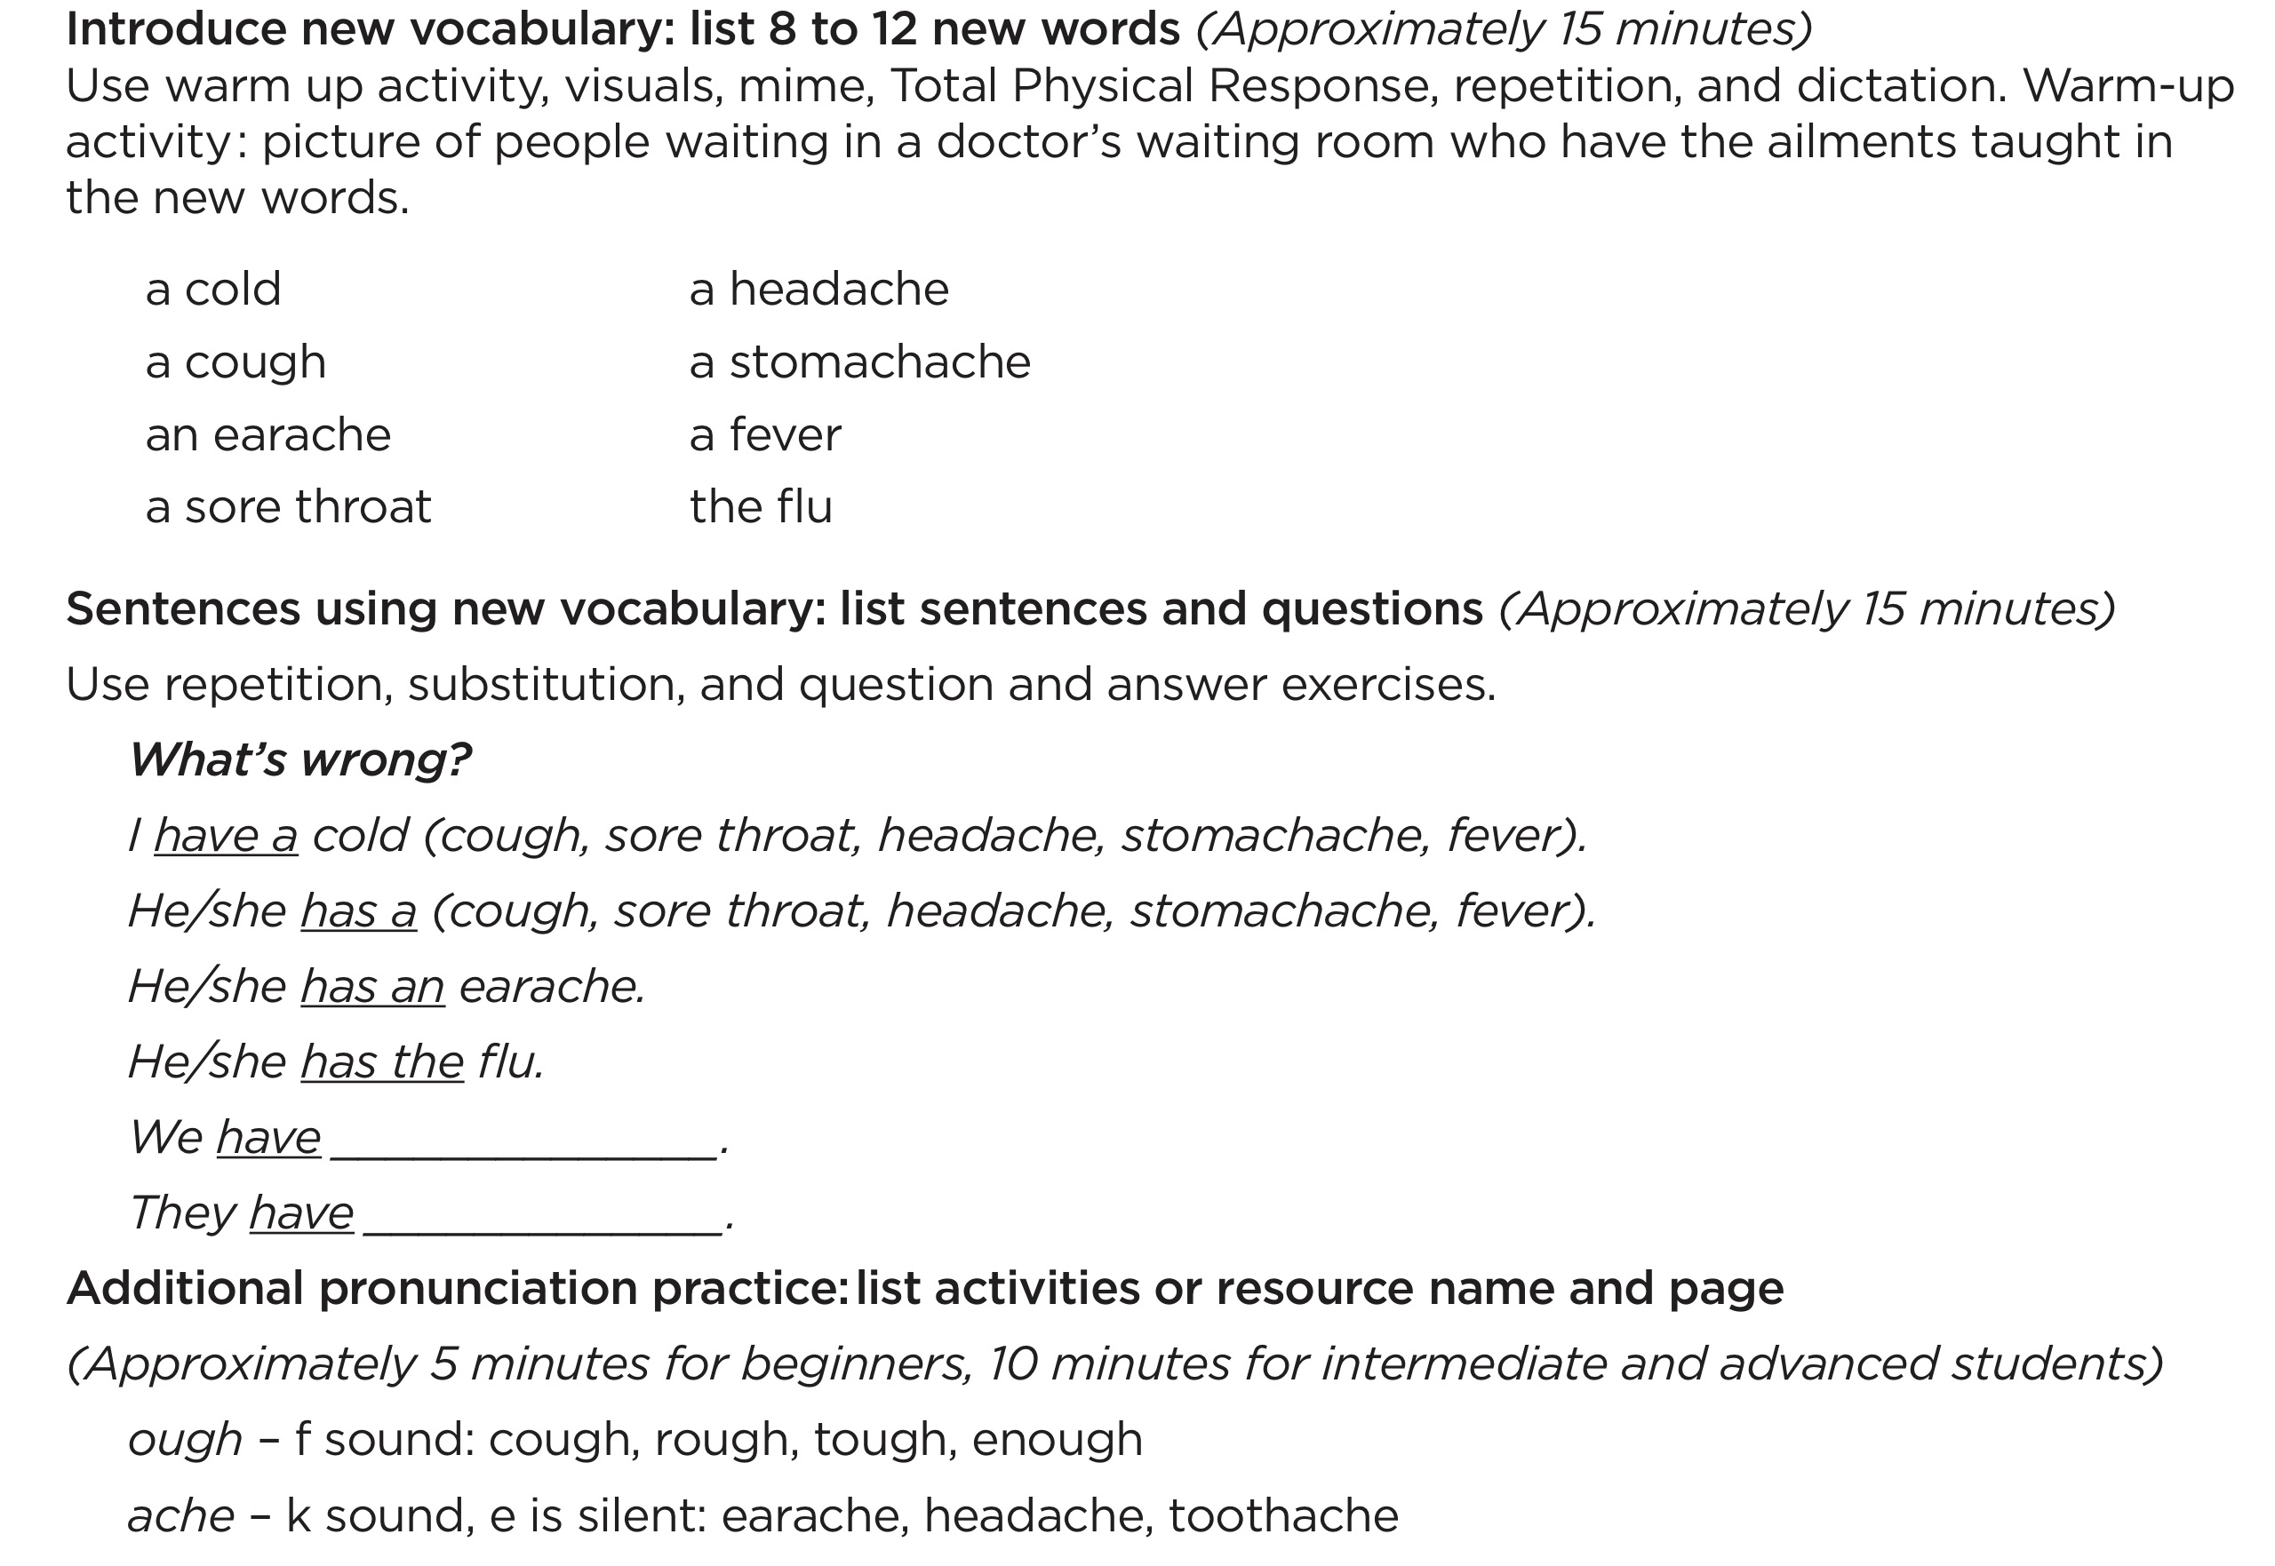
ESL Lesson Plan Section

Slide 10
The Lesson Plan Begins with Guided Practice
• Teacher introduces new material in a structured manner
• Students respond with set predictable responses
• Laying the foundation for the 2nd half of the lesson- structured activities where the student’s communication is spontaneous

Slide 11
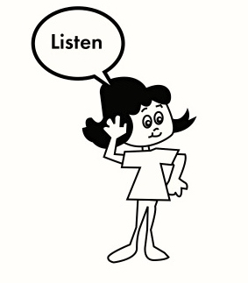
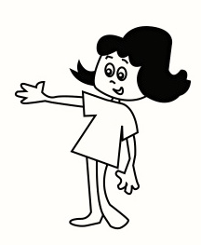
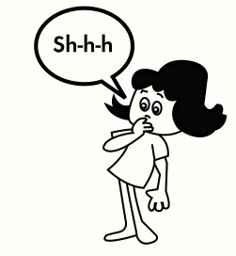

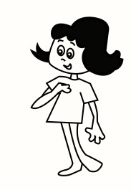
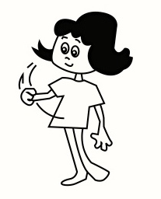
Hand Gestures
1. Listen
4. Teacher points to class
“Ready” verbal cue
Shhhh
3. Teacher points to self
6. Students speak/respond

Slide 12
Basic Teaching Drills for Introducing New Vocabulary
Total Physical Response (TPR)
Repetition
Dictation

Slide 13
Total Physical Response Procedure
1. T says vocabulary word several times, shows picture, places picture where all students can see it. (Repeats until all the vocabulary words are displayed)
Ss watch
2. T gives a command, then models action
Ss watch
3. T gives command, then models action –
Gestures for students to do the action.
T and Ss do action together, but Ss. don’t speak
4. T gives command, but does NOT do action
Ss do action but don’t speak

Slide 14
Total Physical Response - practice
1. Hold up picture and say the word 5 times – put it on the wall or lay it on the table. (Repeat with all pictures.)
2. Say point to… for a picture. Do the action. (Repeat with all pictures.)
3. Say point to… for a picture. (Gesture for students to do it with you. Repeat for all pictures.)
4. Say “point to … and gesture for students to do the action but teacher does not do the action. (Repeat for all pictures.)

Slide 15
Repetition – Words Procedure
3.
T Ready?
Ss listen
4.
T (gestures to self) says word
T gestures students to respond
Ss repeat word
1.
T says word 5 times
Ss listen
2.
T (gestures to self) says word
T (gestures to Ss.) says word
Ss listen

Slide 16
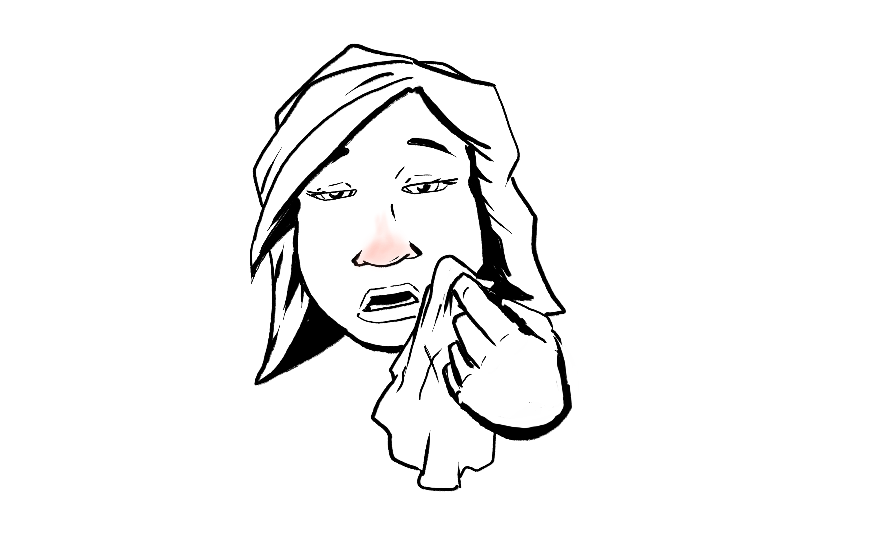
Repetition- practice
1. T: (Repeat 5 times) a cold
2. T: (gestures to self) a cold
(gestures to Ss.) a cold
3. T: Ready?
4. T: (gestures to self) a cold
Gesture students to respond
Ss: a cold

Slide 17
Dictation Drill Procedure
T writes words in numbered list form.
T indicates that Ss. should copy the words Ss Write the numbered words
T Points to a number, says the number; Points to the word and says it
Ss Repeat the number and the word (Do this for all numbers and words)
T (gestures to self) says a word out of sequence
T (gestures to Ss) says the corresponding number
Ss listen (Repeat this word/number sequence with a different word/number.)
T Ready?
T says word out of sequence (Does NOT point to it)
Ss Respond with corresponding number (Repeat with all words)
Reverses what was done in Step 4; say number and Ss respond with word.
T asks Ss to write numbers, then dictates words in random order for Ss to write.

Slide 18
Review: Basic Drills for Teaching New Vocabulary
Total Physical Response (TPR) – students do not speak, but perform actions to show comprehension of new words
Repetition (words) – students practice saying the new words
Dictation – students practice reading and writing the new words

Slide 19
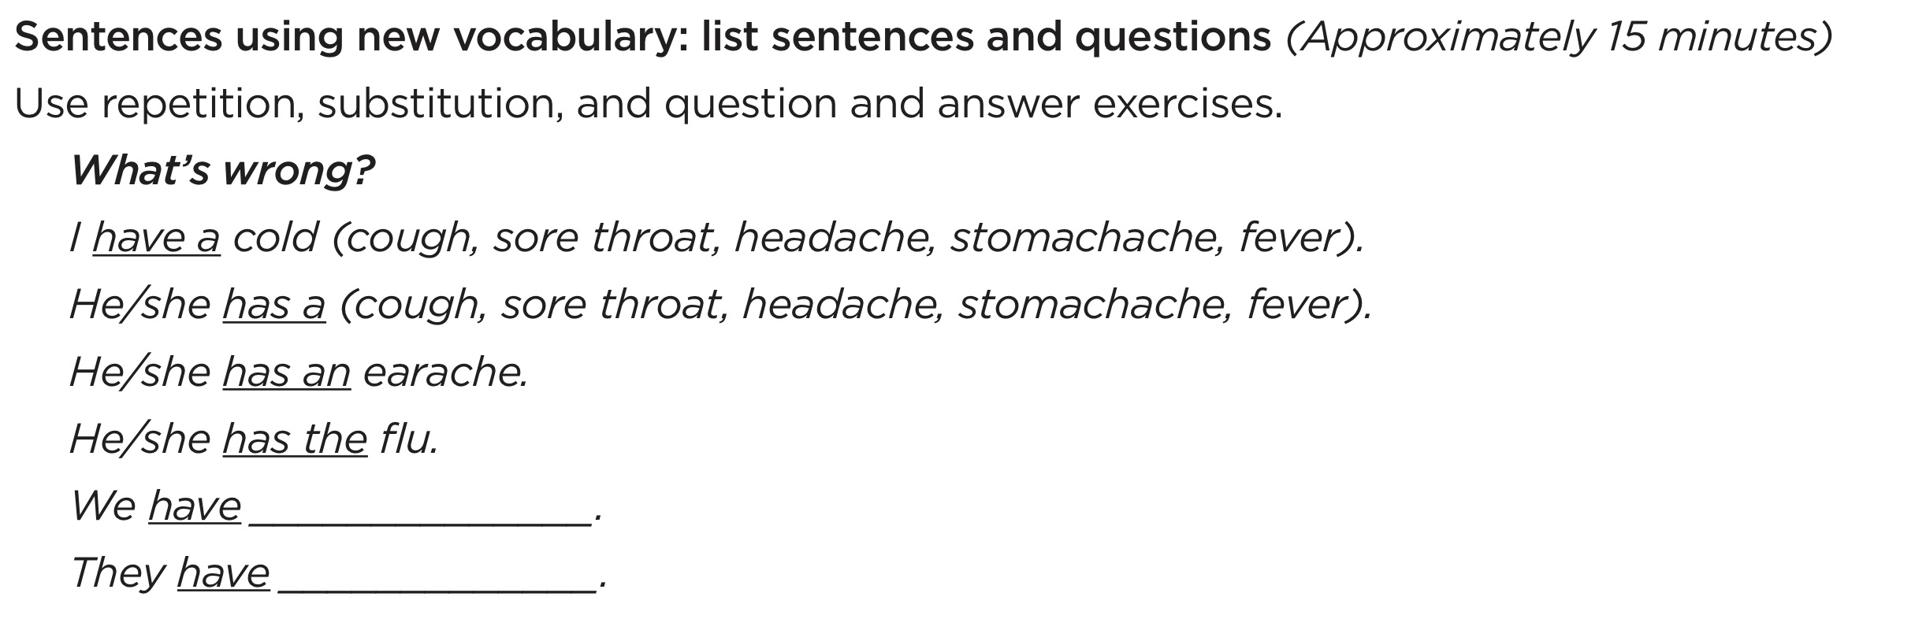
ESL Lesson Plan Section Sentences using new vocabulary words

Slide 20
Basic Teaching Drills for Using New Vocabulary in Sentences
Repetition of Sentences
Substitution
Question/Answer
Chain Drill

Slide 21
Repetition – sentence using new word
1.Set the pattern – say sentence for each picture.
2.
T says the sentence 2 or 3 times
Ss listen
3.
T (gestures to self) says the sentence
T (gestures to Ss.) says the sentence
Ss listen
4.
T Ready?
Ss Listen
5.
T (gestures to self) says the sentence
T Gestures for students to respond.
Ss repeat sentence
Repeat step 5 three times.

Slide 22
Repetition of Sentences - Practice
I have a cold
I have a cough
I have a headache.
1. Set the pattern.
2. T: I have a cold. (Repeat 3 times.)
3. T: (gestures to self) I have a cold.
(gestures to Ss.) I have a cold.
4. T: Ready?
5. T: (gestures to self) I have a cold.
T: Gesture for students to respond.
Repeat step 5 three times.

Slide 23
Substitution
1. Set the Pattern
T (gestures to self) – says word
T (gestures to Ss.) – says sentence using the word
Ss listen
T (gestures to self) – says another word
T (gestures to Ss.) – says sentence using that word
Ss listen
This sets the pattern.
2.
T Ready?
Ss listen
3.
T (gestures to self) - says word
T gestures students to respond
Ss say whole sentence
Repeat Step 3 with all words.

Slide 24
Substitution - practice
1. T (gestures to self) a cough
T (gestures to Ss) I have a cough.
T (gestures to self) a headache
T (gestures to Ss) I have a headache.
T (gestures to self) a cold
T (gestures to Ss) I have a cold.
2. T Ready?
3. T (gestures to self) a cough
Gestures for students to respond.
Repeat Step 3 with a headache and a cold.

Slide 25
Question/Answer Drill – Part 1
1. Set the pattern.
T (holds ? Card and one picture) asks question.
T (flips to . side) answers question.
Ss listen.
Repeat with 2 or 3 different words (pictures).
2. T (gestures to self) asks question
T (gestures to Ss) answers question
Ss listen
Repeat Step 2 with a different word.
3. T Ready?
4. T (gestures to self) asks question.
T gestures to Ss and Ss answer.
Repeat Step 4 with all words.

Slide 26
Question Answer Drill—Part 1- practice
2. T (gestures to self) What’s wrong?
T (gestures to Ss) I have a cold.
3. T Ready?
4. T What’s wrong?
Gesture for students to respond.
Ss I have a cold.
Repeat Step 4 with a headache and a cough
1. Set the pattern:
Use pictures and ? and . card to do the following:
What’s wrong?
I have a cold.
What’s wrong?
I have a headache. What’s wrong?
I have a cough.

Slide 27
Question/Answer Drill—Part 2
1. T: (gestures to Ss)—asks question
T: (gestures to self)—gives answer
Ss: Listens
Repeat Step 1 with a different picture.
2. T: Ready?
3. T: gestures for students to ask question
Ss: ask question
T: answers question
Repeat Step 3 with all words.

Slide 28
Question Answer Drill—Part 2 practice
1. T (gestures to Ss) What’s wrong?
T (gestures to self) I have a cold.
T (gestures to Ss)What’s wrong?
T (gestures to self) I have a headache.
2. T Ready?
3. T Gesture for students to ask question.
Ss What’s wrong?
T (gestures to self) I have a cold.
Repeat Step 3 with a headache and a cough

Slide 29
Chain Drill
T (holds a picture) prompts S1 to ask question
S1 asks question
T Prompts S2 to answer
S2 answers
Move the chain.
T (holds a different picture) prompts S2 to ask question
S2 asks question
T Prompts S3 to answer
S3 answers
Continue the chain until all students have asked and answered at least once.

Slide 30
Chain Drill Demonstration
T Bill, ask Mary (T point to card and hold ?)
S1 What’s wrong?
T Mary, tell Bill (T point to card and hold .)
S2 I have a cold.
Change picture.
T Mary, ask Sam (T hold ?)
S2 What’s wrong?
T Sam, tell Mary (T hold .)

Slide 31
Practice Teaching Question/Answer Drill
1. Set the pattern: Use ? and . and picture cards.
T: (holds ? card and one picture) – asks question
T: (flips to . side) answers question
Ss: Listen
T: Repeat with 2 or 3 different words (pictures)
Part 1 – T Asks/Ss Answer
2. T (gestures to self) What’s wrong?
T (gestures to Ss) I have a cold.
Repeat Step 2 with another picture
3. T Ready?
4. T (gestures to self) What’s wrong?
T (gestures for Ss. to respond)
Repeat Step 4 with all words.
Part 2—Ss Asks/T answers
1. T (gestures to Ss) What’s wrong?
T (gestures to self) I have a cold.
Repeat Step 1 with another picture.
2. T Ready?
3. T (Gestures for Ss. to ask question)
T (Point to self – answers question)
Repeat Step 3 with all words.
Move into Chain Drill

Slide 32
Basic Teaching Drills
Total Physical Response
Repetition - words
Dictation
Repetition - sentences
Substitution
Question/Answer
Chain Drill

Slide 33
Preparing Advanced Lessons
Introduce vocabulary:
Repetition is still necessary
CHANGE – Advanced students define words
CHANGE – Advanced students give synonyms and antonyms
observed

Slide 34
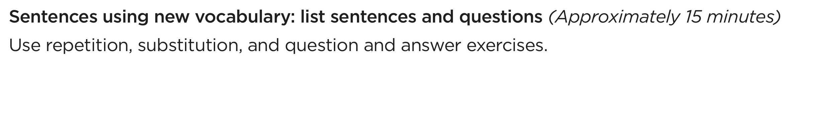
Preparing Advanced Lessons
Sentences using new vocabulary
Advanced students create the sentences
Dictation – sentences; can be done in pairs
Substitution Drill – use only with difficult words

Slide 35
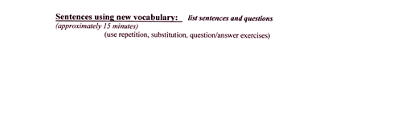
Preparing Advanced Lessons
Sentences using new vocabulary
Advanced students can create questions and answers
Ask a question using the word observed.
Answer a question using the word observed.
Chain Drill – conducted as with beginner and intermediate

Slide 36
Chapter 7 Teaching Pronunciation

Slide 37
Elements in Teaching Pronunciation
How to produce individual sounds
How to hear the differences between sounds
Stress
Intonation
Rhythm
Phrasing
Reduced/Relaxed Speech

Slide 38
1. How to Produce Individual Sounds
Factors in Production of a Speech Sound
1. Lip or jaw position
2. Tongue position
3. Flow of air
4. Vocal cords

Slide 39
Helps for teaching individual sounds
Descriptions of How to Produce the Sounds of English – TELL pp. 101-107
Teacher demonstrations
A hand mirror

Slide 40
2. How to Hear the Differences Between Sounds
Minimal Pairs
Beginning sound
pet - bet
Medial sound
staple - stable
Final sound
tap - tab

Slide 41
Minimal Pair Exercise Sequence
Teacher writes sample on board and models
Teacher presents example; student responds
Students present example; students respond

Slide 42
Minimal Pair Exercise 1
Same or Different
+ +  
bet - bet bet - pet

Slide 43
Minimal Pair Exercise 2
Which is Different? 1, 2, or 3
bet bet pet
1 2 3

Slide 44
Minimal Pair Exercise 3
How does it begin?
/b/ or /p/
pat bat
tab tap
How does it end?
/b/ or /p/
pat bat
tab tap

Slide 45
Minimal Pair Exercise 4
Which did I say ?
led or red

Slide 46
Elements in Teaching Pronunciation
1. How to produce individual sounds
2. How to hear the differences between sounds

Slide 47
3. STRESS
The stressed syllable in a word or the stressed word
in a sentence is
LOUDER
L –o – n – g – e –r
Higher Pitched
trans-por-TA-tion

Slide 48
Stress - 2
In individual words only 1 syllable is stressed
In Sentences
Content words are stressed
Structure and linking words are not

Slide 49
Stress - 3
Where stress is placed affects meaning and comprehension.
Conduct Conduct
Suspect Suspect
I didn’t say you were unorganized.

Slide 50
Ways to Show Stress in Words
Identify the number of syllables
trans-por-ta-tion
Show the stressed syllable
trans-por-TA-tion
Use a rubber band
THIR-ty thir-TEEN

Slide 51
Backward Buildup
tric
- LEC-tric
e-LECt-ric
eLECtric

Slide 52
Ways to Show Stress in Sentences
1.Underline content words
Nouns
Verbs
Adjectives
Adverbs
Question words
My grandmother saw a crocodile.

Slide 53
Ways to Show Stress in Sentences - 2
2. Circle the word/s that get the most stress (focal word).
He ate the whole pie by himself!
3. Use a rubber band
stretch on the stressed word

Slide 54
Elements in Teaching Pronunciation
1. How to produce individual sounds
How to hear the differences between sounds
3. Stress

Slide 55
4. Intonation
The Rise and Fall of Pitch
OH
Disgust
Question
Disappointment
Surprise

Slide 56
Intonation - 2
Shows whether a sentence is a statement or a question
Conveys
Certainty or uncertainty
Cooperativeness or lack of it
Feeling of the speaker

Slide 57
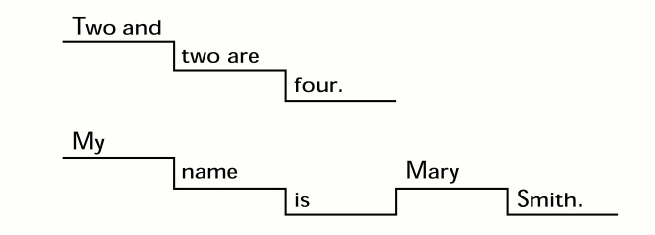
Intonation -3
English sentences move in a descending pattern
from higher pitch to lower pitch.

Slide 58
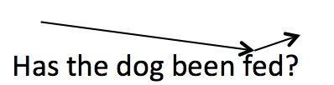

Ways to Teach Intonation Tone Shifts
Show where the tone shifts:
Draw a line to show the direction of pitch movement
Move your hand up and down with pitch shifts.

Slide 59
Ways to Teach Intonation Tone Shifts -2
Hum the sentence (or sing oo)
1. I don’t know.
2. Hello, how are you?

Slide 60
Elements in Teaching Pronunciation
1. How to produce individual sounds
2. How to hear the differences between sounds
3. Stress
4. Intonation

Slide 61
5. Rhythm
North American English has accents/beats that occur
at regular intervals.

Slide 62
Rhythm - 2
   
Yesterday was Wednesday, tomorrow’s Friday.
Yesterday was Wednesday, on Thursday I’ll go home.

Slide 63
Jazz Chant based on Philippians 1:3
A B
Every time Every time
Every time I think of you. Every time I think of you.
I thank the Lord. I thank the Lord.
Every time I think of you. I thank the Lord.
I thank the Lord. Every time I think of you.
A and B Together
Every time I think of you.
I thank the Lord.
Every time I think of you.
I thank the Lord.

Slide 64
Elements in Teaching Pronunciation
1. How to produce individual sounds
2. How to hear the differences between sounds
3. Stress
4. Intonation
5. Rhythm

Slide 65
6. Phrasing
North American English blends words together in “thought groups.”
The Lord is my shepherd,
I shall not want;
He makes me lie down in green pastures.

Slide 66
Phrasing-2
The thought group is said in one breath
We link words together in the thought group
The Lord is my shepherd
I shall not want;
He makes me lie down in green pastures.

Slide 67
7. Reduced/Relaxed Speech
Standard speech becomes
1. He is here.
2. What are you doing?
Hez here.
Whaddaya doin’?
Or
Whatcha doin’?

Slide 68
Elements in Teaching Pronunciation
1. How to produce individual sounds
How to hear the differences between sounds
3. Rhythm
4. Stress
Intonation
6. Phrasing
7. Reduced/relaxed speech

Slide 69
Chapter 8 Communication Practice Activities

Slide 70
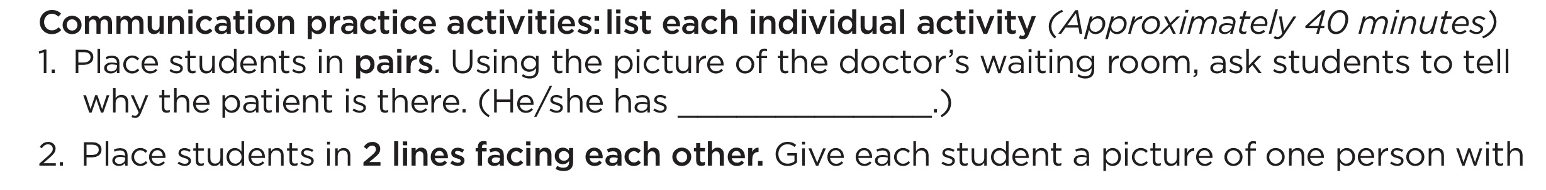
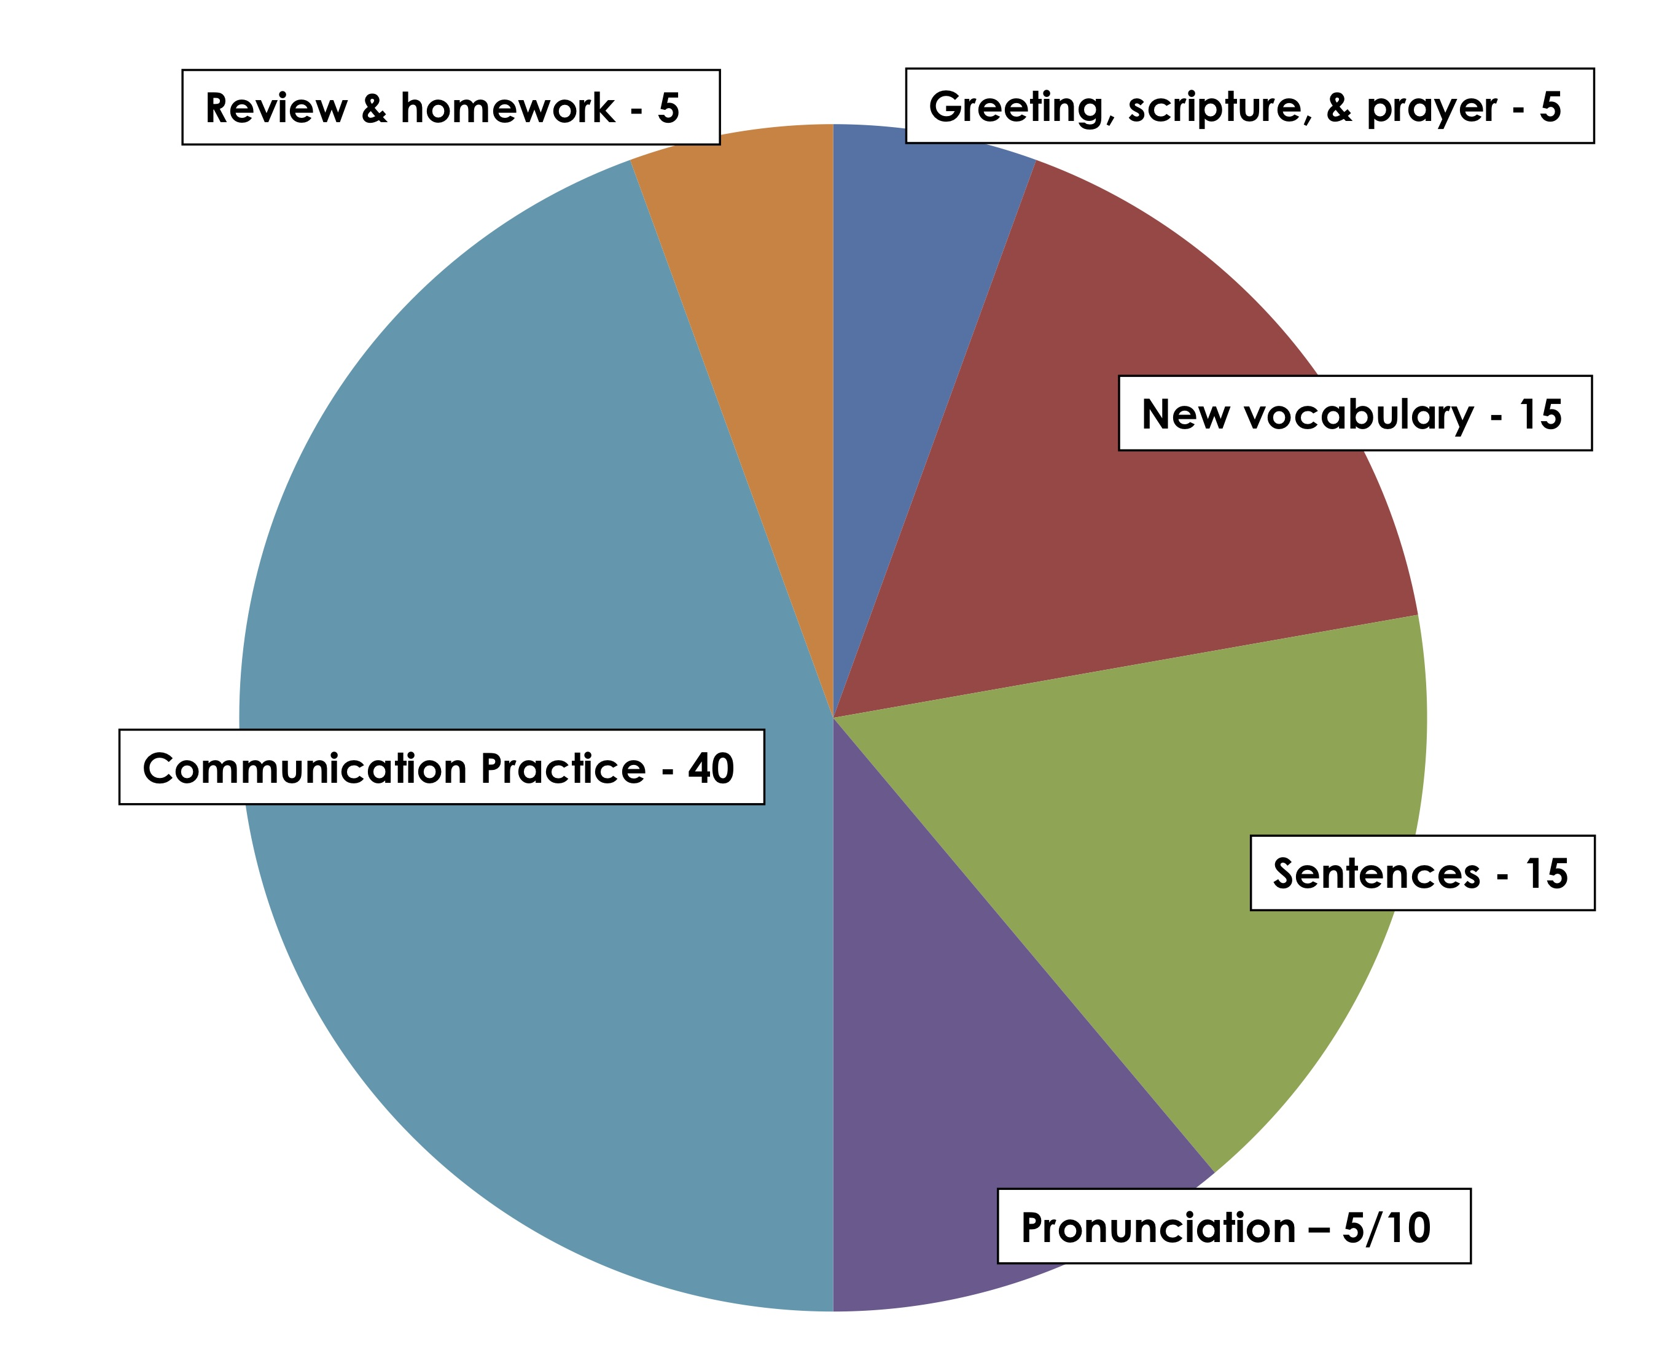
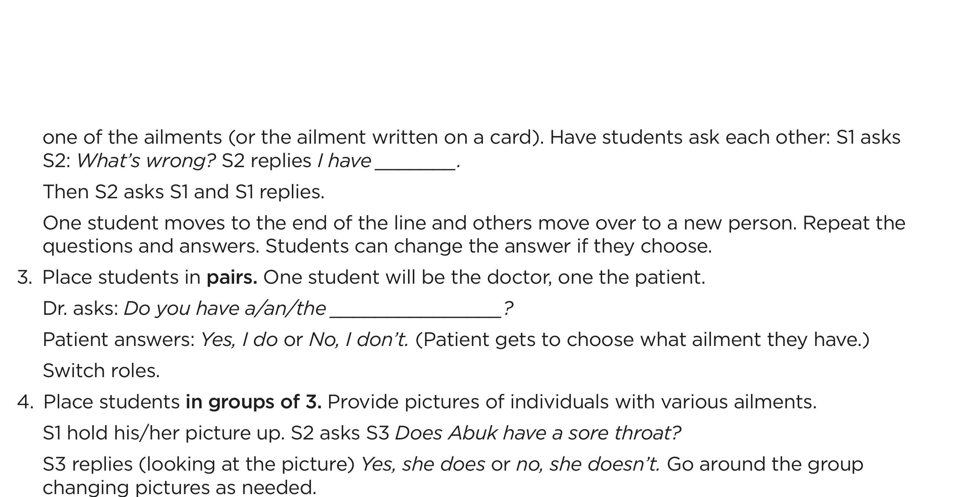
Communication Practice Activities

Slide 71
Communication Practice Activities Information Gap
Pairs have handouts that have similar information on them.
Each handout is missing a portion of the information.
Students must ask their partner questions to get the missing information.

Slide 72
Communication Practice Activity Information Gap directions
Partner 1: asks for information to complete one of his blanks
Partner 2: answers
Partner 2 : asks for information to complete one of his blanks
Partner 1: answers

Slide 73
Combining Pictures and Storytelling Lipson Method
Write story in simple, subject-verb-object sentences.
Make simple line drawings with stick figures to illustrate main ideas of story.
Use pictures to help the student learn, remember, and retell the story.

Slide 74
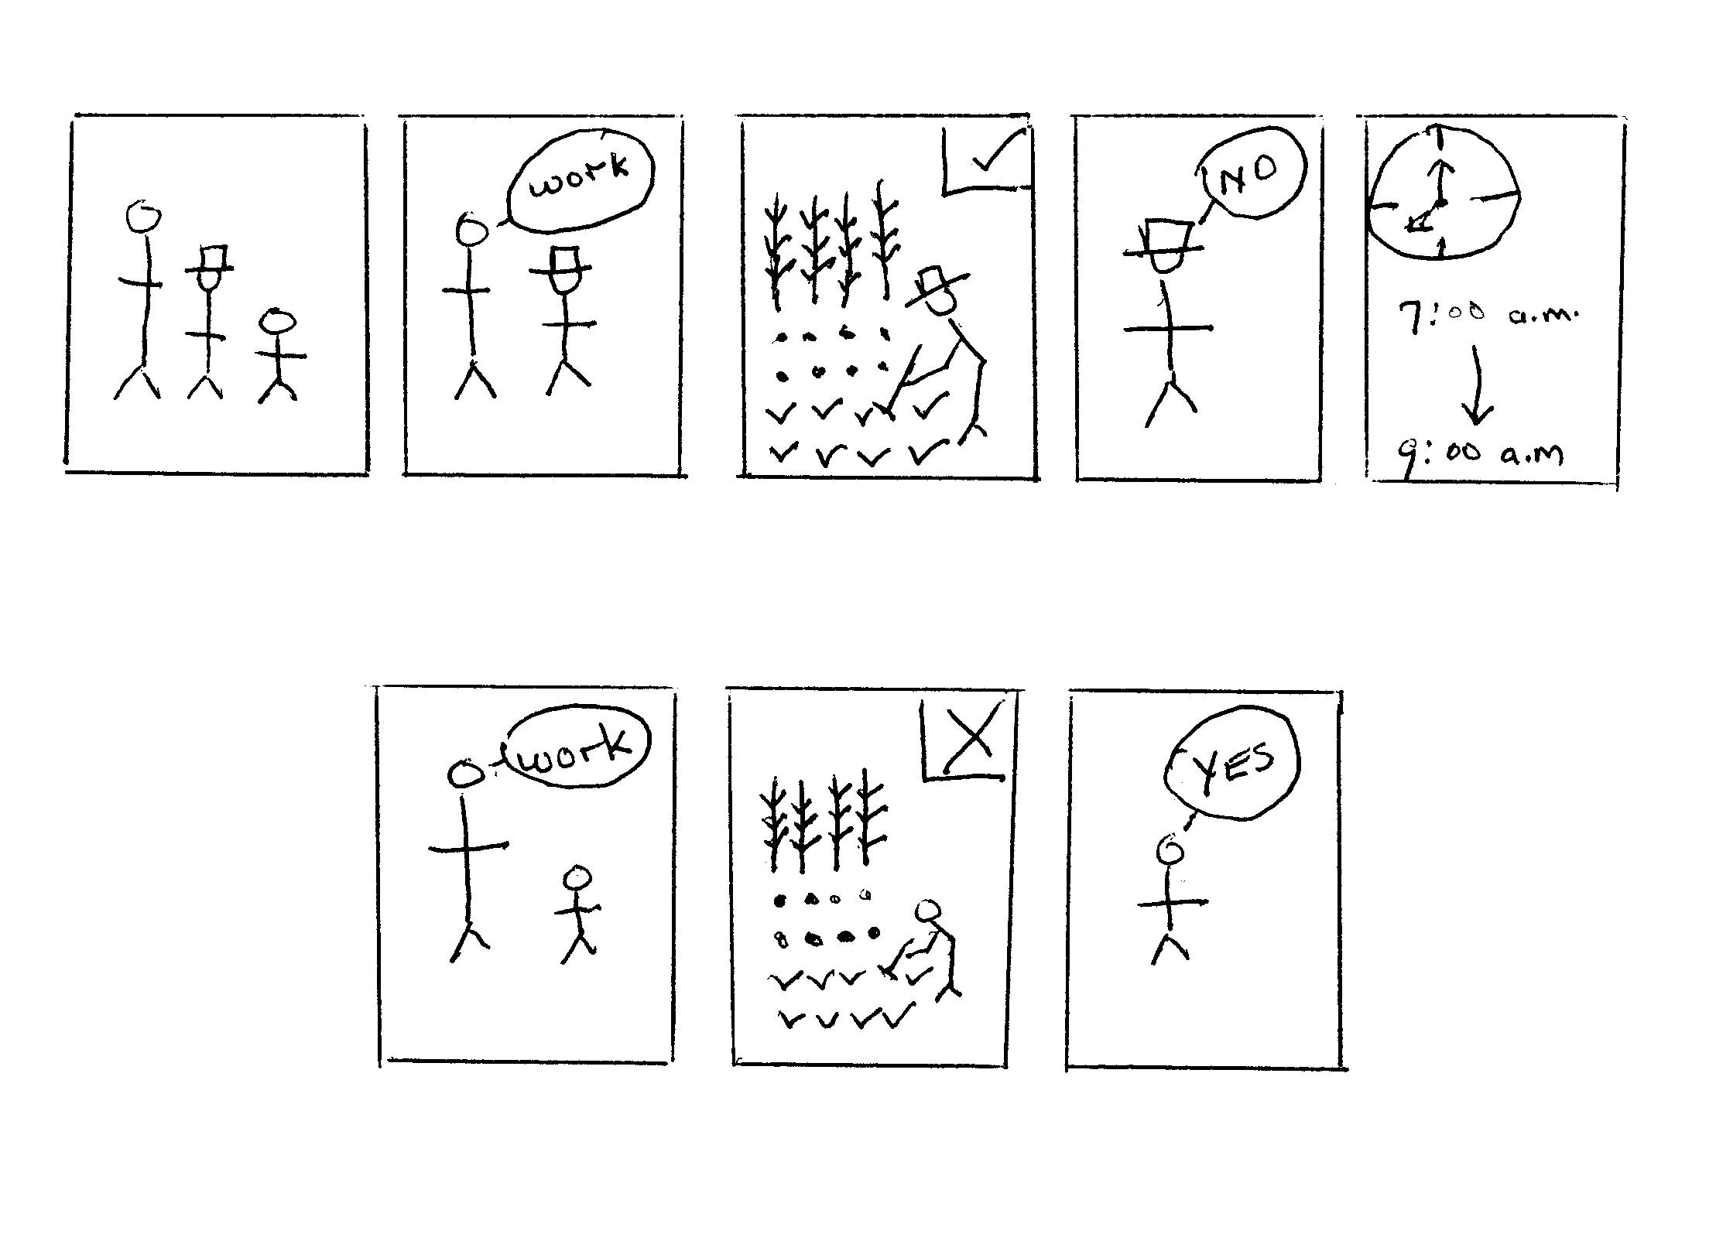

Slide 75
Lipson Method
Ask students to retell the story.
Ask life application questions.
Should the father treat the sons the same? Why?
What would you do if you were the father?
What would your father do?

Slide 76
Types of Communication Practice Activities
Role play
Games
Interviews
Information gap
Describing/discussing pictures

Slide 77
Types of Communication Practice Activities
Storytelliing
Combining pictures and story telling (Lipson Method)
Discussion
Debate
Problem Solving

Slide 78
Communication Practice Activity - Role Play
Person 1 – asks “What’s wrong?”
Person 2 – answers
Person 2- asks “What’s wrong?”
Person 1- answers

Slide 79
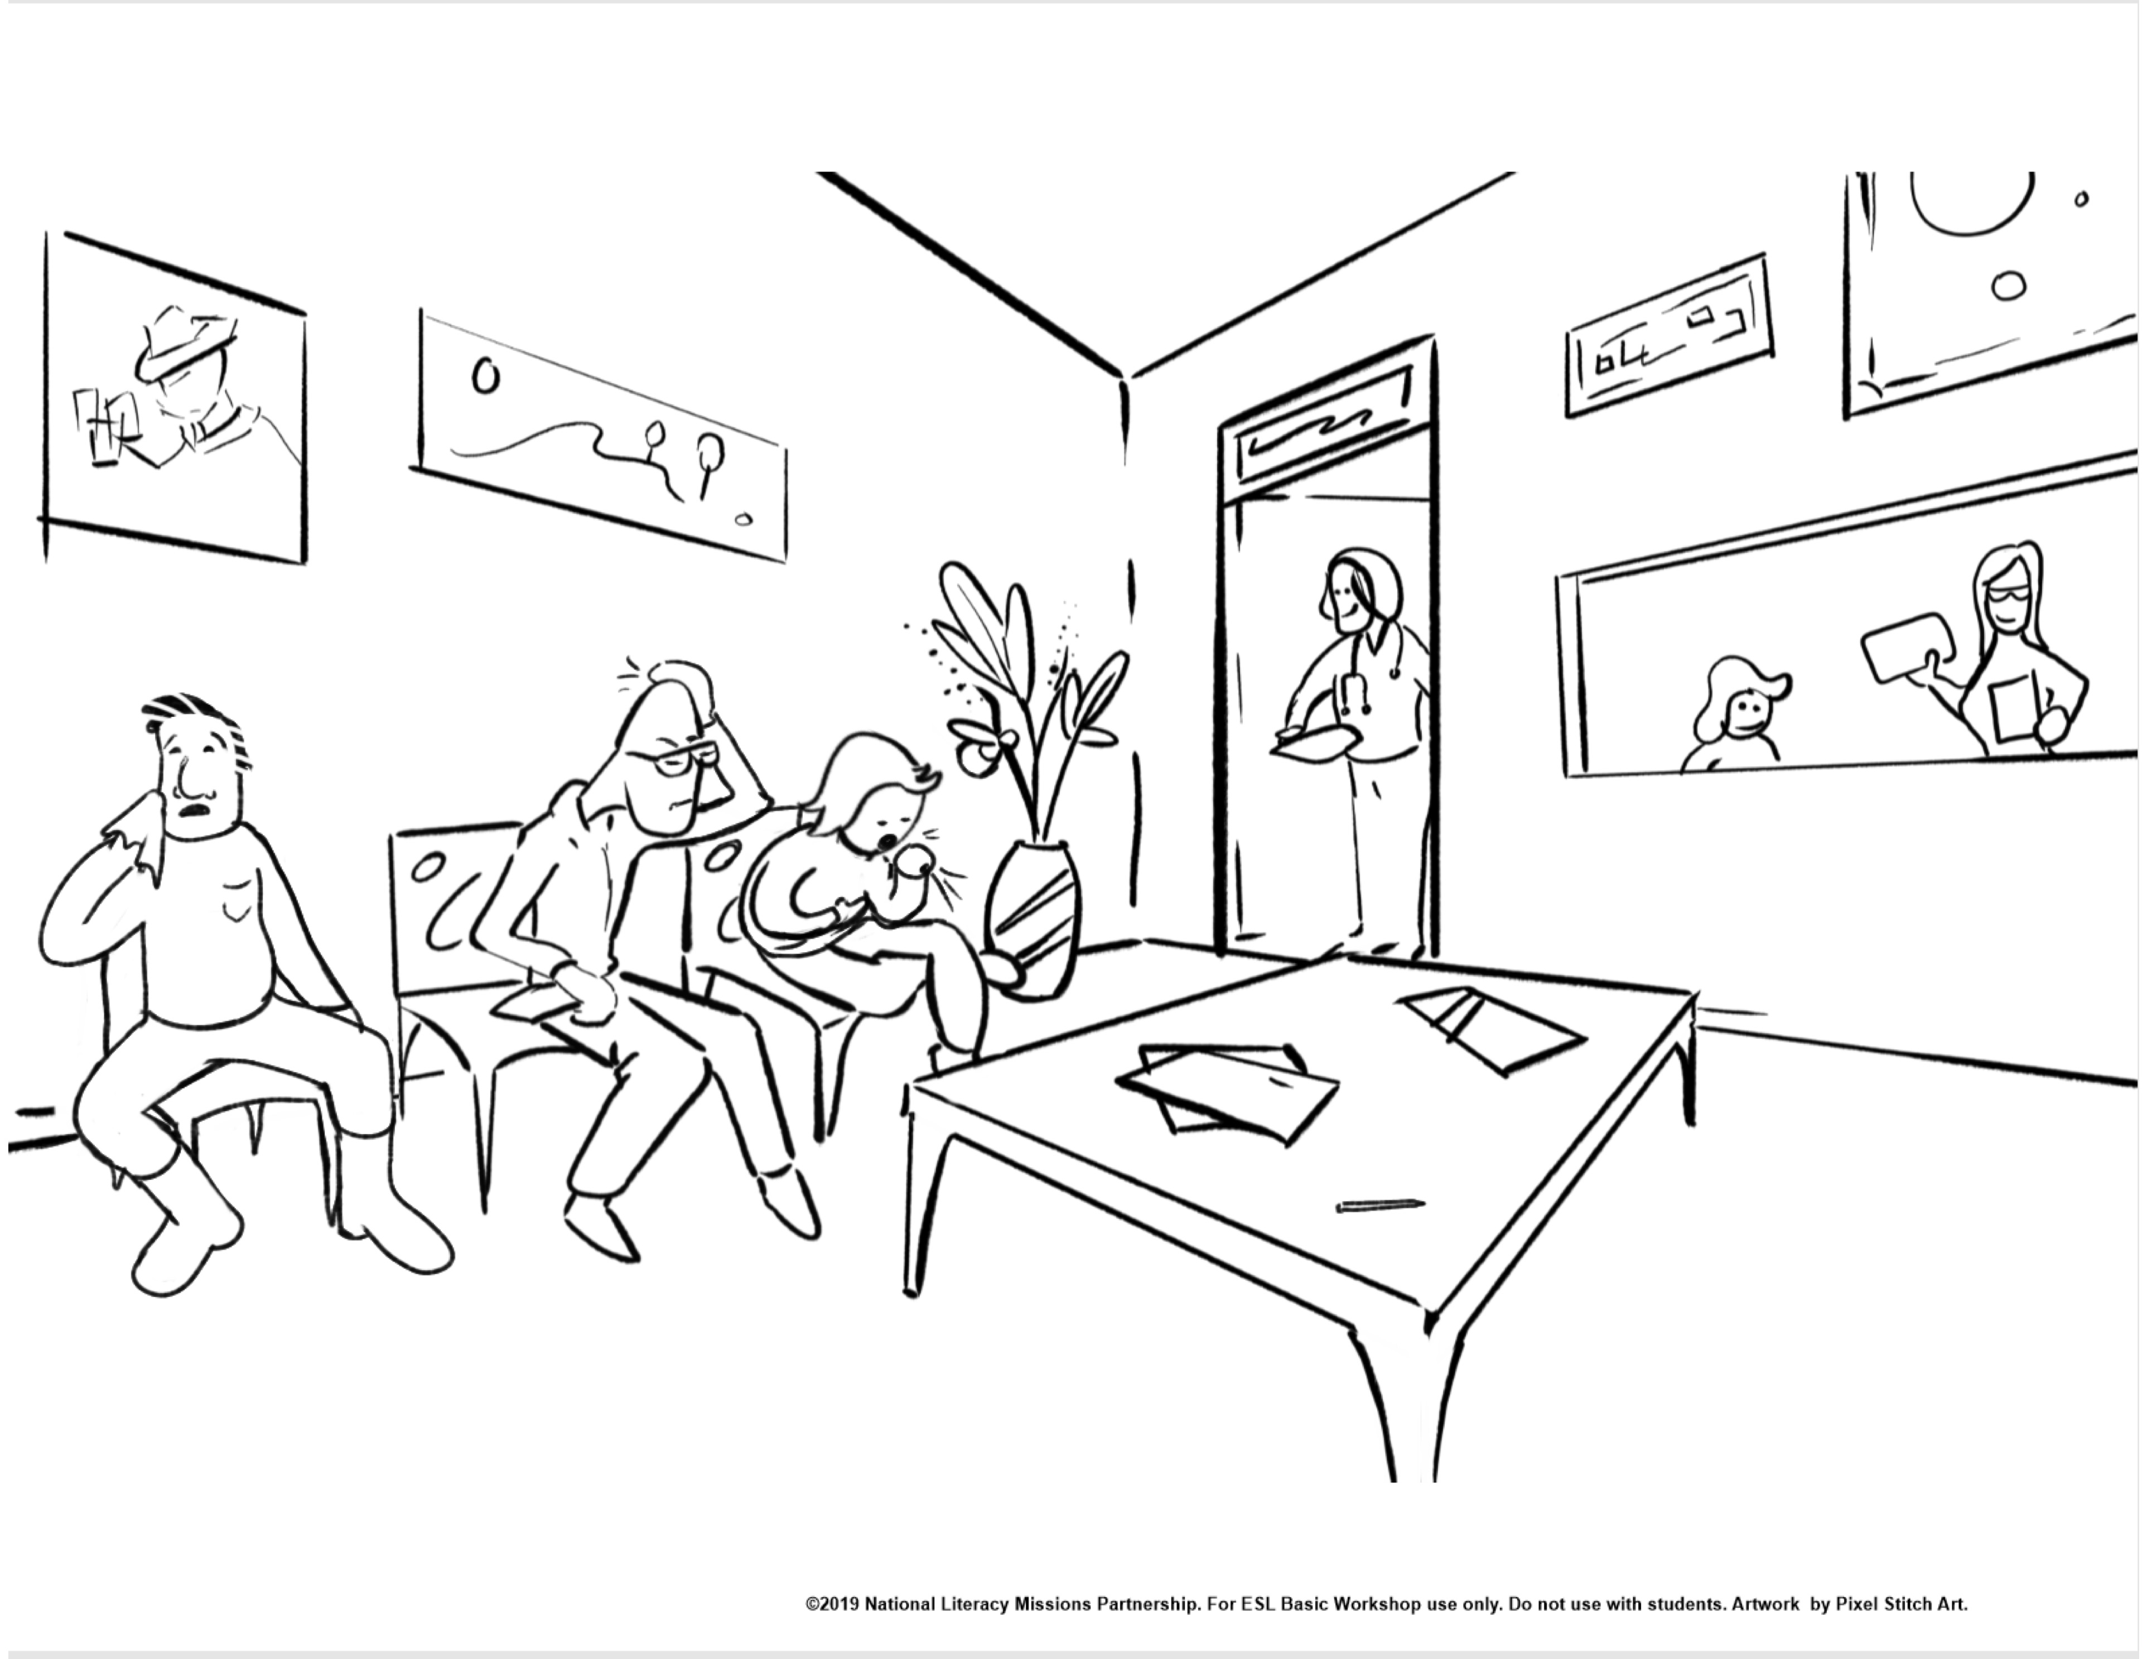

Slide 80
Communication Practice Activity - Games
1. Each person select an illness.
2. Person 1 ask your partner a question that can be answered YES or NO. Guess which illness your partner chose.
3. Person 2 ask your partner a question that can be
answered by YES or NO. Guess which illness your partner chose.
Answer in complete sentences, not just a single word.
Does your head hurt?
No, my head doesn’t hurt.

Slide 82
Group Interview Directions
Interview 2 participants. Alternate asking questions.
Ask the first person 1 question from item 1.
Ask the second person 1 question from item 2.
Ask complete questions: Have you ever eaten squid?
Answer in complete sentences. Yes, I have eaten squid.

Slide 83
Communication Practice Activity Interviews-facing lines
Where did you live when you were 8 years old?
What was your favorite toy?
Who did you play with?

Slide 84
Communication Practice Activity Describing/discussing Pictures-Basic
What do you see? Each person name 1 item
What happened? Each person name 1 thing
What will happen next? Each person name 1 possibility

Slide 85
Communication Practice Activity Describing/discussing Pictures-More complex
What time of day is it?
Why do you think so?
What is the man thinking?”
Would you like to work there?
Why or why not?

Slide 86
Communication Practice Activity Compare and Contrast Pictures
Find differences
between two very similar pictures.

Slide 87
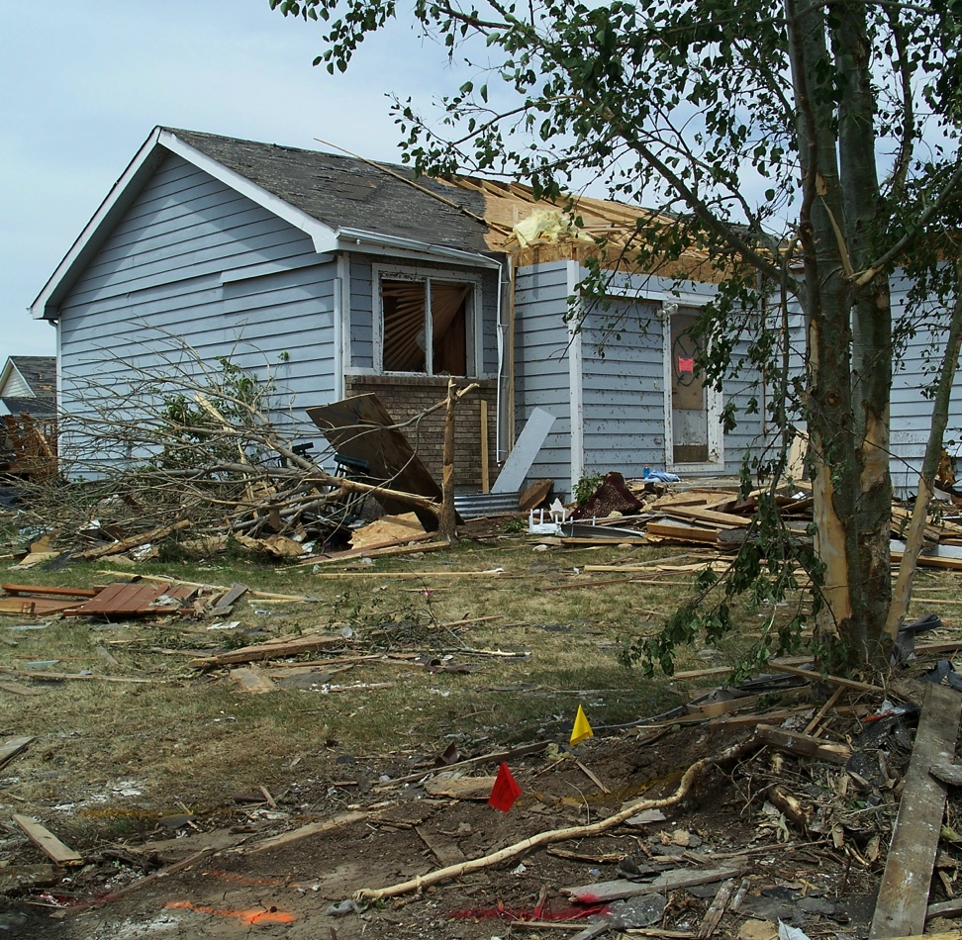
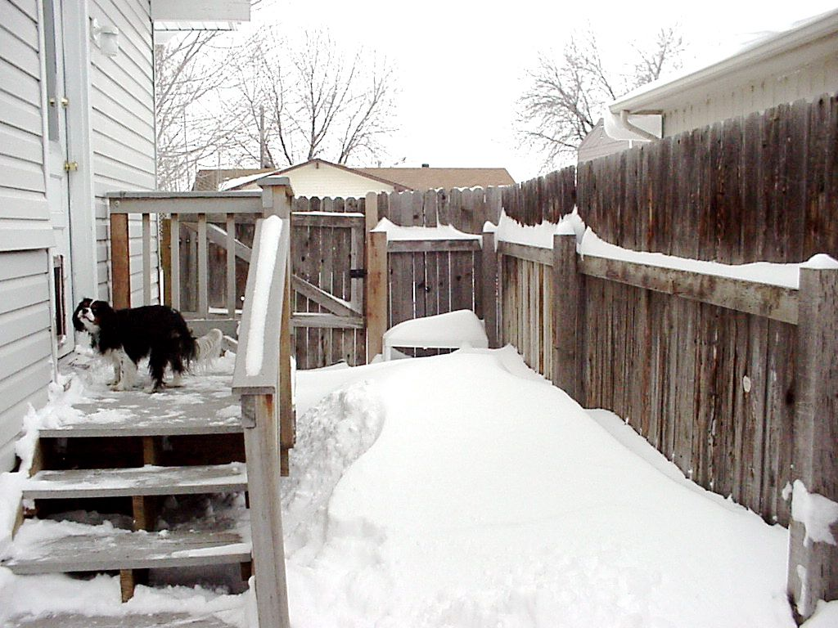
Compare and Contrast two very different pictures
Picture A
Picture B
Photo Credit: Claudean Boatman. © 2008 Used by permission

Slide 88
Communication Practice Activity - Storytelling
The Doctor’s Waiting Room
Partner 1 begins: I went to the doctor. In the waiting room I saw a man. I said, “Excuse me...”
Partner 1 completes the sentence using a question and answer .
Each remaining partner repeats what has been said and adds a sentence, using new question and answer.
Each partner retells the story.

Slide 89
Communication Practice Activity Story
What’s wrong?
I have
She has
He has
We have
They have
I went to the doctor. In the waiting room I saw a man. I said, “Excuse me...”

Slide 90
Communication Practice Activities - Discussion
Pairs or small groups discuss assigned topics.
Discuss the assigned proverb.
What do you think it means?
What cultural value does it teach?
Is there a proverb in your country that means the same thing?
The grass is always greener on the other side of the fence.
You reap what you sow.
Man does not live by bread alone.
A bird in the hand is worth two in the bush.

Slide 91
Communication Practice Activity - Debate
Individuals or small groups present different view points
on a subject.
Your friend Rachel, a college student, has to choose a major. She wants to be a writer. She has won awards for her poetry.
But her parents would like her to become a teacher so she can have a steady income.

Slide 92
Communication Practice Activity - Debate-2
Each pair write two sentences supporting your point of view. Use the two assigned idioms in your sentences.
Pair 1. Rachel should pursue her poetry.
black and white and fine line
Pair 2. Rachel should get a teaching degree.
right under their/her nose and see things in a whole new light

Slide 93
Communication Practice Activity - Problem Solving
Groups work together to solve a problem.
Example:
A friend of yours has just come to the United States.
Make a list of 4 problems he will face.
Suggest one way he could solve each problem.

Slide 94
Chapter 11 Incorporating Biblical Materials in Your Classes

Slide 95
English Lessons From the Bible: The Book of Mark
• Sequentially presented passages from the Book of Mark used as basis for ESL instruction
• Available for free download at https://www.sendrelief.org/poverty/esl/ and for purchase through Fed Ex
• Target group – high beginners/intermediate
• Uses the Lipson Method to help the student remember and tell the story

Slide 96
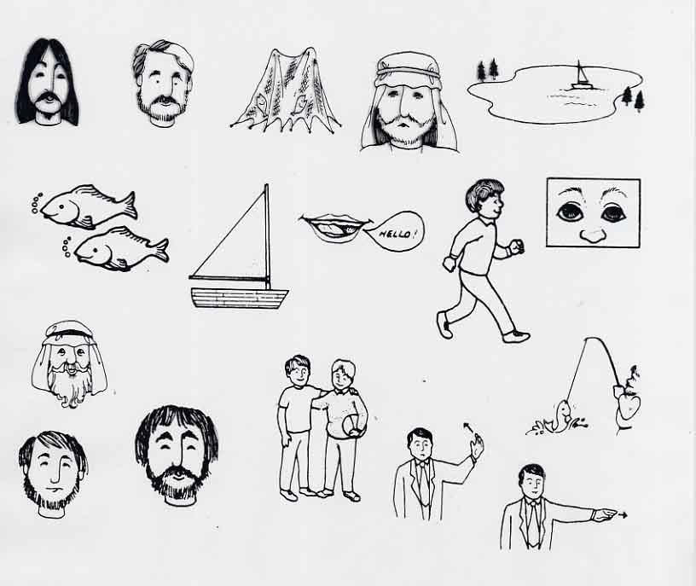
TELL p. 155

Slide 97
ELB Information in the Appendices
• Overview of ELB: TELL p.160
• Sample Lesson Plan: TELL pp. 161-163
• Sample ELB pages: TELL pp. 164-172
• Reference charts for lesson planning : TELL pp. 173-177

Slide 98
With forethought and planning
you can and should
incorporate Biblical materials
into your classes.

Slide 99
Chapter 12 Sharing Your Faith with Your Students

Slide 100
Practice Sharing Your Faith
Partner A – share Partner B – share
Partner B – give feedback Partner A – give feedback
1. Did the presenter use church jargon?
2. Do you know why the presenter needed to acknowledge Christ as Lord?
3. Do you know what the presenter did to acknowledge Christ as Lord?
4. Do you know how Christ is working in the presenter’s life today?

Slide 101
Above all, YOUR STUDENTS NEED TO BE LOVED.
If they know YOU love them,
they will be more open
to hearing and responding
to the message
that GOD loves them.

Slide 102
Closing Thoughts

Slide 103
Literacy Missions Prayer

