Slide 1

Teaching English as a Foreign Language

Slide 2

Then the nations will know that I am the Lord, declares the Sovereign Lord, when I show myself holy through you before their eyes.
Ezekiel 36:23b

Slide 3
Difference between
EFL and ESL
ESL – student living in a country
where English is the native language
EFL – student living in a country where English is not the native language

Slide 4
Workshop Topics
Learning and teaching a foreign language
Planning a lesson
Introducing new vocabulary
Teaching pronunciation
Communication practice
Resources
Questions to ask before you go

Slide 5
Introductions
Get with a partner you don’t know
Interview your partner
  What is your name?
  In what city were you born?
  How many brothers and sisters
  do you have?
  What church do you belong to?

Slide 6
Introductions -2
Get together with another pair
Introduce the person you interviewed

Slide 7

Learning and Teaching a Foreign Language

Slide 8
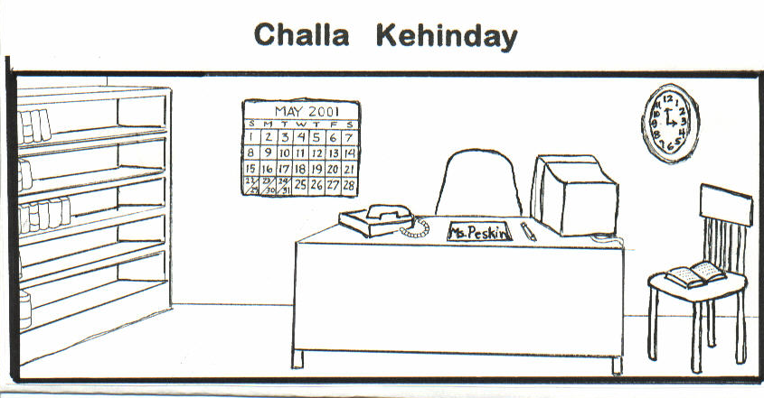

Slide 9
1. goota
2. alay
3. yoma
4. lameechga
5. etoomba

Slide 10
Language Learning Skills
Hearing/Listening
Speaking
Reading
Writing

Slide 11
Differences in learning first and second language
1st language
Acquired without being aware of it. It just seemed to happen
Saturated with 1st language daily
2nd language
Very aware you are learning a language
Often don’t use language outside of class

Slide 12
Differences in learning first and second language - 2
1st language
Learn vocabulary and sentence structure without interference
Willing to take risks to learn
2nd language
Relearn vocabulary and sentence structure
Reluctant to take risks to speak the language

Slide 13
Differences in learning first and second language - 3
1st language
Begin with small vocabulary and expand as needed
Several years of speaking and listening before reading and writing
2nd language
Need for broad vocabulary sooner
Speaking, listening, reading and writing introduced together

Slide 14

Learning to Speak a Language
Students may read English
but not be able to speak it.

Slide 15
Learning to Speak a Language -2
Spoken language has elements that written language doesn’t.
Individual sounds
Rhythm
Stress
Intonation

Slide 16
Learning to Speak a Language -3
Practice speaking the language is essential
A Student must hear and use a word or phrase 40-60 times
Class time should focus on the student speaking
Encourage students to speak, listen to, read, and write English each day

Slide 17
Teaching Suggestions
Create a low anxiety environment
Use material relevant to the student
Build on what the student already knows

Slide 18
Teaching Suggestions -2
Enunciate clearly
Use visuals
Use lots of non-verbal communication- gestures, facial expressions

Slide 19
Teaching Suggestions -3
Demonstrate rather than explain
Structure classes so students do most of the speaking
If you speak the student’s language, don’t translate

Slide 20
THE GREATEST TEACHER ERROR
IS
TALKING TOO MUCH!
You do not teach a spoken language by explaining it.

Slide 21

Lesson Planning

Slide 22
Before you plan…
Beginner – do not speak in sentences
Intermediate – some sentences, many errors
Advanced – use sentences; need pronunciation and vocabulary help

Slide 23
Lessons Can Be Planned
Topic
food, leisure, housing
Language function
requesting information
apologizing
agreeing and disagreeing

Slide 24
Resources for Lessons
ESL resource and textbooks
Newspaper/magazine articles

Slide 25
The Resources are Idea Books
You have to choose which vocabulary and ideas you can teach in a single teaching session.

Slide 26
Why Prepare a Lesson Plan?
Lesson planning provides structure.
Ensures you will cover the basic areas of language learning in the correct sequence
Provides an outline to use in class.

Slide 27
Steps in Preparing an EFL Lesson Plan
Pray
Review the idea books
Select the material and activities
Complete the lesson plan form

Slide 28
EFL Lesson Plan
Name of book, lesson title and/or number, pages
Lesson objective
Visual or teaching aids needed

Slide 29
EFL Lesson Plan -2
Greetings
Introduce New Vocabulary
  Warmup
  8-12 words
Sentences Using New Vocabulary
Additional Pronunciation

Slide 30
EFL Lesson Plan -3
Communication Practice Activities
Review new words/Homework assignment

Slide 31

Introducing New Vocabulary

Slide 32
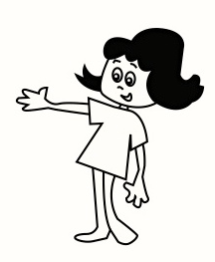
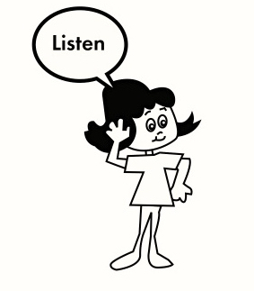
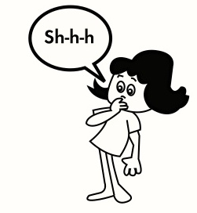

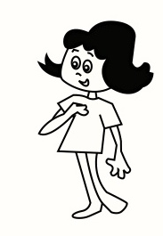
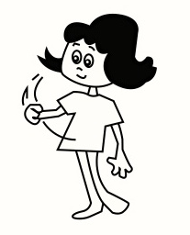
Hand Gestures
1. Listen
4. Teacher points to class
“Ready” verbal cue
Shhhh
3. Teacher points to self
6. Students speak/respond

Slide 33
Introducing New Vocabulary
To convey meaning, use
Real objects
Pictures
Mime
Gestures
Demonstrations

Slide 34
How many new words or phrases can you teach in a class?
8-12,
depending upon the level
of the students

Slide 35
Basic Teaching Drills
Note: start the lesson with a warm-up activity.
Total Physical Response
Repetition (word)
Repetition (sentence)
Substitution
Question Answer (1 and 2)
Chain Drill

Slide 36
Total Physical Response
T. models vocabulary
S. watches
T. gives a command and models action
S. watches
T. gives command and models action -
T. and S. do action together but S. doesn’t speak
T. gives command
S. does action but doesn’t speak

Slide 37
Total Physical Response - practice
1. Hold up picture and say the word 5 times – put it on the wall or lay it on the table. (Repeat with all pictures.)
2. Say point to… for a picture. Do the action. (Repeat with all pictures.)
3. Say point to… for a picture. (Gesture for students to do it with you. Repeat for all pictures.)
4. Say “point to … and gesture for students to do the action but teacher does not do the action. (Repeat for all pictures.)
2026 EFL | NAMB/Send Relief

Slide 38
Repetition
1. T. models word 5 or 6 times
S. listens
2. T. models, points to self, points to S.
S. Listens
3. T. says “ready”
S. Listens
4. T. says word
S. repeats word

Slide 39
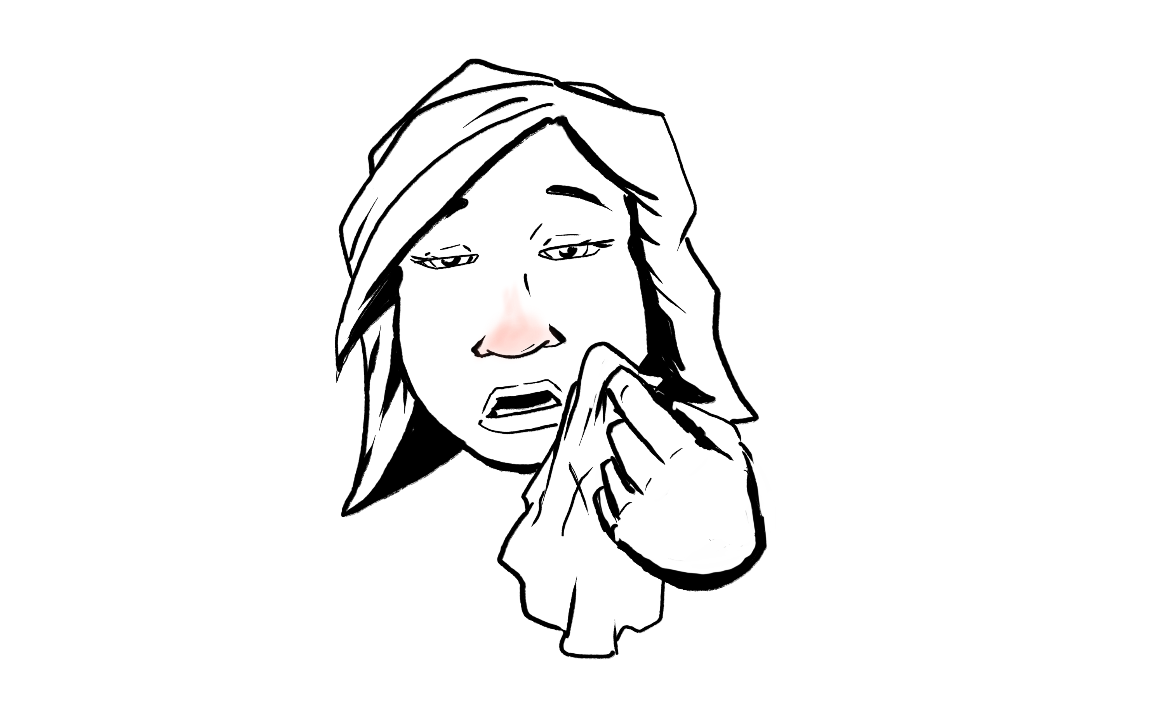
Repetition- practice
1. T: (Repeat 5 times) a cold
2. T: (points to self) a cold
(points to Ss.) a cold
3. T: Ready?
4. T: (points to self) a cold
Gesture students to respond
Ss: a cold

Slide 40
Dictation
T. writes words in numbered list form
S. number and copy the words
T. points to the number, says the number
T. points to the word, says it
S. repeat the number and the word
T. says a word
S. say the number
T. says a number
S. say the word
T. asks the students to number 1-5
T. reads words out of sequence
S. write them down.

Slide 41
Teaching Drills to Practice
P1. Total Physical Response - 3 words
P2. Repetition - 1 word
P3. Repetition - 1 remaining word
P4. Dictation - 3 words

Slide 42
Basic Teaching Drills for Using New Vocabulary in Sentences
Repetition
Substitution
Question/Answer
Chain Drill

Slide 43
Repetition - Sentence
T. models sentence 5 or 6 times—change pictures each time
S. listens
T: says sentence 2 or 3 times with one vocabulary word
Ss: listen
T. models, points to self, points to S.
S. listens
T. says Ready?
T. says sentence
S. repeats sentence

Slide 44
Repetition of Sentences - Practice
I have a cold
I have a cough
I have a headache.
Set the pattern.
1. T: I have a cold. (Repeat 5 times.)
2. T: (point to self) I have a cold.
(point to Ss.) I have a cold.
3. T: Ready?
4. T: (point to self) I have a cold.
T: Gesture for students to respond.
Repeat step 4 three times.

Slide 45
Substitution
T. (points to self) says word
T. (points to S.) says sentence using the word
Listens
T. (points to self) says a different word
T. (points to S.) says sentence using the word
Listens
T. says Ready?
T. says word
S. says sentence

Slide 46
Substitution - practice
T (points to self) a cough
T (points to Ss) I have a cough.
2. T (points to self) a headache
T (points to Ss) I have a headache.
3. T (points to self) a cold
T (points to Ss) I have a cold.
T Ready?
4. T (points to self) a cough
Gestures for students to respond.
Repeat Step 4 with a headache and a cold.

Slide 47
Question/Answer Drill -1
T: (holds ? card and one picture) asks question
T: (flips to . side of card, using same picture) answers question
Ss: listen
T. points to self – asks question
T. points to student – gives answer
S. listens
T. Says Ready?
T. asks question
S. answers question

Slide 48
Question Answer Drill—Part 1- practice
Set the pattern:
Use pictures and ? and . card to do the following.
  What’s wrong?
  I have a cold.
  What’s wrong?
  I have a headache.
  What’s wrong?
  I have a cough.
1. T (points to self) What’s wrong?
T (points to Ss) I have a cold.
T (points to self) What’s wrong?
T (points to Ss) I have a headache.
T (points to self) What’s wrong?
T (points to Ss) I have a cough.
2. T Ready?
3. T What’s wrong?
Gesture for students to respond.
Ss I have a cold.
Repeat Step 3 with a headache and a cough.

Slide 49
Question/Answer drill -2
T: (holds ? card; gestures to Ss.) What's wrong?
T: (holds . card; gestures to self) answers question
Ss: listen
Repeat Step 1 with a different picture.
T: Ready?
T: (gestures for Ss. to respond)
Ss: What's wrong?
T: (gestures to self) answers question
(Repeat Step 3 with all the pictures as the students ask the question, changing the picture each time they ask.)

Slide 50
Question Answer Drill—Part 2 practice
1. T (Point to Ss) What’s wrong?
T (Point to self) I have a cold.
T (Point to Ss)What’s wrong?
T (Point to self) I have a headache.
T (Point to Ss) What’s wrong?
T (Point to self) I have a cough.
2. T Ready?
3. T Gesture for students to ask question.
Ss What’s wrong?
T I have a cold.
Repeat Step 3 with a headache and a cough.

Slide 51
Chain Drill
T. tells one student to ask question to another student
S. asks question
T. tells other student to answer
S. answers
T. tells the one who answered to ask another student the question
S. answers, etc

Slide 52
Chain Drill- practice
Bill ask Mary, What’s wrong?
S. What’s wrong?
Mary, tell Bill, I have a cold.
S. I have a cold.
T. (Change picture) Mary, ask Sam What’s wrong?
S. What’s wrong?
T. Sam tell Mary, I have a headache.
S. I have a headache.

Slide 53
Basic Teaching Drills
for Introducing New Vocabulary
Total Physical Response
Repetition – Words
Dictation
Repetition – Sentences
Substitution
Question/Answer
Chain Drill

Slide 54
Conducting Drills
Model several items before student speaks
Students repeat 5-6 times
Move from all to groups to individuals
Speak naturally

Slide 55
Conducting Drills-2
Be consistent (rhythm, stress, intonation)
Speak naturally
Conduct drills briskly; vary word order
Encourage verbally
Review

Slide 56
Tips for Error Correction
Don’t correct every error
Avoid negative terms
  No
  You made a mistake
  Wrong
Simply repeat the statement correctly

Slide 57
Tips for Error Correction -2
Never interrupt or correct when student is expressing a thought
Allow time for students to correct themselves
Review errors common to class
Don’t correct errors in a social setting

Slide 58
Basic Teaching Drills
for Introducing New Vocabulary
Total Physical Response
Repetition – Words
Dictation
Repetition – Sentences
Substitution
Question/Answer
Chain Drill

Slide 59
Introducing Vocabulary Sequence
Total Physical Response
Repetition (word)
Dictation
Repetition (sentence)
Substitution
Question/Answer (teacher asking and student answering)
Question/Answer (student asking and teacher answering)
Chain Drill

Slide 60
Advanced Students and Vocabulary
Need to work on
  Vocabulary expansion
  Specialized job vocabulary
  Idioms and slang expressions
  Pronunciation
  Writing skills
  TOEFL exam preparation

Slide 61
Materials for Advanced Students
Newspaper
Idiom texts
Conversation/discussion texts
Specialized texts
  Pronunciation
  Job-specific
  TOEFL
  Citizenship

Slide 62
Advanced Vocabulary
Introduce vocabulary
Repetition is still necessary
CHANGE – Advanced students define words
CHANGE – Advanced students give synonyms and antonyms
observed

Slide 63
Things to keep in mind for preparing advanced level lessons
Introduce vocabulary words: Students define words
Sentences using new vocabulary: Students create sentences and question/answers
Under Additional Pronunciation Practice, activities may be longer, more complex
Under Communication Practice, activities may be more complex and include discussion, debate, and problem solving.

Slide 64

Teaching Pronunciation

Slide 65
Elements in Teaching Pronunciation
How to produce individual sounds
How to hear the differences between sounds

Slide 66
Elements in Teaching Pronunciation
Stress
Intonation
Rhythm
Phrasing
Reduced/Relaxed Speech

Slide 67
Factors in Production of a Speech Sound
1. Lip or jaw position
2. Tongue position
3. Flow of air
4. Vocal cords

Slide 68
Minimal Pairs
Beginning sound
  pet – bet
Medial sound
  staple – stable
Final sound
  tap - tab

Slide 69
Minimal Pair Exercises
Teacher writes sample on board and models
Teacher presents example student responds
Students present example students respond

Slide 70
Minimal Pair Exercise 1
Same or Different
+ +  
bet - bet bet - pet

Slide 71
Minimal Pair Exercise 2
Which is Different? 1, 2, or 3
bet bet pet
1 2 3

Slide 72
Minimal Pair Exercise 3
How does it begin/end?
/b/ or /p/
pat bat
tab tap

Slide 73
Minimal Pair Exercise 4
Which did I say ?
led or red

Slide 74
Review Exercise 1
In pairs:
 Partner 1: look at Section A
 Partner 2: look at Section B
 Beginning with question 1,
alternate asking and answering the questions

Slide 75
Answers for Review Exercise 1
1. Voiceless
2. Continuous
3. Behind the top teeth
4. Rounded
5. Different
6. 2

Slide 76
STRESS
Trans-por-TA-tion
The stressed syllable in a word or the stressed word in a sentence is
  LOUDER
  L –o – n – g – e –r
Higher Pitched

Slide 77
Stress-2
In an individual word, only one syllable is stressed.
Content words are stressed in sentences.

Slide 78
Stress -3
Where stress is placed affects meaning and comprehension.
conduct conduct
suspect suspect
He ate the whole pie by himself.

Slide 79
Review Exercise - 2
In pairs:
Partner 1 look at section A
Partner 2 look at section B
Beginning with question 1, alternate asking and answering the questions

Slide 80
Answers for Review Exercise - 2
five
2. higher pitched
3. ex-AG-ger-ate
4. The big BLACK dog did it.
The BIG black dog did it.

Slide 81
Ways to show Stress In Words
Show the number of syllables
  trans-por-ta-tion
Identify stressed syllable
  trans-por-TA-tion
Use a rubber band
  thir-ty thir-teen

Slide 82
Backward Buildup
-ric
- LEC-tric
eLECtric

Slide 83
Ways to show Stress In Sentences
Underline content words
  Nouns
  Verbs
  Adjectives
  Adverbs
  Question words
  My grandmother saw a crocodile.

Slide 84
Ways to show Stress In Sentences -2
Circle the word/s that get the most emphasis (focal word).
He ate the whole pie by himself.
Use a rubber band
Stretch on the stressed word

Slide 85
Intonation
The Rise and Fall of Pitch
OH
Disgust
Question
Disappointment
Surprise

Slide 86
Intonation-2
  Shows whether a sentenc is a statement or a question
Conveys
    Certainty or uncertainty
    Cooperativeness or lack of it
    Feeling of the speaker

Slide 87
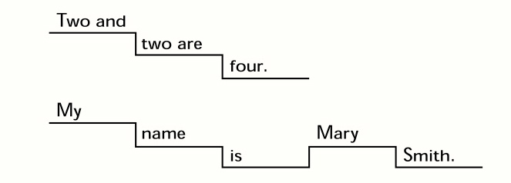
Intonation-3
English sentences move in a descending pattern from higher pitch to lower pitch.
.

Slide 88
Ways toTeach Intonation Tone Shifts
Show where the tone shifts
  Draw a line to show the direction of pitch movement.
  Move your hand up and down with pitch shifts.

Slide 89
Ways to Teach
Intonation Tone Shifts
Hum the sentence (or sing oo)
I don’t know.
Hello, how are you?
Fine, thank you. And you?

Slide 90
Rhythm
North American English has accents/beats
that occur at regular intervals.

Slide 91
Rhythm -2
   
Yesterday was Wednesday, tomorrow’s Friday.
Yesterday was Wednesday, on Thursday I’ll go home.

Slide 92
Jazz Chant
A
Hello, how are you?
I’m fine.
Got to go.
(Gotta go.)
Bye.
B
Fine, thank you,
And you?
I’m glad.
See you.
(See ya.)
Bye.

Slide 93
Phrasing
North American English blends words
together in thought groups.
The Lord is my shepherd,
I shall not want;
He makes me lie down in green pastures.

Slide 94
Phrasing -2
The thought group is said in one breath.
We link words together in the thought group.
The Lord is my shepherd
I shall not want;
He makes me lie down in green pastures.

Slide 95
Reduced/Relaxed Speech
Standard speech becomes
1. He is here.
2. What are you doing?
Hez here.
Whaddaya doin’? Whatcha doin’?

Slide 96
Things to keep in mind
Advanced level lessons and additional pronunciation practice
Can be longer than for beginners
Advanced students can work on more complex rhythms, phrasing, and reduced/relaxed speech

Slide 97
Communication Practice Activities

Slide 98
Communication Practice Activities
Structured activities to help the student
have a reason to intentionally generate
English-language sentences.

Slide 99
Communication Practice Activities -2
Students work in pairs or groups of 3 or 4.

Slide 100
Communication Practice Activities -3
The teacher
  Demonstrates activity
  Circulates verifying groups understand the task and are using English
  Doesn’t correct errors during the activity

Slide 101
Communication Practice Activities -4
Generating meaning in English is the main objective
Complete accuracy is not the objective

Slide 102
Types of
Communication Practice Activities
Role Play
Games
Interviews
Information Gap
Describing/discussing pictures

Slide 103
Types of
Communication Practice Activities -2
Storytelling
Combining pictures and storytelling(Lipson Method)
Discussion
Debate
Problem Solving

Slide 104
Communication Practice Activities
Role Play
Person 1 – asks What’s wrong?
Person 2 – answers with an illness
Person 2 – asks What’s wrong?
Person 1 – answers with a different illness
Answer in complete sentences.

Slide 105
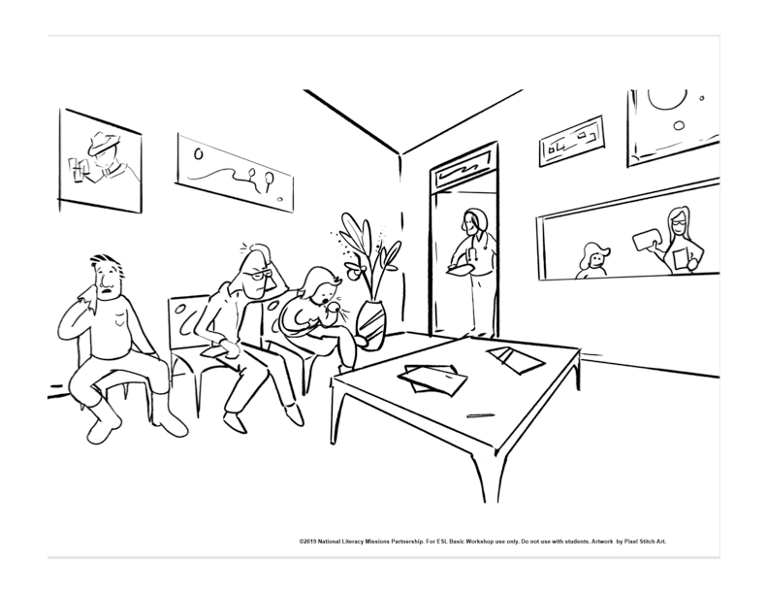

Slide 106
Communication Practice Activity - Games
20 Questions Variation
1. Each person selects an illness.
    2. Person 1 ask your partner a question that can be answered YES or NO. Guess the illness.
  3. Person 2 ask your partner a question that can be answered by YES or NO. Guess which illness.
  Answer in complete sentences, not just a single word.
      Do you have a runny nose?
      No, I don’t have a runny nose.

Slide 108
Communication Practice Activity
Interviews
Factual – name and address
Experiential – Have you ever..?
Opinions/preferences – Do you like? Would you prefer A or B? Why?

Slide 109
Interviewing all or a portion of the class
Popular forms:
• Have you ever_______
• Do you_________
• Find someone who _____

Slide 110
Group interview directions
Interview the number of participants listed in your question.
Alternate asking questions.
Use complete questions.
Answer in complete sentences. Don’t use one-word answers.

Slide 111
Communication Practice Activity
Interviews -2
How many people didn’t like broccoli?
How many people have eaten squid?

Slide 112
Communication Practice Activity
Interviews-facing lines
Where did you live when you were 8 years old?
Who lived with you?
What did your father do then?

Slide 113
Communication Practice Activity
Information Gap
Pairs have handouts that have similar information on them.
Each handout is missing a portion of the information.
Students must ask their partner questions to get the missing information.

Slide 114
Communication Practice Activity
Information Gap -2
Partner 1: asks for information to complete one of his blanks
Partner 2: answers
Partner 2: asks for information to complete one of his blanks
Partner 1: answers

Slide 115
Communication Practice Activity
Describing/discussing Pictures
What do you see?
Each person names 1 item
What happened?
Each person names 1 thing
What will happen next?
Each person names 1 possibility

Slide 116
Communication Practice Activity
Describing/discussing Pictures -2
More complex:
What time of day is it?
Why do you think so?
What is the large man thinking?
Would you like to work there? Why or why not?”

Slide 117
Communication Practice Activity
Describing/discussing Pictures -3
Compare and Contrast Pictures
Find 8 differences in the two pictures

Slide 118
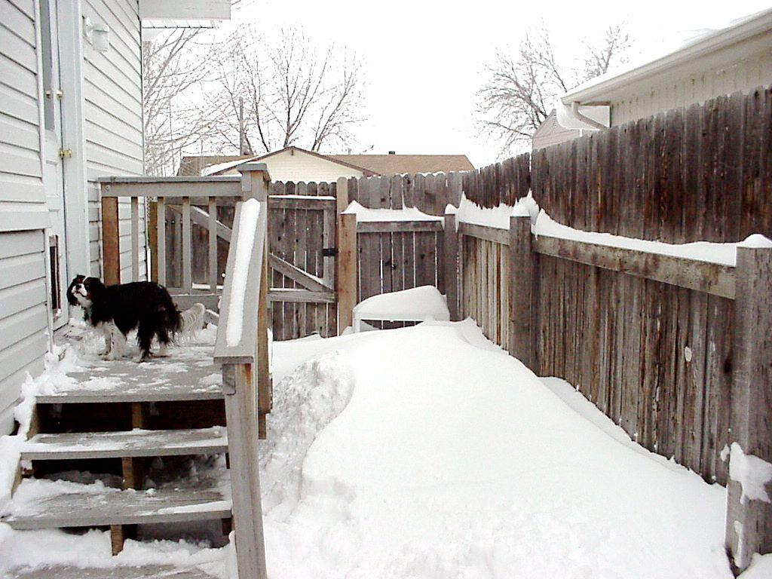
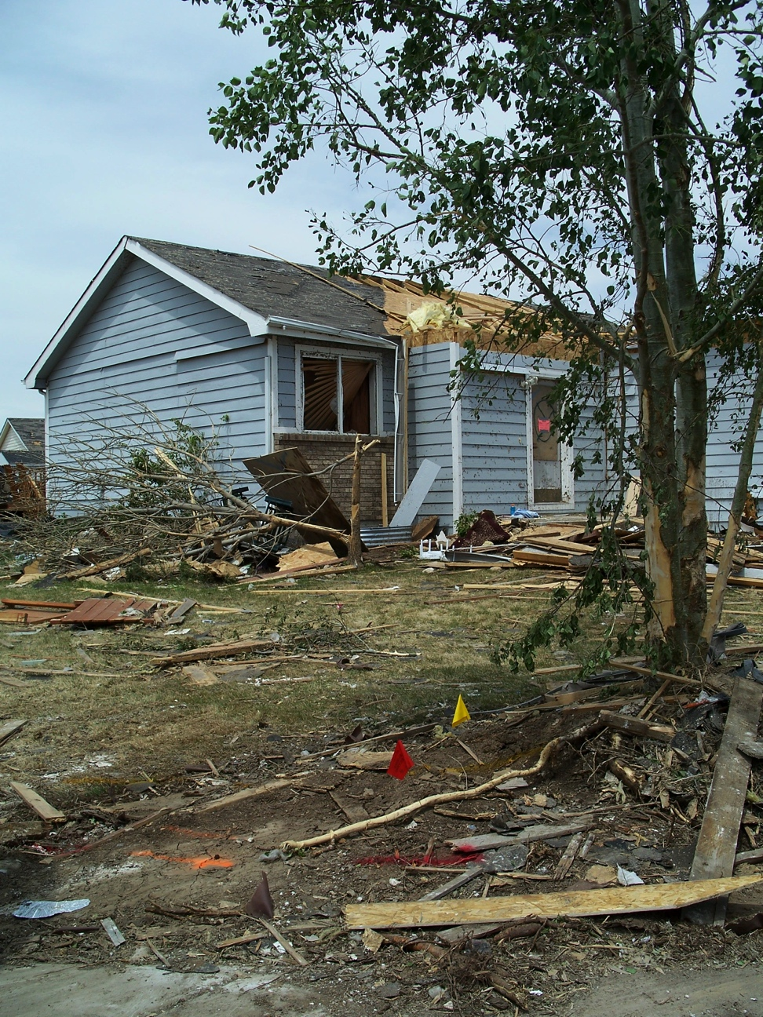
Compare and Contrast two very different pictures
Picture A
Picture B

Slide 119
Communication Practice Activity
Story Telling
Create a story of 6 or 8 sentences
Partner 1 begins: “I went to the doctor. In the waiting room I met a man. I said, “Excuse me,____,” and adds 1 sentence.
Each remaining partner adds a sentence.
Everyone will add 1 more sentence to conclude the story.
Each partner retells the story.
Place Words
a cold
a cough
an earache
a sore throat
a headache
a stomachache
a fever
the flu
Direction Words
What’s wrong?
She has
He has
We have
They have
I have

Slide 120
Communication Practice Activity
Lipson Method
Combining Pictures and Story Telling:
Write story in simple, subject-verb-object sentences
Make simple line drawings with stick figures to illustrate main ideas of story
Use pictures to help the student learn, remember, and retell the story

Slide 121
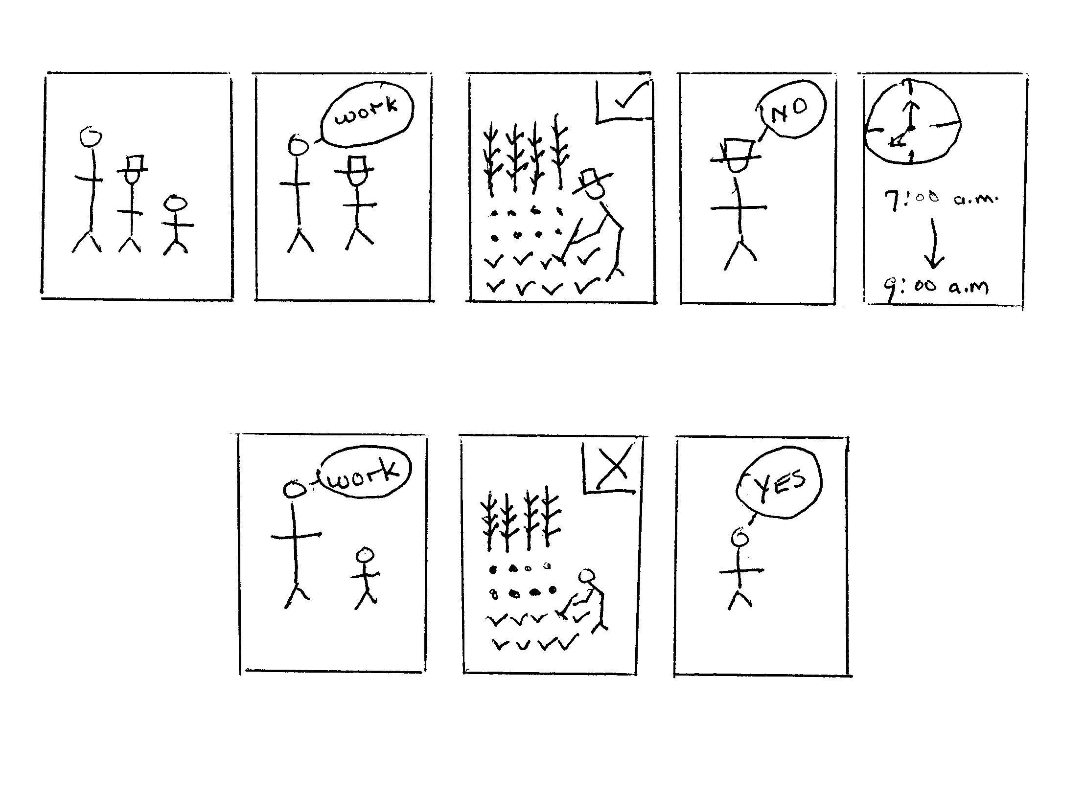

Slide 122
Lipson Method
Ask students to retell the story.
Ask life application questions.
  Should the father treat the sons the same? Why?
  What would you do if you were the father?
  What would your father have done?

Slide 123
Communication Practice Activities
Appropriate for Advanced Learners
Discussion
Debate
Problem solving

Slide 124
Communication Practice Activity
Discussion
Pairs or small groups discuss assigned topics
The grass is always greener on the other side of the fence.
You reap what you sow.
Man does not live by bread alone.
A bird in the hand is worth two in the bush.

Slide 125
Communication Practice Activity
Discussion -2
Discuss the assigned proverb
  What do you think it means?
  What cultural value does it teach?
Create a situation where you would use this proverb in a conversation.
Is there a proverb in your country that means the same thing?

Slide 126
Communication Practice Activity
Debate
Individuals or small groups present different viewpoints on a subject.
Your friend Rachel, a college student, has to choose a major. She wants to be a writer. She has won awards for her poetry.
But her parents would like her to become a teacher so she can have a steady income.

Slide 127
Communication Practice Activity
Debate -2
Each pair write two sentences supporting your point of view. Use the two assigned idioms in your sentences.
Pair 1. Rachel should pursue her poetry.
Black and white
Fine line
Pair 2. Rachel should get a teaching degree.
Right under their/her nose
See things in a whole new light

Slide 128
Communication Practice Activity
Problem Solving
Groups work together to solve a problem.
Example:
A friend of yours has just come to the United States.
Make a list of 4 problems he will face
.
Suggest one way he could solve each problem.

Slide 129
Types of
Communication Practice Activities
Role Play
Games
Interviews
Information gap
Describing/discussing pictures

Slide 130
Types of
Communication Practice Activities -2
Story telling
Combining pictures and storytelling (Lipson Method)
Discussion
Debate
Problem Solving

Slide 131
Things to keep in mind
Advanced level lessons and Communication Practice Activities
Plan more complex activities for advanced students. Include
Discussion
Debate
Problem solving

Slide 132
Practice EFL Lesson Planning
Lesson Topic
Food and items that you take on a picnic

Slide 133
Lesson Plan Assignment
Complete items in box
Do not complete Greetings and warm up
Complete Introduce New Vocabulary
Complete Sentences Using New Vocabulary
Do not complete Additional Pronunciation Practice
Complete Communication Practice Activities - select 3
Do not complete Review, Homework

Slide 134
Resource Review

Slide 135
Reproducible Resources

Slide 136
Not Reproducible but Valuable

Slide 137

Children’s ESL Resources

Slide 138
Internet Websites

Slide 139
Internet Websites - 2
Links to multiple ESL sites grouped by type
http://a4esl.org/
http://eslcafe.com/
http://www.englishforums.com/
http://www.vocabulary.com/

Slide 140
Websites for Children’s ESL
eslkidstuff.com
teachchildrenesl.com
eslflow.com
preschoolcoloringbook.com

Slide 141
Practical Resources
White garbage bags
2 gallon zip lock bags
10 Medium weight sheet protectors
1 large roll of 1-2” wide painters tape

Slide 142
Practical Resources-2
1 pack of 100 3x5 white index cards
1 pack of 100 3x5 multi-colored index cards
Several sheets of different colored construction paper
Scissors

Slide 143
Practical Resources-3
1 pack of 4 different color dry erase markers
1 pack of 4 different color overhead transparency markers (i.e. vis-à-vis)
1 box dustless chalk/eraser

Slide 144
Practical Resources -4
  map of your state
  large folding US map
  pictures of your family, home, church

Slide 145
Some Questions to Ask
Before You Go to Teach English Overseas

Slide 146
1. Who will we be teaching?
Children – what age
Youth
Adults
English teachers

Slide 147
2. What language level will the students be?
Zero
Beginners
Intermediate/advanced

Slide 148
3. What size class will we be teaching?
10
20
45

Slide 149
4. How long will we be teaching?
1 day
3 days
5 days
1 hour a day
4 hours a day
6 hours a day

Slide 150
Will we be teaching… the same group each day? different groups each day?

Slide 151
6. Where will we be teaching?
Everyone in the same location
School
Community building
Under a tree

Slide 152
7. What resources will be available?
Chalk/white boards
Electrical outlets (what form?)
Overhead projectors
Audio/video resources
Copiers

Slide 153
8. What will we be teaching?
Is there a set curriculum?
Are we creating our own lessons?

Slide 154
Then the nations will know that I am the Lord, declares the Sovereign Lord, when I show myself holy through you before their eyes.
Ezekiel 36:23b

Slide 155
I took you from the ends of the earth, from its farthest corners I called you. I said, “You are my servant;” I have chosen you and have not rejected you. So do not fear, for I am with you; do not be dismayed, for I am your God. I will strengthen you and help you; I will uphold you with my righteous right hand.
Isaiah 41:9-10

